Slide 1


SAFETY INCLUDED
Workplace Health and Safety
Training Series

Slide 2

EFFECTIVE
SAFETY AND
HEALTH
PROGRAMS
Presenters:
Todd Culver, President and CEO
Katie Kinde, Education Coordinator
Incompass Michigan

Slide 3
INTOUCH SAFETY
Training Project in Partnership with MIOSHA CET Division
This material was prepared under a Consultation Education and Training (CET) Grant, awarded by the Michigan Occupational Safety and Health Administration (MIOSHA). MIOSHA is a part of the Department of Labor and Economic Opportunity (LEO). Points of view or opinions stated in this document do not necessarily reflect the view or policies of LEO.

Slide 4
ABOUT YOUR PRESENTERS:
Todd Culver
Todd provides leadership in developing programs, strategic initiatives, and financial plans, in accordance with the purpose, vision and values of the association.
He has been with the Association since 1995, also serving as Project Director and Assistant Director.
As Project Director, lead a technical assistance and training project, focusing on Occupational Health and Safety for member organizations.
Prior to coming to Incompass, Todd worked in manufacturing for an automotive supplier, with plant management responsibilities that included environmental health and safety compliance

Slide 5
ABOUT YOUR PRESENTERS:
Katie Kinde
Katie is a 36 year old Autistic self advocate, who loves learning and helping others learn. Katie graduated with a Masters in Education with a focus in Learning Design and Technology in 2021 from Wayne State University.
She currently works for Incompass Michigan as the Education Coordinator, creating trainings, coordinating events, and handling certificate distribution.
Katie has completed multiple Leadership programs in 2023-4, and has presented multiple times about Autism in the workplace.
She became a co-leader in 2024 for the Michigan Advocates to End Seclusion and Restraint, and is now on the EndSAR Board.
She loves playing videogames with her husband Andrew, walking her rescue yorkie Agro, and drawing.

Slide 6
ABOUT THE CONTENT
Inclusivity is very important to us
This presentation is made with all needs in mind. We try to avoid using too many colors and pictures, and when we do, we describe them for low vision users
Handouts are available, link to our site with files will be posted in the chat

Slide 7
Safety Included 2026
OSHA’s recommended practices for safety and health programs present a step-by-step approach to implementing a safety and health program, built around seven core elements that make up a successful program.
The main goal of safety and health programs is to prevent workplace injuries, illnesses, and deaths, as well as the suffering and financial hardship these events can cause for workers, their families, and employers.

Slide 8
Safety Included 2026
The recommended practices use a proactive approach to managing workplace safety and health.
Traditional approaches are often reactive – problems are addressed only after a worker is injured or becomes sick, a new standard or regulation is published, or an outside inspection finds a problem that must be fixed.
These recommended practices recognize that finding and fixing hazards before they cause injury or illness is a far more effective approach.

Slide 9
Safety Included 2026
The most rigorous preventive safety program takes the view that there is ALWAYS something about an incident leading to injury that could have been different.
Accidents don’t “just happen.”
It is incumbent upon us to continuously assess the landscape to identify the potential for a problem, and fix it before one occurs.
That’s what this presentation is all about, providing a framework for effective safety programs that promote prevention.

Slide 10
Safety Included 2026
Clear, structured visuals and graphics to support comprehension
Minimized sensory distractions in both virtual and in-person settings
Options for verbal and non-verbal participation
Interactive components that promote engagement without overwhelming
Time-buffered schedules to allow for processing and reflection

Slide 11
A SAFE WORKPLACE IS SOUND BUSINESS –
FOR EVERYBODY REGARDLESS OF NEUROTYPE

Slide 12
Training Objectives
RECOMMENDED PRACTICES
  Management Leadership
  Worker Participation
  Hazard Identification and Assessment
  Hazard Prevention and Control
  Education and Training
  Program Evaluation and Improvement
  Communication and Coordination

Slide 13
Training Objectives
Employee Training Considerations
  Building Trust
  Sensory Overload and Sensitivities
  Accommodations
  Verbal vs Non-Verbal
  Clear Signs
  Proprioception
  Time Buffered Schedules and Memory Capacity
  Training Locations

Slide 14
MANAGEMENT LEADERSHIP
Management provides the leadership, vision, and resources needed to implement an effective safety and health program.
Management leadership means that business owners, managers, and supervisors:
  Make worker safety and health a core organizational value.
  Are fully committed to eliminating hazards, protecting workers, and continuously improving workplace safety and health.
  Provide sufficient resources to implement and maintain the safety and health program.
  Visibly demonstrate and communicate their safety and health commitment to workers and others.
  Set an example through their own actions.

Slide 15
WORKER PARTICIPATION
To be effective, any safety and health program needs the meaningful participation of workers and their representatives. Workers have much to gain from a successful program and the most to lose if the program fails. They also often know the most about potential hazards associated with their jobs. Successful programs tap into this knowledge base.
Worker participation means that workers are involved in establishing, operating, evaluating, and improving the safety and health program.
All workers at a worksite should participate, including those employed by contractors, subcontractors, and temporary staffing agencies.

Slide 16
WORKER PARTICIPATION
In an effective safety and health program, all workers:
  Are encouraged to participate in the program and feel comfortable providing input and reporting safety or health concerns.
  Have access to information they need to participate effectively in the program.
  Have opportunities to participate in all phases of program design and implementation.
  Do not experience retaliation when they raise safety and health concerns; report injuries, illnesses, and hazards; participate in the program; or exercise safety and health rights.

Slide 17
HAZARD IDENTIFICATION AND ASSESSMENT
One of the "root causes" of workplace injuries, illnesses, and incidents is the failure to identify or recognize hazards that are present, or that could have been anticipated.
A critical element of any effective safety and health program is a proactive, ongoing process to identify and assess such hazards.
To identify and assess hazards, employers and workers:
  Collect and review information about the hazards present or likely to be present in the workplace.
  Conduct initial and periodic workplace inspections of the workplace to identify new or recurring hazards.

Slide 18
HAZARD IDENTIFICATION AND ASSESSMENT
Investigate injuries, illnesses, incidents, and close calls/near misses to determine the underlying hazards, their causes, and safety and health program shortcomings.
Group similar incidents and identify trends in injuries, illnesses, and hazards reported.
Consider hazards associated with emergency or nonroutine situations.
Determine the severity and likelihood of incidents that could result for each hazard identified, and use this information to prioritize corrective actions.

Slide 19
HAZARD IDENTIFICATION AND ASSESSMENT
Some hazards, such as housekeeping and tripping hazards, can and should be fixed as they are found. Fixing hazards on the spot emphasizes the importance of safety and health and takes advantage of a safety leadership opportunity.
To learn more about fixing other hazards identified using the processes described here, see "Hazard Prevention and Control."

Slide 20
HAZARD PREVENTION AND CONTROL
Effective controls protect workers from workplace hazards; help avoid injuries, illnesses, and incidents; minimize or eliminate safety and health risks; and help employers provide workers with safe and healthful working conditions.
The processes described in this section will help employers prevent and control hazards identified in the previous section.

Slide 21
HAZARD PREVENTION AND CONTROL
To effectively control and prevent hazards, employers should:
  Involve workers, who often have the best understanding of the conditions that create hazards and insights into how they can be controlled.
  Identify and evaluate options for controlling hazards, using a "hierarchy of controls."
  Use a hazard control plan to guide the selection and implementation of controls, and implement controls according to the plan.
  Develop plans with measures to protect workers during emergencies and nonroutine activities.
  Evaluate the effectiveness of existing controls to determine whether they continue to provide protection, or whether different controls may be more effective. Review new technologies for their potential to be more protective, more reliable, or less costly.

Slide 22
EDUCATION AND TRAINING
Education and training are important tools for informing workers and managers about workplace hazards and controls so they can work more safely and be more productive.
Another role is to provide workers and managers with a greater understanding of the safety and health program itself, so that they can contribute to its development and implementation.

Slide 23
EDUCATION AND TRAINING
Education and training provides employers, managers, supervisors, and workers with:
  Knowledge and skills needed to do their work safely and avoid creating hazards that could place themselves or others at risk.
  Awareness and understanding of workplace hazards and how to identify, report, and control them.
  Specialized training, when their work involves unique hazards.

Slide 24
PROGRAM EVALUATION AND IMPROVEMENT
Once a safety and health program is established, it should be evaluated initially to verify that it is being implemented as intended.
Employers should annually assess what is working and what is not, and whether the program is on track to achieve its goals.
Sharing the results of monitoring and evaluation within the workplace, and celebrating successes, will help drive further improvement.

Slide 25
PROGRAM EVALUATION AND IMPROVEMENT
Program evaluation and improvement includes:
  Establishing, reporting, and tracking goals and targets that indicate whether the program is making progress.
  Evaluating the program initially and periodically thereafter to identify shortcomings and opportunities for improvement.
  Providing ways for workers to participate in program evaluation and improvement.

Slide 26
COMMUNICATION AND COORDINATION
In the current labor market, an increasing number of workers are assigned by community rehabilitation organizations (CRO) or staffing agencies to work at specific host worksites under the direction and control of the host employer.
In these situations, it is important for the CRO or staffing agency and the host employer to communicate and coordinate to provide and maintain a safe work environment for their workers.

Slide 27
COMMUNICATION AND COORDINATION
Safety is enhanced if employers coordinate their efforts and communicate effectively to afford all workers equal protection against hazards.
Failure to take these steps may undermine safety programs.
  For example, if the different employers have inconsistent policies for when and where to wear personal protective equipment, workers may mistakenly believe that the equipment is not needed, leading to injury.

Slide 28
COMMUNICATION AND COORDINATION
Inconsistent safety policies may also cause workers to question the credibility of safety and health programs, resulting in less meaningful employee engagement and participation.

Slide 29
COMMUNICATION AND COORDINATION
Effective communication and coordination among such employers means that, before coming on site, CROs and staffing agencies and their workers are aware of:
  The types of hazards that may be present.
  The procedures or measures they need to use to avoid or control their exposure to these hazards.
  The appropriate contact (host employer/CRO/staffing agency) to report an injury, illness, or incident or if they have a safety concern.
  What to do in case of an emergency.

Slide 30
HEALTH AND SAFETY PROGRAM BENEFITS
Safety and health programs help businesses:
  Prevent workplace injuries and illnesses
  Improve compliance with laws and regulations
  Reduce costs, including significant reductions in workers' compensation premiums
  Engage workers
  Enhance their social responsibility goals
  Increase productivity and enhance overall business operations

Slide 31
How to Train Effectively
Each person, regardless of neurotype, has a preferred learning method
The following is meant to help employers improve training methods for better outcomes

Slide 32
CONSIDERATIONS FOR NEURODIVERSE EMPLOYEES
Employees of different neurotypes may have different needs to consider, talking to employees directly about their preferences is the best way to ensure learning needs are met
Gain trust by asking if employees would like to give input on ways to improving trainings and respect their feedback

Slide 33
CONSIDERATIONS FOR NEURODIVERSE EMPLOYEES
Create a trusting relationship so that in times of stress, like injury, employees can go to employers without fear. Neurodiverse employees can have anxiety so be patient
  Speak concise and in a neutral tone

Slide 34
CONSIDERATIONS FOR NEURODIVERSE EMPLOYEES
Some employees may need additional support and freedom to ask questions to better understand. It is important to forge this trust early on
  Treat questions with respect so that employees do not fear being ridiculed in the future

Slide 35
SENSORY OVERLOAD
Sensory overload -
Sensory overload is a state where the brain receives too much sensory input to process, leading to symptoms like anxiety, irritability, confusion, and physical discomfort.
It can be triggered by common stimuli such as loud noises, bright lights, strong smells, and crowded spaces, but also by emotional stress, physical fatigue, or environmental changes

Slide 36
SENSORY OVERLOAD
Sensory overload -
During sensory overload, information is less likely to be retained, this leads to an unsuccessful training
Recognizing triggers and using strategies like reducing exposure to stimuli, using sensory aids, or finding quiet spaces can help manage it

Slide 37
SENSITIVITIES
Consider ways to ensure neurodiverse people are comfortable when training to ensure information is more easily retained
Sensitivities -
Especially when it comes to employees with Autism, they made be extra sensitive to loud noises or bright lights

Slide 38
SENSITIVITIES
Consider their needs. Converse and ask if any changes to the environment could help their learning experience and prevent sensory overload
  Some items that can be offered:
    white noise machines
    access to white noise music
    tinted glasses
    headphones

Slide 39
SENSITIVITIES
Auditory and visual considerations
  Ensure that your trainings are accessible. Neurodiverse people are prone to co-morbidities
  Visually, you should have large text and describe images or steps for anyone with low vision
  When speaking, ensure that you are using a microphone if any employees have low hearing

Slide 40
SENSITIVITIES
Consider sensitivities to scents -
  For those who are sensitive to scents, some smells may be overwhelming especially from machinery
  There are ways to manage these scents personally and environmentally

Slide 41
SENSITIVITIES
For Employee Personal Management
  Masking: Dab Vicks VapoRub, lavender, peppermint oil, or even toothpaste/ChapStick under employees' nose or inside their mask
  Breathing: Breathe through mouth or take shallow breaths; try humming to block smells
  Scented Items: minty gum, strong mints, or Listerine strips

Slide 42
SENSITIVITIES
For Employee Personal Management
  Essential Oils: Use a badge reel with a felt pad soaked in lemon or peppermint oil for personal scent relief
  Hygiene
  Quick Breaks

Slide 43
SENSITIVITIES
For Environmental Management
  Source Control: Cleanliness is key, Enzymatic Cleaners
  Odor Absorbers: Place coffee grounds, charcoal, or baking soda in bowls around the room
  Air Fresheners/Diffusers
  Ventilation

Slide 44
SENSITIVITIES
Consider Tactile sensitivities -
  They may need extra padding on PPE, or different material that can help them avoid sensory overload

Slide 45
Accommodations
Consider buying hypoallergenic solutions for repetitive tasks too, such as shoe insoles for standing employees, or wrist protection for employees at the computer.

Slide 46
Accommodations
For a comprehensive database on potential accommodation alternatives, visit https://askjan.org/

Slide 47
Proprioception
Proprioception: awareness of one's body
  You should also consider an employee's proprioception as some neurotypes do not perceive themselves well, especially if they are hyper focused
  They may work themselves too hard physically without even realizing until after a task is done
  They may not realize their PPE is damaging their skin until it is too late
Be proactive with reminders of self – Todd reminds me a lot!

Slide 48
PROXIMITY
Consider proximity comfort/consent.
  This should be discussed for everyday interactions beyond trainings.
Even something as simple as placing a hand on an employee's shoulder may be extremely uncomfortable to a neurodivergent employee.
Always ask for consent.

Slide 49
PROXIMITY
For example, during an interactive in-person training on PPE, a trainer may want to show an employee an object up close
Trainers should ask if it's alright to be up close before showing each step.
Also, let the employee learn by using the PPE themselves.

Slide 50
VERBAL AND NON-VERBAL
Consider some employees may prefer verbal or non-verbal communication
Non-Verbal -
  isn't just about not talking; it's about using diverse communication methods beyond speech. Respect those who facing sensory challenges or processing language differently
    gestures, visuals
    literal, not nuanced

Slide 51
SHUTDOWN
Sometimes certain neurotypes may need to "go nonverbal" (employee shuts down) due to overwhelm.
  Requires patience
  clear, direct communication
  respecting their cues
  understanding their unique sensory/processing needs
Communication before a shutdown is essential for preparing for these moments

Slide 52
DURING SHUTDOWN
An emergency buddy –
  May be called something else, but the main goal is to ensure there is a trustworthy coworker for a neurodivergent employee in times of an emergency who can guide them during moments they are overwhelmed

Slide 53

VERBAL AND NON-VERBAL
Though not required, some employees may even prefer having signs on their door or on their name badge that show their current availability verbally
  Color coding can be helpful
  This can also be helpful when employees wear headphones

Slide 54
VERBAL AND NON-VERBAL
Make sure when you make trainings that any signage is also clear
Examples to follow

Slide 55
EXAMPLE UNCLEAR
Imagine a notice that says the following:
Due to new ordinance 3.6 of the safety committee, all emergency entryways, regardless of where they are located, cannot be blocked for any reason.
This means that you cannot block the door with furniture, such as desks, cabinets, or light fixtures.
The door must be able to open all the way, without any items impeding its opening.
This example, though thorough, may not be a suitable training tool for everyone
Due to new ordinance 3.6 of the safety committee, all emergency entryways, regardless of where they are located, cannot be blocked for any reason.
This means that you cannot block the door with furniture, such as desks, cabinets, or light fixtures.
The door must be able to open all the way, without any items impeding its opening.
SAFETY NOTICE – PLEASE REVIEW

Slide 56
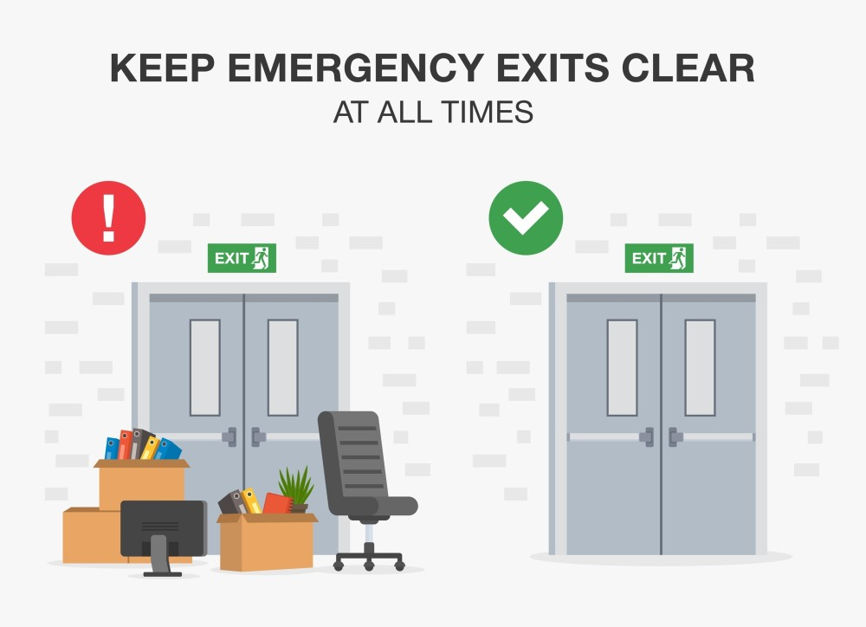
EXAMPLE CLEAR VISUALS AND DESCRIPTIONS
Sidenote: add a phone number or email for employees to ask for more information

Slide 57
UNIVERSAL DESIGN METHODS
Universal design allows educators and learners to set clear goals, anticipate environmental barriers, create meaningful options, and fully embrace human variability
Having multiple methods to learn safety ensures that everyone has the resources they need to learn processes, regardless of neurotype
Consider making step by step documents, signs, videos, and plan on showing processes in person

Slide 58
TIME BUFFERED SCHEDULES
Time-buffered schedules to allow for processing and reflection, for all neurotypes
Consider having breaks during long trainings, or breaks in video trainings

Slide 59
MEMORY CAPACITY
Even after all you can do to make a training, consider memory capacity
On average, it is estimated 50% of what is learned, is immediately forgotten
Spaced Learning helps retain what is taught

Slide 60
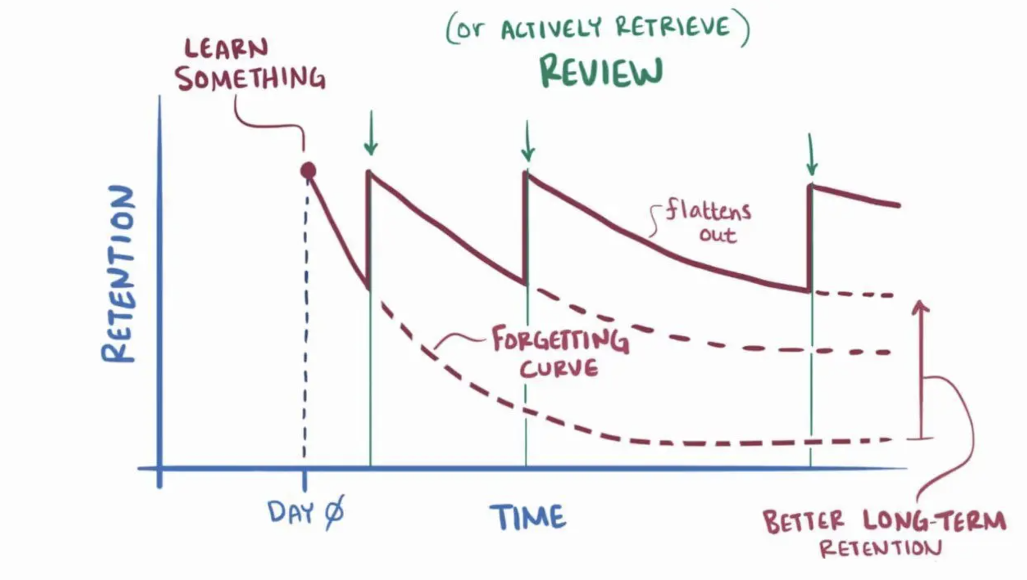
MEMORY CAPACITY

Slide 61
TRAINING LOCATION
There is evidence showing that information retention for all neurotypes is also affected by location
Employees are more likely to remember information in the spot they learned that information
This means that procedures should be taught in the spot they will be used

Slide 62
SUMMARY
Effective safety and health programs require engagement at all levels
Leadership from management and involvement from the folks who now the job best
Finding and fixing hazards, and a culture that encourages this, is a key to success
Celebrate success, including reporting a near miss and correcting the problem that caused it
Training is a key component

Slide 63
SUMMARY
Remember all considerations and accommodations supporting a diverse workforce
When creating trainings, remember to consider the needs of all your employees to improve retention

Slide 64

Thank You – stay safe and healthy!
Incompass Michigan remains committed to being a trusted resource for getting connected and staying informed.

Slide 65
RESOURCE CITATIONS
MIOSHA, Recommended Practices for Safety and Health Programs: https://www.michigan.gov/leo/-/media/Project/Websites/leo/Documents/MIOSHA/MTI_Course-Material/Recommended-Practices-for-Safety-and-Health-Programs.pdf
OSHA, Recommended Practices for Safety and Health Programs: https://www.osha.gov/safety-management
OSHA, Hazard Prevention and Control: https://www.osha.gov/safety-management/hazard-prevention
  This includes specific info on the Hierarchy of Controls

Slide 66
RESOURCE CITATIONS
Honeybourne, Victoria. (2020). The Neurodiverse Workplace: An Employer’s Guide to Managing and Working with Neurodivergent Employees, Clients and Customers. Jessica Kingsley Publishers: London & Philadelphia, PA.
Praslova, Ludmila N. (2024). The Canary Code: A Guide to Neurodiversity, Dignity, And Intersectional Belonging At Work. Berrett-Koehler Publishers, Inc.: Oakland, CA.
Thompson, E. (2023) A Hidden Force: Unlocking the Potential of Neurodiversity at Work. Fast Company Press: New York.
https://www.cnsnevada.com/what-is-the-memory-capacity-of-a-human-brain/
NEUROINCLUSIVE LEARNING QUICK START PACKET BY TRACEY KING

Slide 67
SAFETY
INCLUDED
Training Project in Partnership with MIOSHA CET Division
This material was prepared under a Consultation Education and Training (CET) Grant, awarded by the Michigan Occupational Safety and Health Administration (MIOSHA). MIOSHA is a part of the Department of Labor and Economic Opportunity (LEO). Points of view or opinions stated in this document do not necessarily reflect the view or policies of LEO.

