Slide 1
SAFETY INCLUDED
Workplace Health and Safety
Training Series

Slide 2

PERSONAL PROTECTIVE EQUIPMENT (PPE)
Presenters: Todd Culver, President and CEO
Katie Kinde, Education Coordinator
Incompass Michigan

Slide 3
SAFETY INCLUDED
Training Project in Partnership with MIOSHA CET Division
This material was prepared under a Consultation Education and Training (CET) Grant, awarded by the Michigan Occupational Safety and Health Administration (MIOSHA).
MIOSHA is a part of the Department of Labor and Economic Opportunity (LEO).
Points of view or opinions stated in this document do not necessarily reflect the view or policies of LEO.

Slide 4
ABOUT YOUR PRESENTERS:
Todd Culver
Todd provides leadership in developing programs, strategic initiatives, and financial plans, in accordance with the purpose, vision and values of the association.
He has been with the Association since 1995, also serving as Project Director and Assistant Director.
As Project Director, lead a technical assistance and training project, focusing on Occupational Health and Safety for member organizations.
Prior to coming to Incompass, Todd worked in manufacturing for an automotive supplier, with plant management responsibilities that included environmental health and safety compliance

Slide 5
ABOUT YOUR PRESENTERS:
Katie Kinde
Katie is a 35 year old Autistic self advocate, who loves learning and helping others learn. Katie graduated with a Masters in Education with a focus in Learning Design and Technology in 2021 from Wayne State University.
She currently works for Incompass Michigan as the Education Coordinator, creating trainings, coordinating events, and handling certificate distribution.
Katie has completed multiple Leadership programs in 2023-4, and has presented multiple times about Autism in the workplace.
She became a co-leader in 2024 for the Michigan Advocates to End Seclusion and Restraint, and is now on the EndSAR Board.
In her spare time, she loves playing videogames with her husband Andrew, walking her rescue yorkie Agro, making jewelry, drawing, gardening, and creating miniature houses.

Slide 6
ABOUT THE CONTENT
Inclusivity is very important to us
This presentation is made with all needs in mind. We try to avoid using too many colors and pictures, and when we do, we describe them for low vision users
Handouts are available on a shared drive, link will be posted in the chat

Slide 7
Safety Included 2026
OSHA’s recommended practices for safety and health programs present a step-by-step approach to implementing a safety and health program, built around seven core elements that make up a successful program.
The main goal of safety and health programs is to prevent workplace injuries, illnesses, and deaths, as well as the suffering and financial hardship these events can cause for workers, their families, and employers.

Slide 8
Safety Included 2026
The recommended practices use a proactive approach to managing workplace safety and health.
Traditional approaches are often reactive – problems are addressed only after a worker is injured or becomes sick, a new standard or regulation is published, or an outside inspection finds a problem that must be fixed.
These recommended practices recognize that finding and fixing hazards before they cause injury or illness is a far more effective approach.

Slide 9
Safety Included 2026
The most rigorous preventive safety program takes the view that there is ALWAYS something about an incident leading to injury that could have been different.
Accidents don’t “just happen.”
It is incumbent upon us to continuously assess the landscape to identify the potential for a problem, and fix it before one occurs.
That’s what this presentation is all about, providing a framework for effective safety programs that promote prevention.

Slide 10
Safety Included 2026
Clear, structured visuals and graphics to support comprehension
Minimized sensory distractions in both virtual and in-person settings
Options for verbal and non-verbal participation
Interactive components that promote engagement without overwhelming
Time-buffered schedules to allow for processing and reflection

Slide 11
A SAFE WORKPLACE IS SOUND BUSINESS –
FOR EVERYBODY REGARDLESS OF NEUROTYPE

Slide 12
PERSONAL PROTECTIVE EQUIPMENT (PPE)
MIOSHA Standard Requirements
  Hazard Assessment
  Equipment Selection
  Employee Training
  Documentation

Slide 13
Training Objectives Continued
Employee Training Considerations
  Building Trust
  Sensory Overload and Sensitivities
  Accommodations
  Verbal vs Non-Verbal
  Clear Signs
  Emergency/Safety Buddy
  Proprioception
  Time Buffered Schedules and Memory Capacity
  Training Locations
Using Safety Included Resources

Slide 14
HAZARD ASSESSMENT
Employers are required to assess the workplace to determine if hazards that would required the use of personal protective equipment are present
If hazards are found, employers must select and have affected employees use, properly fitted and suitable PPE

Slide 15
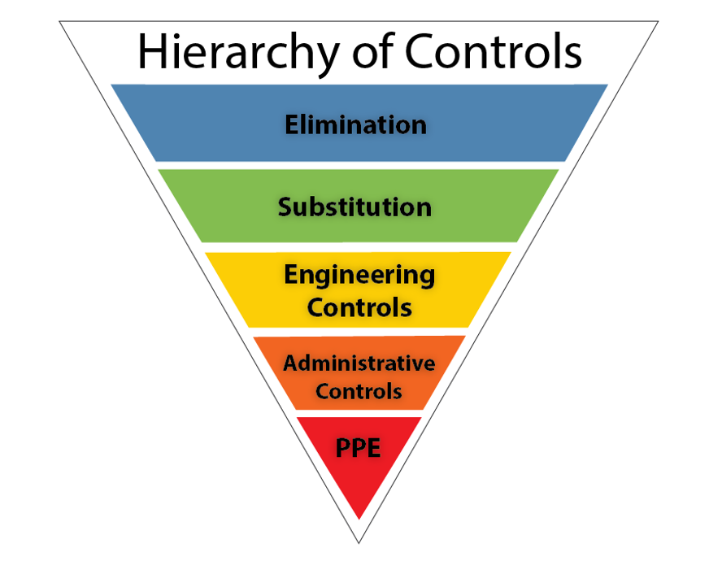
HIERARCHY OF CONTROLS
  The hierarchy of controls is a NIOSH-developed framework ranking hazard safeguards from most to least effective:
  ØIt prioritizes physically removing hazards (e.g., stopping a process) over relying on human behavior (e.g., training) to ensure maximum worker safety
  PPE is the last line of defense

Slide 18
TRAINING
Before requiring an employee to use PPE, an employer must provide training on the following:
When PPE is necessary
What type is required
How to wear it properly
The limits of PPE
Proper care, maintenance, useful life, and disposal
Additional requirements when sharing PPE

Slide 19
IDENTIFICATION AND
SELECTION
OF
PPE
TYPES OF EQUIPMENT
  COMMON HAZARDS

Slide 20
HEAD PROTECTION - Hardats
Falling or flying objects
Other harmful contacts or exposures
Risk of injury from electrical shock
Chemicals
Temperature extremes
Hair entanglement

Slide 21
EYE and FACE PROTECTION – Safety Glasses, Goggles, or Face Shields
Flying particles
Frontal and side impact
Electrical flash
Molten metal
Chemical splash, gases or vapors
Injurious light radiation
Glare
A combination of these hazards

Slide 22
FOOT and LEG PROTECTION – Safety Boots or Shoes
When heavy objects such as barrels or tools might roll onto or fall on the employee’s feet.
Working with sharp objects such as nails or spikes that could pierce the soles or uppers of ordinary shoes.
Exposure to molten metal that might splash on feet or legs.
Working on or around hot, wet or slippery surfaces.
Working when electrical hazards are present.

Slide 23
HAND and ARM PROTECTION – Gloves, Protective Sleeves
Skin absorption of harmful substances (look for ‘skin’ warning on Safety Data Sheets).
Chemical or thermal burns.
Electrical dangers.
Bruises, abrasions, cuts, punctures.

Slide 24
FALL PROTECTION - Note
An employer shall ensure that each employee whose fall protection is not covered by another MIOSHA safety standard, and the employee’s work area is more than 6 feet above the ground, floor, water, or other surface, shall be protected as prescribed in Construction Safety Standard Part 45 “Fall Protection.”
  Guardrail systems.
  Safety net systems.
  Personal fall arrest systems.

Slide 25
RESPIRATORY PROTECTION - Note
MIOSHA encourages employers to help protect outdoor workers by monitoring air quality, limiting strenuous outdoor work, providing breaks in smoke-free areas and allowing the voluntary use of N95 respirators when appropriate.
Because the smoke is largely suspended particulates, N95 or similar face masks are effective at providing protection. If you require employees to wear an N95, you must implement a full respiratory protection program. If you provide N95 masks for voluntary use only, you need then only provide employees with appendix D from MIOSHA Part 451, Respiratory Protection
If your employer provides respirators for your voluntary use, or if you provide your own respirator, you need to take certain precautions to be sure that the respirator itself does not present a hazard.

Slide 26
How to Train Effectively
Each person, regardless of neurotype, has a preferred learning method
The following is meant to help employers improve training methods for better outcomes

Slide 27
CONSIDERATIONS FOR NEURODIVERSE EMPLOYEES
Employees of different neurotypes may have different needs to consider, talking to employees directly about their preferences is the best way to ensure learning needs are met
Gain trust by asking if employees would like to give input on ways to improving trainings

Slide 28
CONSIDERATIONS FOR NEURODIVERSE EMPLOYEES
Create a trusting relationship so that in times of stress, like injury, employees can go to employers without fear. Neurodiverse employees can have anxiety so be patient
  Speak concise and in a neutral tone

Slide 29
CONSIDERATIONS FOR NEURODIVERSE EMPLOYEES
Some employees may need additional support and freedom to ask questions to better understand. It is important to forge this trust early on
  Treat questions with respect so that employees do not fear being ridiculed in the future

Slide 30
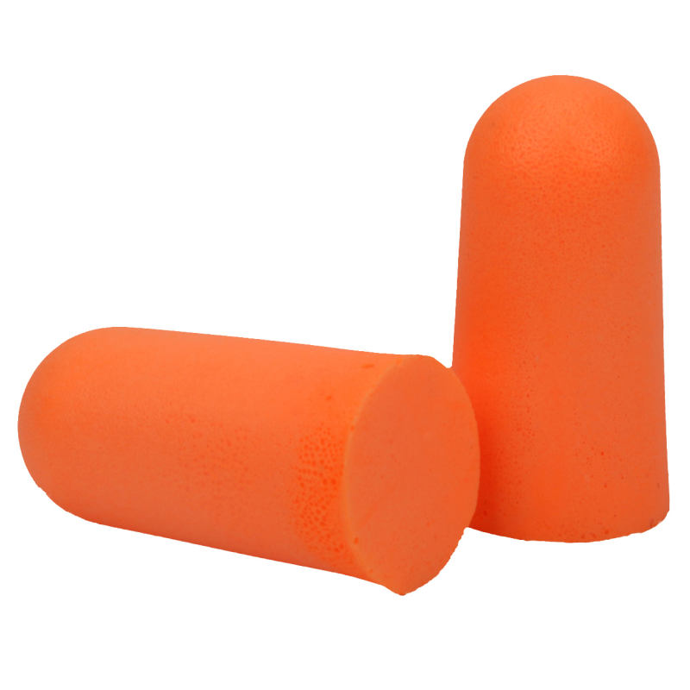
Conversation Example
Examples of conversation during a training:
"Why do we get orange earplugs?"
  "I am not sure; it's just the ones that we order."
"Can we get other colors?"
  "I am not sure. I may have to get back with you on that."
"Can I bring in my own?"
  "It's company policy to use the ones provided, which will help keep you safe. They are designed to be appropriate for the job we must do. If you need different ones, let's do some research."

Slide 31
SENSORY OVERLOAD
Sensory overload -
Sensory overload is a state where the brain receives too much sensory input to process, leading to symptoms like anxiety, irritability, confusion, and physical discomfort.
It can be triggered by common stimuli such as loud noises, bright lights, strong smells, and crowded spaces, but also by emotional stress, physical fatigue, or environmental changes

Slide 32
SENSORY OVERLOAD
Sensory overload -
During sensory overload, information is less likely to be retained, this leads to an unsuccessful training
Recognizing triggers and using strategies like reducing exposure to stimuli, using sensory aids, or finding quiet spaces can help manage it

Slide 33
SENSITIVITIES
Consider ways to ensure neurodiverse people are comfortable when training to ensure information is more easily retained
Sensitivities -
Especially when it comes to employees with Autism, they made be extra sensitive to loud noises or bright lights

Slide 34
SENSITIVITIES
Consider their needs. Converse and ask if any changes to the environment could help their learning experience and prevent sensory overload
  Some items that can be offered:
    white noise machines
    access to white noise music
    tinted glasses
    Headphones as stated earlier

Slide 35
SENSITIVITIES
Auditory and visual considerations
  Ensure that your trainings are accessible. Neurodiverse people are prone to co-morbidities
  Visually, you should have large text and describe images or steps for anyone with low vision
  When speaking, ensure that you are using a microphone if any employees have low hearing

Slide 36
SENSITIVITIES
Consider sensitivities to scents -
  For those who are sensitive to scents, some smells may be overwhelming especially from machinery
  There are ways to manage these scents personally and environmentally

Slide 37
SENSITIVITIES
For Employee Personal Management
  Masking: Dab Vicks VapoRub, lavender, peppermint oil, or even toothpaste/ChapStick under employees' nose or inside their mask
  Breathing: Breathe through mouth or take shallow breaths; try humming to block smells
  Scented Items: minty gum, strong mints, or Listerine strips

Slide 38
SENSITIVITIES
For Employee Personal Management
  Essential Oils: Use a badge reel with a felt pad soaked in lemon or peppermint oil for personal scent relief
  Hygiene
  Quick Breaks

Slide 39
SENSITIVITIES
For Environmental Management
  Source Control: Cleanliness is key, Enzymatic Cleaners
  Odor Absorbers: Place coffee grounds, charcoal, or baking soda in bowls around the room
  Air Fresheners/Diffusers
  Ventilation

Slide 40
SENSITIVITIES
Consider Tactile sensitivities -
  They may need extra padding on PPE, or different material that can help them avoid sensory overload

Slide 41
Accommodations
The following is meant to teach employers about accommodations for better outcomes for all employees of all neurotypes

Slide 42
Accommodations
Neurodivergent-friendly PPE is not all the same. Each person may have different needs. Ensure that all employees have various options, especially hypoallergenic ones
prioritize sensory comfort
  Straps of various materials
  Pressure points
  Tactile sensitivities

Slide 43
Accommodations
Goggles -
Neurodivergent-friendly goggles prioritize sensory comfort. Look for frames with:
  wide, soft silicone seals,
  fabric straps instead of pulling rubber
  anti-fog lenses

Slide 44
Accommodations
Hard Hats -
Choose helmets that prioritize comfort, sensory regulation, and weight distribution to prevent overstimulation.
  minimize pressure points
  feature adjustable fits

Slide 45
Accommodations
Breathability: Moisture-wicking liners and ventilation holes prevent overheating
Sensory-Friendly Liners: Soft, seamless, and tag-free interiors prevent skin irritation
Adjustable Chinstraps: Soft fabrics with quick-release velcro or snap closures under the chin prevent digging and discomfort

Slide 46
Accommodations
Face Shield
It should be lightweight, and use soft materials. Look for shields with adjustable head straps instead of tight bands to prevent tension headaches.
  No Skin Contact
  No Ear Loops
  Ultra-Lightweight: weighing under 2 ounces, to prevent neck strain
  Anti-Fog: anti-fog coatings diminish distractions

Slide 47
Accommodations
Hearing protection -
Ear plugs or normal earmuffs may not be enough to help reduce sensory overload on their own
Bone conduction headphones send sound as vibrations through your cheekbones and jaw to your inner ear, bypassing the eardrum
Noise cancelling headphones, which suppress ambient sounds using active noise control (ANC)
  Eliminate background noise
  Improve productivity and focus

Slide 48
Accommodations
Headphones and earmuffs don't accommodate all employees

Slide 49
Accommodations
Communication with Headphones
The key is open dialogue to find what works for specific tasks and team dynamics, ask "What's the best way to get your attention when you're wearing headphones?"
  Set clear communication rules, using visual cues (like one headphone out) for availability
    Get their attention visually first (wave, knock) before speaking.
  establishing a headphone policy (when/where okay)
  using digital tools
  ensuring safety/volume limits

Slide 50
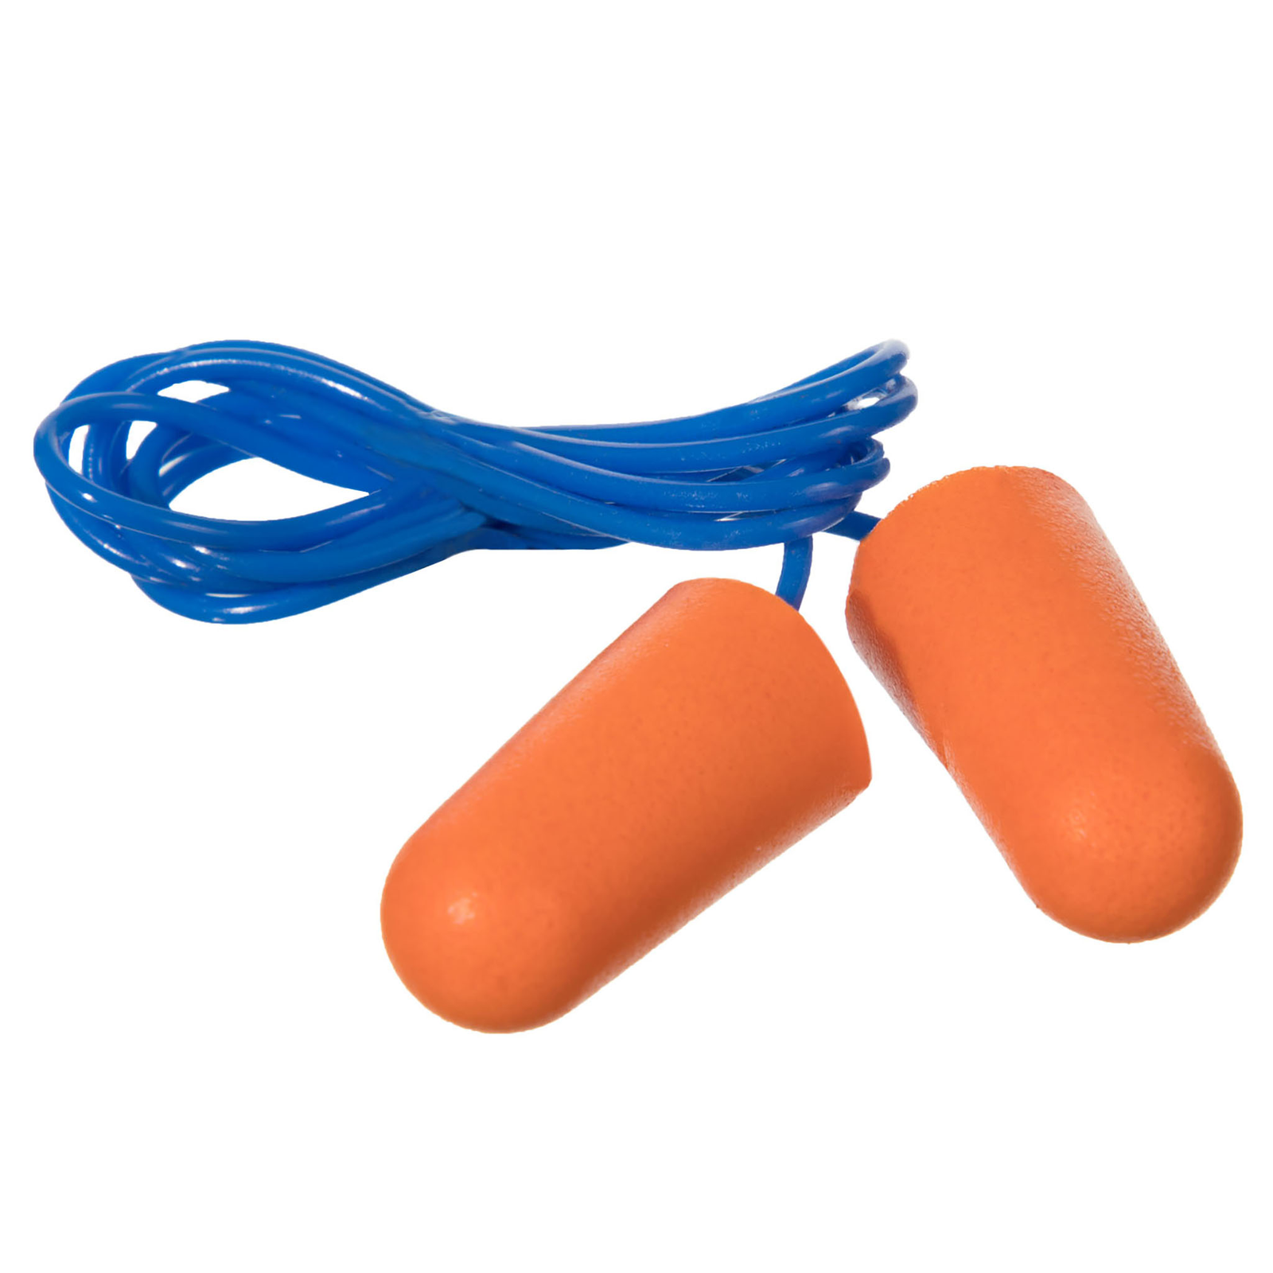
Accommodations
Consider earplugs with additional hardware
  Different shaped earplugs, such as surfers earplugs, etc.
  Earplugs with a cord
  A carrying case that can attach to employee for their earplugs

Slide 51
Accommodations
Hypoallergenic earplugs may be needed if an employee has skin conditions
Consider ones made from medical-grade silicone, soft synthetic rubber, or memory foam, that are suitable for sensitive skin

Slide 52
Accommodations
HAZMAT Gloves -
Nitrile Gloves (Powder-Free): The most common choice; they are 100% latex-free and provide a strong barrier against chemicals.
Accelerator-Free Nitrile: Specially engineered to avoid Type IV chemical allergies (contact dermatitis) caused by rubber accelerators during manufacturing.

Slide 53
Accommodations
Vinyl Gloves: A, cost-effective, latex-free, and hypoallergenic alternative, though generally less puncture-resistant than nitrile.
Neoprene Gloves: Offer excellent protection against a wide range of hazardous materials.

Slide 54
Accommodations
Texture/Grip: find gloves with textured fingertips for better handling of wet or greasy hazardous materials.

Slide 55
Accommodations
Footwear-
Prioritize fit, and ease of use. Look for
  seam-free interiors to prevent rubbing
  wide toe boxes to avoid toe-pinching,
  slip-on/zipper designs

Slide 56
Accommodations
Body suits-
Key features include flat seams, tagless labels, and flexible closures. Your employees may need compression or loose clothes.
  Sensory Compression Suits: body-hugging bodysuits designed to calm the nervous system. A comfortable base layer underneath standard, looser medical PPE
  Breathable Coveralls: Avoid stiff, loud, plastic-feeling suits. Instead, search for lightweight, microporous hazmat-style suits that allow air to flow, preventing overheating

Slide 57
Accommodations
N95 respiratory masks
  Head straps instead of ear loops
  Foam nose cushions

Slide 58
Accommodations
Consider buying hypoallergenic solutions for repetitive tasks too, such as shoe insoles for standing employees, or wrist protection for employees at the computer.

Slide 59
Accommodations
For a comprehensive database on potential accommodation alternatives, visit https://askjan.org/

Slide 60
Proprioception
Proprioception: awareness of one's body
  You should also consider an employee's proprioception as some neurotypes do not perceive themselves well, especially if they are hyper focused
  They may work themselves too hard physically without even realizing until after a task is done
  They may not realize their PPE is damaging their skin until it is too late
Be proactive with reminders of self – Todd reminds me a lot!

Slide 61
PROXIMITY
Consider proximity comfort/consent.
  This should be discussed for everyday interactions beyond trainings.
Even something as simple as placing a hand on an employee's shoulder may be extremely uncomfortable to a neurodivergent employee.
Always ask for consent.

Slide 62
PROXIMITY
For example, during an interactive in-person training on PPE, a trainer may want to show an employee an object up close
Trainers should ask if it's alright to be up close before showing each step.
Also, let the employee learn by using the PPE themselves.

Slide 63
VERBAL AND NON-VERBAL
Consider some employees may prefer verbal or non-verbal communication
Non-Verbal -
  isn't just about not talking; it's about using diverse communication methods beyond speech. Respect those who facing sensory challenges or processing language differently
    gestures, visuals
    literal, not nuanced

Slide 64
SHUTDOWN
Sometimes certain neurotypes may need to "go nonverbal" (employee shuts down) due to overwhelm.
  Requires patience
  clear, direct communication
  respecting their cues
  understanding their unique sensory/processing needs
Communication before a shutdown is essential for preparing for these moments

Slide 65
DURING SHUTDOWN
An emergency buddy –
  May be called something else, but the main goal is to ensure there is a trustworthy coworker for a neurodivergent employee in times of an emergency who can guide them during moments they are overwhelmed

Slide 66
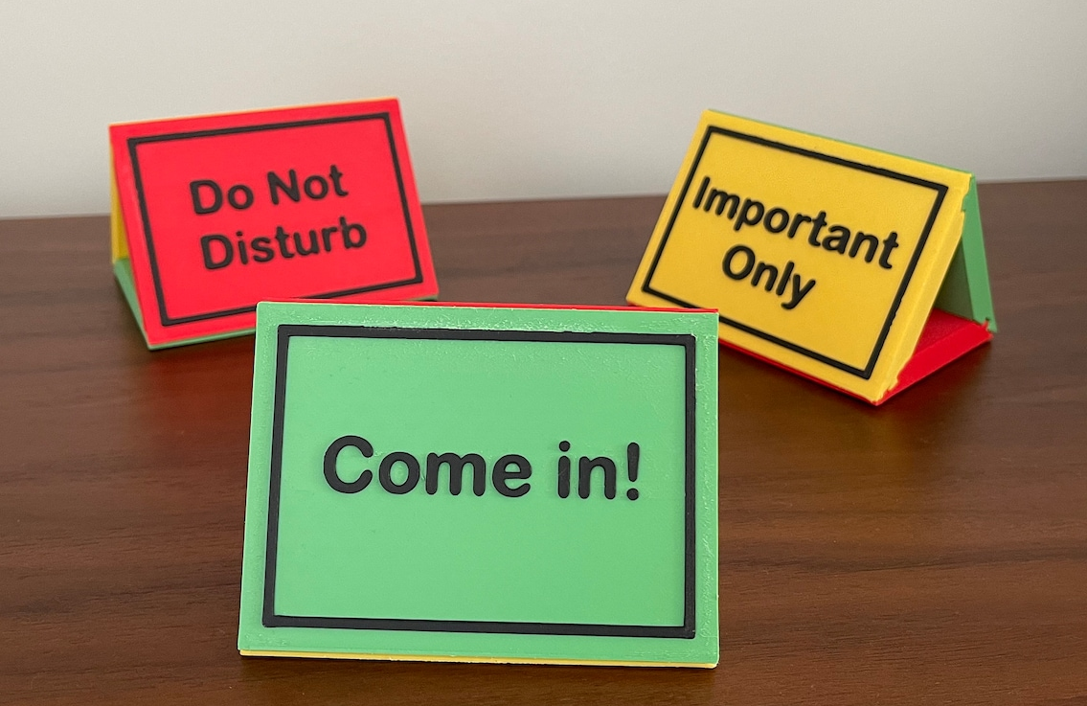
VERBAL AND NON-VERBAL
Though not required, some employees may even prefer having signs on their door or on their name badge that show their current availability verbally
  Color coding can be helpful
  This can also be helpful when employees wear headphones

Slide 67
VERBAL AND NON-VERBAL
Make sure when you make trainings that any signage is also clear
Examples to follow

Slide 68
EXAMPLE UNCLEAR
Imagine a notice that says the following:
Due to new ordinance 3.8 of the safety committee, we must all be cautious of hearing loss
When you are exposed to high noise levels, serious and permanent damage can result
Although you may believe you are getting used to high noise levels, this usually means you are enduring hearing loss
If the noise level is loud enough that you have to “get used to it,” hearing protection is probably necessary
If you must raise your voice to be heard in the workplace, noise levels should be evaluated to ensure excessive exposures are controlled
Contact your manager asap if you believe changes need to be made or if you are suffering from hearing loss
SAFETY NOTICE – PLEASE REVIEW
Due to new ordinance 3.8 of the safety committee, we must all be cautious of hearing loss
When you are exposed to high noise levels, serious and permanent damage can result
Although you may believe you are getting used to high noise levels, this usually means you are enduring hearing loss
If the noise level is loud enough that you have to “get used to it,” hearing protection is probably necessary
If you must raise your voice to be heard in the workplace, noise levels should be evaluated to ensure excessive exposures are controlled
Contact your manager asap if you believe changes need to be made or if you are suffering from hearing loss

Slide 69
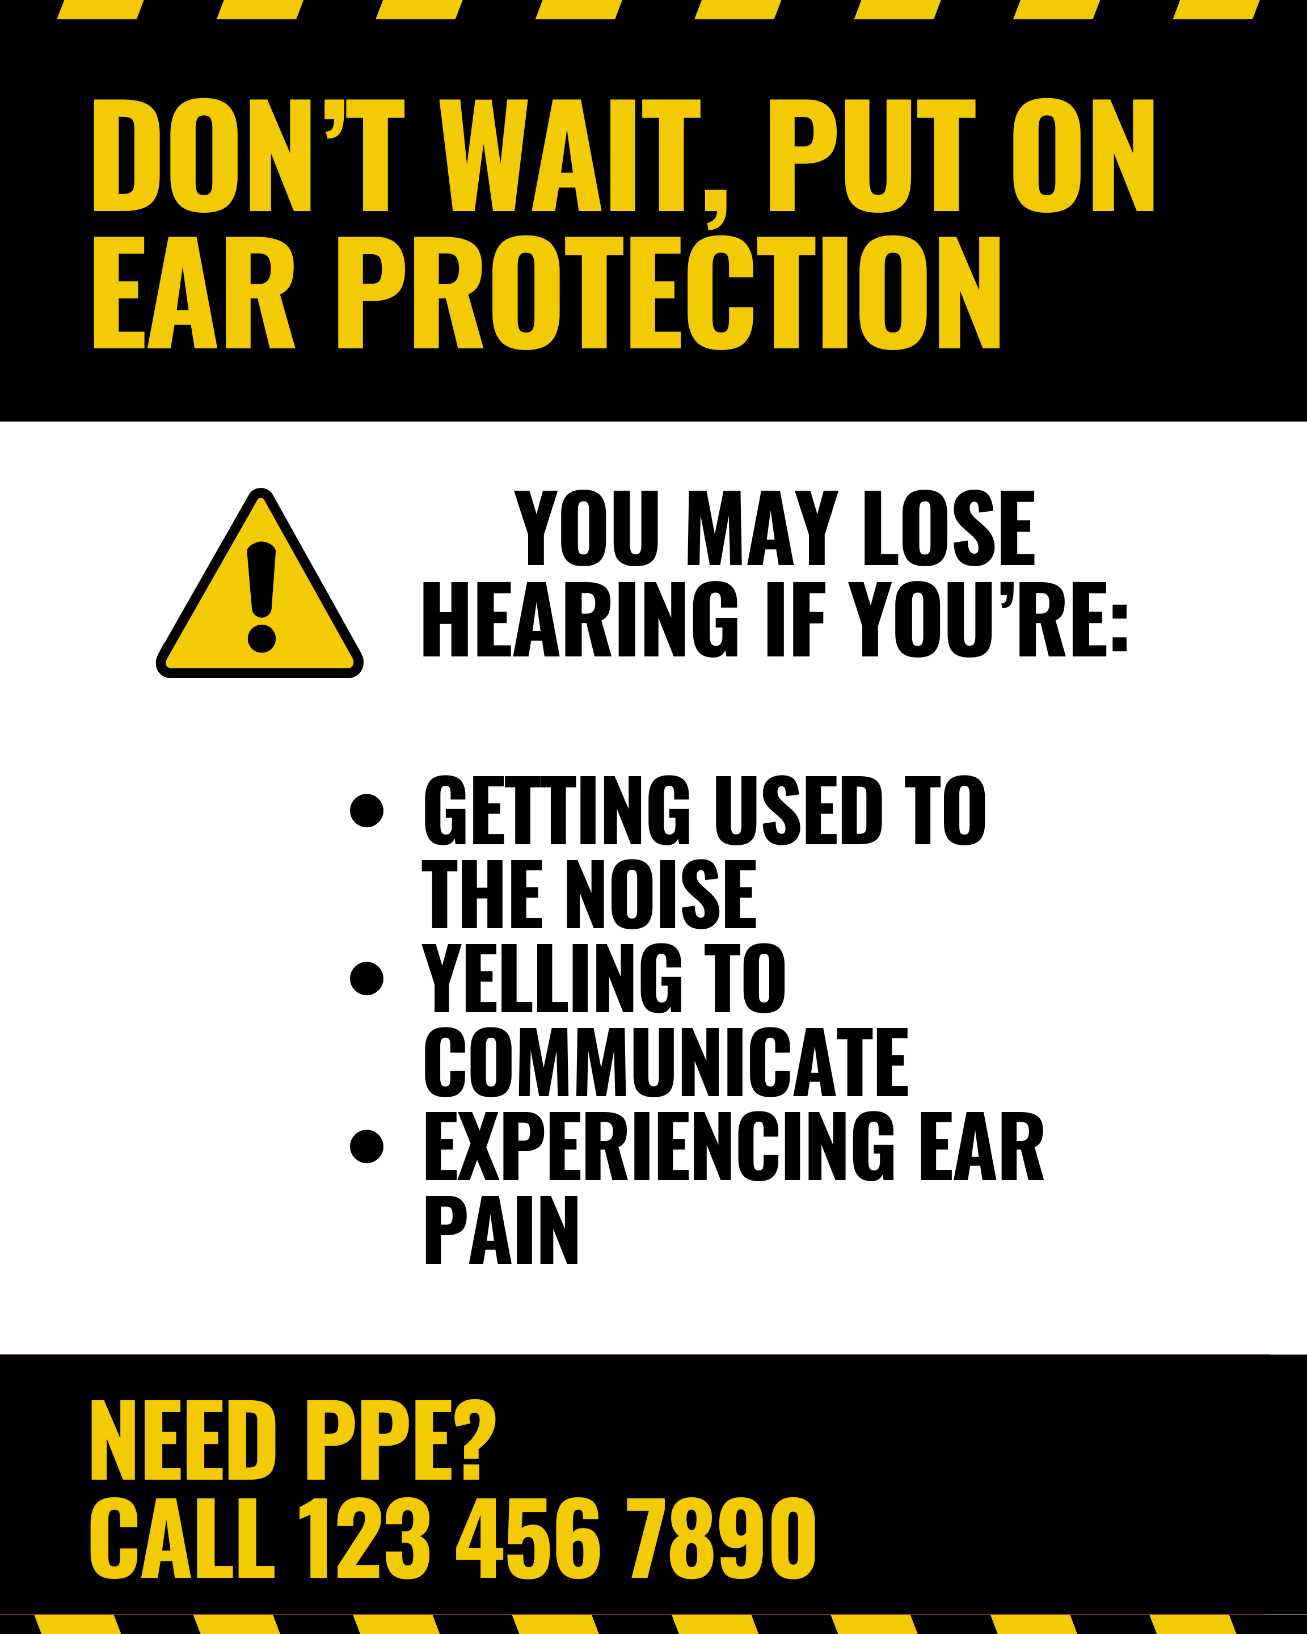
EXAMPLE CLEAR VISUALS AND DESCRIPTIONS
The last slide was too wordy
Hearing protection should be first and foremost
Contact Information should be readily available

Slide 70
UNIVERSAL DESIGN METHODS
Universal design allows educators and learners to set clear goals, anticipate environmental barriers, create meaningful options, and fully embrace human variability
Having multiple methods to learn safety ensures that everyone has the resources they need to learn processes, regardless of neurotype
Consider making step by step documents, signs, videos, and plan on showing processes in person

Slide 71
TIME BUFFERED SCHEDULES
Time-buffered schedules to allow for processing and reflection, for all neurotypes
Consider having breaks during long trainings, or breaks in video trainings

Slide 72
MEMORY CAPACITY
Even after all you can do to make a training, consider memory capacity
On average, it is estimated 50% of what is learned, is immediately forgotten
Spaced Learning helps retain what is taught

Slide 73
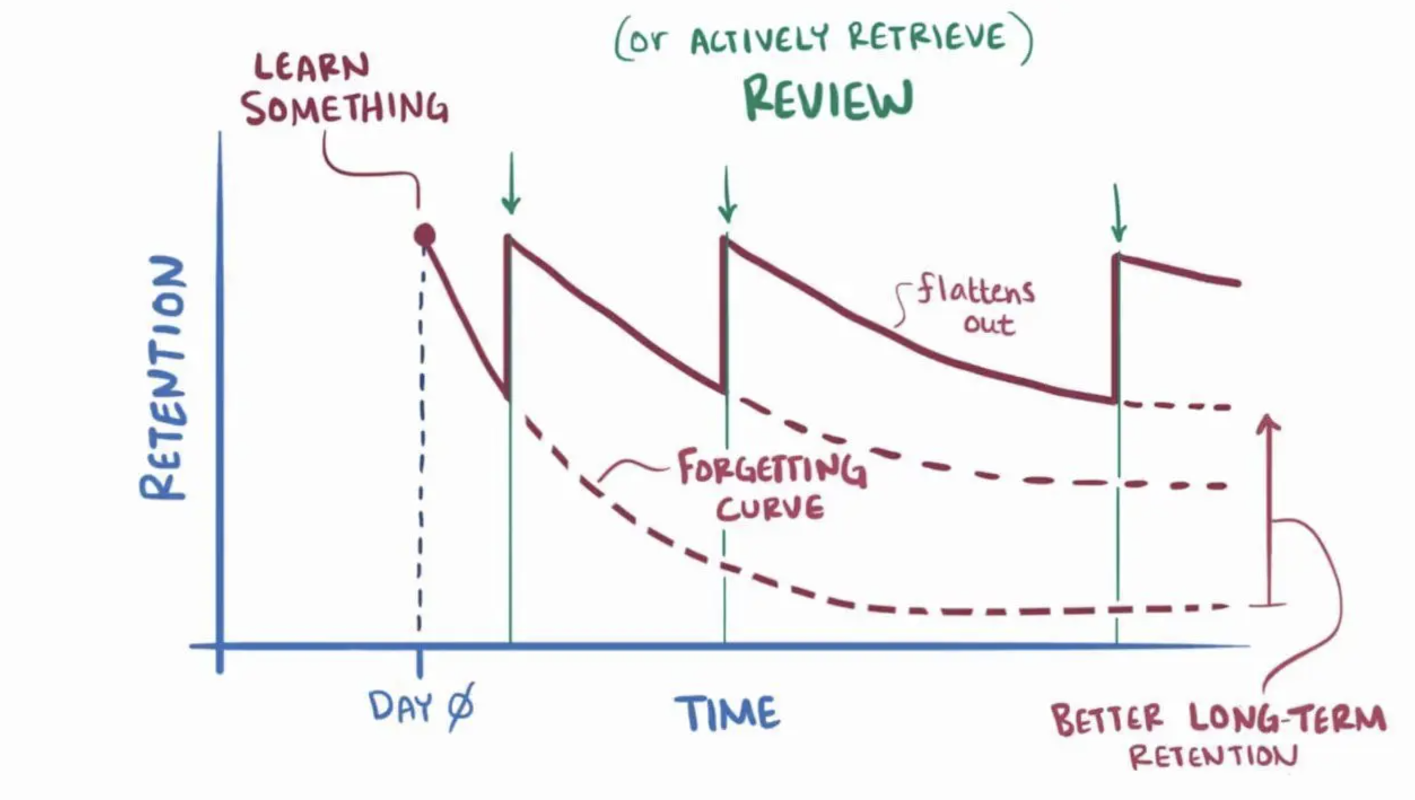
MEMORY CAPACITY

Slide 74
TRAINING LOCATION
There is evidence showing that information retention for all neurotypes is also affected by location
Employees are more likely to remember information in the spot they learned that information
This means that procedures should be taught in the spot they will be used

Slide 75
WHAT CAN YOU APPLY TO YOUR TRAININGS?
We created a checklist for you to discuss with your employees and apply to your trainings.

Slide 76
SUMMARY
Remember to conduct a Hazard Assessment
Apply the hierarchy of controls
Train employees on safe use, proper care, and limitations
Maintain documentation – written program, assessment, and training

Slide 77
SUMMARY
Remember all considerations and accommodations supporting a diverse workforce
When creating trainings, remember to consider the needs of all your employees to improve retention

Slide 78

Thank You – stay safe and healthy!
Incompass Michigan remains committed to being a trusted resource for getting connected and staying informed.

Slide 79
RESOURCE CITATIONS
MIOSHA General Industry Standard
  “Part 433 Personal Protective Equipemnt”
MIOSHA Fact Sheet
  "SP-16 PPE-GI, Persona Protective Equipment for General Industry"

Slide 80
RESOURCE CITATIONS
Honeybourne, Victoria. (2020). The Neurodiverse Workplace: An Employer’s Guide to Managing and Working with Neurodivergent Employees, Clients and Customers. Jessica Kingsley Publishers: London & Philadelphia, PA.
Praslova, Ludmila N. (2024). The Canary Code: A Guide to Neurodiversity, Dignity, And Intersectional Belonging At Work. Berrett-Koehler Publishers, Inc.: Oakland, CA.
Thompson, E. (2023) A Hidden Force: Unlocking the Potential of Neurodiversity at Work. Fast Company Press: New York.
https://www.cnsnevada.com/what-is-the-memory-capacity-of-a-human-brain/
NEUROINCLUSIVE LEARNING QUICK START PACKET BY TRACEY KING

Slide 81
Schedule a free training with us!
Contact us if you wish to have Todd and Katie conduct a free training!
Let us know the following information
  Date, time and length of training
  Desired training content
  How many attendees will be at this training
Katie Kinde – kkinde@incompassmi.org

Slide 82
SAFETY INCLUDED
Training Project in Partnership with MIOSHA CET Division
This material was prepared under a Consultation Education and Training (CET) Grant, awarded by the Michigan Occupational Safety and Health Administration (MIOSHA).
MIOSHA is a part of the Department of Labor and Economic Opportunity (LEO).
Points of view or opinions stated in this document do not necessarily reflect the view or policies of LEO.

