Slide 1
SAFETY INCLUDED
Workplace Health and Safety
Webinar Series

Slide 2

Preventing Slips, Trips, and Falls
Presenters:
Todd Culver, President and CEO
Katie Kinde, Education Coordinator
Incompass Michigan

Slide 3
SAFETY INCLUDED
Training Project in Partnership with MIOSHA CET Division
This material was prepared under a Consultation Education and Training (CET) Grant, awarded by the Michigan Occupational Safety and Health Administration (MIOSHA).
MIOSHA is a part of the Department of Labor and Economic Opportunity (LEO).
Points of view or opinions stated in this document do not necessarily reflect the view or policies of LEO.

Slide 4
ABOUT YOUR PRESENTERS:
Todd Culver
Todd provides leadership in developing programs, strategic initiatives, and financial plans, in accordance with the purpose, vision and values of the association.
He has been with the Association since 1995, also serving as Project Director and Assistant Director.
As Project Director, lead a technical assistance and training project, focusing on Occupational Health and Safety for member organizations.
Prior to coming to Incompass, Todd worked in manufacturing for an automotive supplier, with plant management responsibilities that included environmental health and safety compliance

Slide 5
ABOUT YOUR PRESENTERS:
Katie Kinde
Katie is a 35 year old Autistic self advocate, who loves learning and helping others learn. Katie graduated with a Masters in Education with a focus in Learning Design and Technology in 2021 from Wayne State University.
She currently works for Incompass Michigan as the Education Coordinator, creating trainings, coordinating events, and handling certificate distribution.
Katie has completed multiple Leadership programs in 2023-4, and has presented multiple times about Autism in the workplace.
She became a co-leader in 2024 for the Michigan Advocates to End Seclusion and Restraint, and is now on the EndSAR Board.
In her spare time, she loves playing videogames with her husband Andrew, walking her rescue yorkie Agro, making jewelry, drawing, gardening, and creating miniature houses.

Slide 6
ABOUT THE CONTENT
Inclusivity is very important to us
This presentation is made with all needs in mind. We try to avoid using too many colors and pictures, and when we do, we describe them for low vision users
Handouts are available on a shared drive, link will be posted in the chat

Slide 7
Safety Included 2026
OSHA’s recommended practices for safety and health programs present a step-by-step approach to implementing a safety and health program, built around seven core elements that make up a successful program.
The main goal of safety and health programs is to prevent workplace injuries, illnesses, and deaths, as well as the suffering and financial hardship these events can cause for workers, their families, and employers.

Slide 8
Safety Included 2026
The recommended practices use a proactive approach to managing workplace safety and health.
Traditional approaches are often reactive – problems are addressed only after a worker is injured or becomes sick, a new standard or regulation is published, or an outside inspection finds a problem that must be fixed.
These recommended practices recognize that finding and fixing hazards before they cause injury or illness is a far more effective approach.

Slide 9
Safety Included 2026
The most rigorous preventive safety program takes the view that there is ALWAYS something about an incident leading to injury that could have been different.
Accidents don’t “just happen.”
It is incumbent upon us to continuously assess the landscape to identify the potential for a problem, and fix it before one occurs.
That’s what this presentation is all about, providing a framework for effective safety programs that promote prevention.

Slide 10
Safety Included 2026
Clear, structured visuals and graphics to support comprehension
Minimized sensory distractions in both virtual and in-person settings
Options for verbal and non-verbal participation
Interactive components that promote engagement without overwhelming
Time-buffered schedules to allow for processing and reflection

Slide 11
A SAFE WORKPLACE IS SOUND BUSINESS –
FOR EVERYBODY REGARDLESS OF NEUROTYPE

Slide 12
Preventing Slips, Trips, and Falls – Training Objectives
Definitions
Conditions that can cause accidents
Effective prevention strategies
Things to look out for that are frequently missed

Slide 13
Training Objectives Continued
Employee Training Considerations for Employers
  Building Trust
  Sensory Overload and Sensitivities
  Verbal vs Non-Verbal
  Clear Signs
  Emergency/Safety Buddy
  Proprioception
  Time Buffered Schedules and Memory Capacity
  Training Locations
Using Safety Included Resources

Slide 14
STF Data
Department of Labor (DOL): slips, trips, and falls make up the majority of General Industry accidents
2nd leading cause of workplace deaths
Account for approximately 25% of workers’ compensation claims

Slide 15
SLIPS
Loss of balance caused by too little friction between a person’s foot/shoe and a walking surface
Common causes:
  Wet or oily surfaces
  Spills
  Weather hazards, especially in parking lots/sidewalks, entryways
Loose rugs or mats
Overly worn flooring

Slide 16
TRIPS
Hit an object, losing balance
Common Causes:
  Obstructed view
  Poor lighting
  Clutter or poor housekeeping
  Torn carpeting or curled-up floor mats
  Cords or cables across a walkway
  Uneven walking surfaces

Slide 17
FALLS
Loss of balance, drop to the floor
Three types of falls:
  Fall - same level – slip or trip immediately precedes drop to floor
  Fall - lower level – fall from ladder, steps, stairs
  Jump to lower level - accident resulting from jumping off one level to another, such as off a ladder, stairs, or platform

Slide 18

Slip and Fall Dynamics
Center of gravity: hip level
When one foot advances, we can lose traction
If that foot lacks friction with walking surface, it can slide forward
And the other foot may not provide sufficient stability
Result: loss of balance and potential fall
  Can result in trauma to butt, hips, back, or head

Slide 19
Potential Causes – Slip and Fall Accidents
Flooring (not enough/too much friction, spill) – 50%
Footwear – (shoes/boots not suitable for working surface) – 24%
Remaining: Fraud (10%), Hazard Identification (9%), Training (7%)
  Source: National Floor Safety Institute

Slide 20
What to look for…
If the majority of slip/fall accidents are attributed to flooring and footwear:
  Monitor surfaces, both inside and out, to maintain level, clear, dry walkways
  Provide guidelines to employees for proper slip-resistant shoes or boots
Hazard identification and training:
  Promote and reward recognition of both hazards and their correction
  Training and coaching – slow down, shorten stride

Slide 21
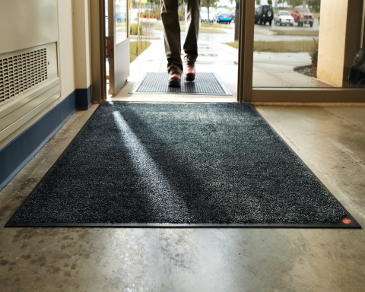
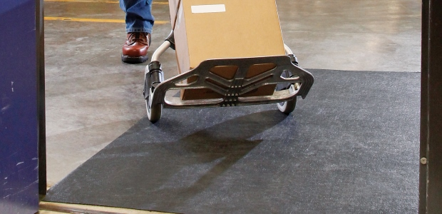

High Risk Areas
Transitions – entry mats, tile to carpet, any change in surface material
Curbs – especially those that are not well-marked

Slide 22
Potential Causes of Falls on Stairs
Stairway design and construction
  Width, depth, height of steps
  Poor tread or step surface material
  Riser dimensions vary
  Lack of handrails, or improper height/placement of railings

Slide 23
Fall Prevention Program Components
Loss prevention and control as part of workplace safety strategy
Good housekeeping culture and preventive maintenance practices
Selection and treatment of flooring surfaces
Employee engagement, management responsibility and leadership

Slide 24
Loss Prevention and Control
THREE-STEP PROGRAM
  Identify risks
  Implement abatement procedures and train employees accordingly
  Document procedures and their effectiveness; update as needed

Slide 25

Identify Risks
Inspect all working areas - accident and injury records reflect high frequency of slips and falls in the following areas:
  Parking lots (cracks, potholes, rain/snow)
  Ramps
  Entrances / Exits
  Walkways
  Stairways (poor lighting, irregular height)
  Irregular surfaces due to deterioration
  Carpets or mats not properly secured

Slide 26

Abatement and Training
Staff training should include:
  How to identify hazards
  How to fix them when you find them
    But also warning of hazards when they can’t be fixed (“Wet Floor” signs, blocking off hazardous areas)
  The impact of slips/trips/falls on employee health and the cost to employers

Slide 27

Documenting Procedures
Maintain documentation of procedures for both inspection and maintenance
  Establishes standard of care for both employees and visitors
  Evidence of adhering to safety best practices
  Support for accreditation, compliance audit, and litigation protection
Who conducted the inspection, who is responsible for any corrective action, and when it was completed
  Maintenance logs and hazard reports – quick, easy, and MANDATORY

Slide 28
Good Housekeeping Practices
ENTRANCE FLOOR MATS
Benefits:
  Can trap moisture and debris that can cause slips/falls
  Reduces maintenance costs by protecting surface
Risks:
  Placement or wear/tear can actually create a slip/trip/fall hazard
General rule:
  Should not be able to see footprints after stepping off mat

Slide 29
Things to look out for that are frequently missed
(9 Common Mistakes)
Source: Midwest Employers Casualty Company
  Not being systematic in approach to prevention
    Planning, design, risk assessment, corrective action, documentation
  Wrong type of flooring for the work
    Aesthetics over functionality; budget constraints; known slip resistance; expected utilization
  Inadequate cleaning protocols
    Products, equipment, and process for desired effect

Slide 30
Things to look out for that are frequently missed
(9 Common Mistakes)
Source: Midwest Employers Casualty Company
  4. Ineffective spill/containment response
    How likely is occurrence; how will it be detected; how will it be corrected; how will it be prevented?
  5. Improper footwear
    Slip-resistance, accountability for mandatory shoes/boots, replacement policy
  6. Inadequate maintenance
    Regular inspections to identify hazards, documentation they are promptly addressed, and corrective action was effective

Slide 31
Things to look out for that are frequently missed
(9 Common Mistakes)
Source: Midwest Employers Casualty Company
  7. Ineffective warnings
    Cones, signage, tape or barriers, proper placement and lighting
  8. Prevention is not integrated into everyday action
    Make it accessible, easy to use, and part of acknowledged job responsibilities
  9. Follow up is not thorough or neglected altogether
    Document – did we find it, fix it, and prove that it worked?

Slide 32
How to Train Effectively
Each person, regardless of neurotype, has a preferred learning method
The following is meant to help employers improve training methods for better outcomes

Slide 33
CONSIDERATIONS FOR NEURODIVERSE EMPLOYEES
Employees of different neurotypes may have different needs to consider, talking to employees directly about their preferences is the best way to ensure learning needs are met
Gain trust by asking for consent to ask neurodivergent employees ways on improving trainings

Slide 34
CONSIDERATIONS FOR NEURODIVERSE EMPLOYEES
Create a trusting relationship so that in times of stress, like injury, employees can go to employers without fear. Neurodiverse employees can have anxiety so be patient
  Speak concise and in a neutral tone

Slide 35
CONSIDERATIONS FOR NEURODIVERSE EMPLOYEES
Some employees may need additional support and freedom to ask questions to better understand. It is important to forge this trust early on
  Treat questions with respect so that employees do not fear being ridiculed in the future

Slide 36

Conversation Example
Examples of conversation during a training:
"What closet do I get the wet floor sign from?"
  "There are two utility closets, one on each floor, I will show them both to you."
"Can I use a different color sign? It would be easier for me to spot."
  "Let's talk about that more after the training, we have to make sure if we can do that. We want to be cautious that it doesn't conflict with the process in place."

Slide 37
CONSIDERATIONS FOR NEURODIVERSE EMPLOYEES
Some neurotypes have what is termed as "Black and White" thinking. They cannot see the grey in between.
  This is the way their brain sees situations, usually with only two solutions.
  It also leads to rigidity: Believing there is only "one right way" to do things.
  This is also why it is important to be concise with directions.

Slide 38
SENSORY OVERLOAD
Sensory overload -
Sensory overload is a state where the brain receives too much sensory input to process, leading to symptoms like anxiety, irritability, confusion, and physical discomfort. It can be triggered by common stimuli such as loud noises, bright lights, strong smells, and crowded spaces, but also by emotional stress, physical fatigue, or environmental changes

Slide 39
SENSORY OVERLOAD
Sensory overload -
During sensory overload, information is less likely to be retained, this leads to an unsuccessful training
Recognizing triggers and using strategies like reducing exposure to stimuli, using sensory aids, or finding quiet spaces can help manage it

Slide 40
CONSIDERATIONS FOR NEURODIVERSE EMPLOYEES
An emergency buddy –
  May be called something else, but the main goal is to ensure there is a trustworthy coworker for a neurodivergent employee in times of an emergency who can guide them during moments they are overwhelmed.

Slide 41
SENSITIVITIES
Consider ways to ensure neurodiverse people are comfortable when training to ensure information is more easily retained
Sensitivities -
Especially when it comes to employees with Autism, they made be extra sensitive to loud noises or bright lights

Slide 42
SENSITIVITIES
Consider their needs. Converse and ask if any changes to the environment could help their learning experience and prevent sensory overload. (While some of these can help during training, it may not be appropriate while equipment is operating)
  Some items that can be offered:
    white noise machines
    access to white noise music
    tinted glasses
    headphones

Slide 43
SENSITIVITIES
Auditory and visual considerations
  Ensure that your trainings are accessible. Neurodiverse people are prone to co-morbidities
  Visually, you should have large text and describe images or steps for anyone with low vision
  When speaking, ensure that you are using a microphone if any employees have low hearing

Slide 44
SENSITIVITIES
Consider sensitivities to scents -
  For those who are sensitive to scents, some smells may be overwhelming especially from machinery
  There are ways to manage these scents personally and environmentally

Slide 45
SENSITIVITIES
For Employee Personal Management
  Masking: Dab Vicks VapoRub, lavender, peppermint oil, or even toothpaste/ChapStick under employees' nose or inside their mask
  Breathing: Breathe through mouth or take shallow breaths; try humming to block smells
  Scented Items: minty gum, strong mints, or Listerine strips

Slide 46
SENSITIVITIES
For Employee Personal Management
  Hygiene: Wear clean uniforms and socks daily to avoid carrying odors
  Quick Breaks: Step away for fresh air if overwhelmed

Slide 47
SENSITIVITIES
For Environmental Management
  Source Control: Cleanliness is key; clean surfaces
  Enzymatic Cleaners
  Ventilation: Ensure proper air circulation, using fans or opening windows when possible

Slide 48
SENSITIVITIES
Consider Tactile sensitivities -
  May include discomfort from material if wearing certain materials
  Hypoallergenic options should always be considered

Slide 49
PROPRIOCEPTION
Proprioception: awareness of one's body
  You should also consider an employee's proprioception as some neurotypes do not perceive themselves well, especially if they are hyper focused
  They may work themselves too hard physically without even realizing until after a task is done
Be proactive with reminders of self – Todd reminds me a lot!

Slide 50
PROXIMITY
Consider proximity comfort/consent.
  This should be discussed for everyday interactions beyond trainings.
Even something as simple as placing a hand on an employee's shoulder may be extremely uncomfortable to a neurodivergent employee.
Always ask for consent.

Slide 51
PROXIMITY
For example, during an interactive in-person training on how to go through a procedure, a trainer may want to show an employee up close
Trainers should ask if it's alright to be up close before showing each step.
Also, let the employee learn by going through the steps themselves.

Slide 52
VERBAL AND NON-VERBAL
Consider some employees may prefer verbal or non-verbal communication
Non-Verbal -
  isn't just about not talking; it's about using diverse communication methods (gestures, visuals,) beyond speech, facing sensory challenges, processing language differently (literal, not nuanced)

Slide 53
VERBAL AND NON-VERBAL
Sometimes certain neurotypes may need to "go nonverbal" (The employee shuts down) due to overwhelm, requiring patience and clear, direct communication, respecting their cues, and understanding their unique sensory/processing needs to bridge gaps
Communication before a shutdown is essential for preparing for these moments

Slide 54
VERBAL AND NON-VERBAL
Though not required, some employees may even prefer having signs on their name badge that show their current availability verbally
  Color coding can be helpful
  This can also be helpful when employees wear headphones

Slide 55
VERBAL AND NON-VERBAL
Make sure when you make trainings that they are also clear
Examples to follow

Slide 56

EXAMPLE CLEAR VISUALS AND DESCRIPTIONS
This shows the most important information all on one page in large.
Consider also providing contact information in case employees have questions.

Slide 57
UNIVERSAL DESIGN METHODS
Universal design allows educators and learners to set clear goals, anticipate environmental barriers, create meaningful options, and fully embrace human variability
Having multiple methods to learn safety ensures that everyone has the resources they need to learn processes, regardless of neurotype
Consider making step by step documents, signs, videos, and plan on showing processes in person
This way, everyone can have multiple options to learn the same information

Slide 58
TIME BUFFERED SCHEDULES
Time-buffered schedules to allow for processing and reflection, for all neurotypes
Consider having breaks during long trainings, or breaks in video trainings
A 15-minute break for every 1-2 hours in-person or live. Be sure to break up with activities and discussions

Slide 59
TIME BUFFERED SCHEDULES
An example for a live day training may look like:
9:30-11:00am Training with 2 breakouts
11:00-11:15am Break
11:15-12:30pm Training with 1 activity
12:30-1:30pm Lunch
1:30-3:00pm Training with 2 breakouts

Slide 60
TIME BUFFERED SCHEDULES
What if you wanted to take that same roughly 6-hour training, and record it? In other words, make it on-demand/ accessible at any time.
That may look like:
15-30 minute videos, with questions in between would be best.
Understandably that is a lot of editing so breaking it up into hour long videos is good if there is a way for learners to pause and return to the content

Slide 61
MEMORY CAPACITY
Even after all you can do to make a training, consider everyone's' memory capacity
On average, it is estimated 50% of what is learned, is immediately forgotten
Spaced Learning helps retain what is taught

Slide 62
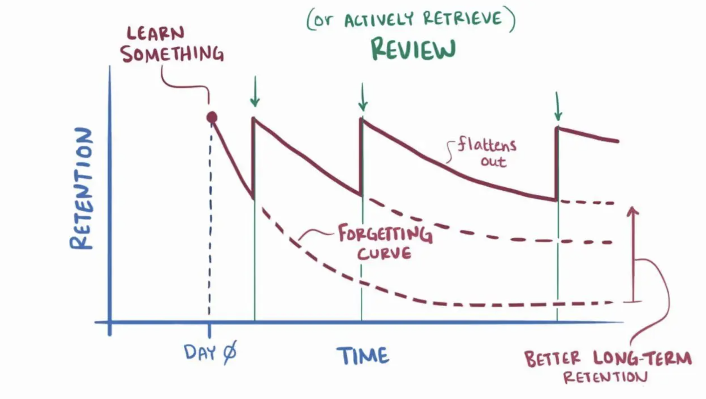
MEMORY CAPACITY

Slide 63
TRAINING LOCATION
There is evidence showing that information retention for all neurotypes is also affected by location
Employees are more likely to remember information in the spot they learned that information
This means that procedures should be taught in the spot they will be used

Slide 64
WHAT CAN YOU APPLY TO YOUR TRAININGS?
How can you improve your safety training?
We created a checklist for you to discuss with your employees and apply to your trainings.

Slide 65
WHAT CAN YOU APPLY TO YOUR TRAININGS?
Is there anything specific from this training that would be beneficial for your safety trainings?

Slide 66
SUMMARY
Maintain traction and the right amount of friction
Choose the right flooring and footwear
Ingrain good housekeeping and preventive maintenance in workplace culture
Inspect and document

Slide 67
SUMMARY
Remember all considerations and accommodations supporting a diverse workforce
When creating trainings, remember to consider the needs of all your employees to improve retention

Slide 68

Thank You – stay safe and healthy!
Incompass Michigan remains committed to being a trusted resource for getting connected and staying informed.

Slide 69
RESOURCE CITATIONS
Midwest Employers Casualty Company, “Preventing Slips, Trips, and Falls”
MIOSHA General Industry Standard, “Part 2, Walking-Working Surfaces”
MIOSHA Fact Sheet, “Fall Prevention”
  https://www.michigan.gov/leo/bureaus-agencies/miosha/topics/fall-prevention
National Flooring Institute, “Slip and Fall Quick Facts”
  https://nfsi.org/nfsi-research/quick-facts/
OSHA Blog, “Preventing Workplace Trip Hazards”
  https://www.osha.com/blog/slips-trips-falls-prevention

Slide 70
RESOURCE CITATIONS
Honeybourne, Victoria. (2020). The Neurodiverse Workplace: An Employer’s Guide to Managing and Working with Neurodivergent Employees, Clients and Customers. Jessica Kingsley Publishers: London & Philadelphia, PA.
Praslova, Ludmila N. (2024). The Canary Code: A Guide to Neurodiversity, Dignity, And Intersectional Belonging At Work. Berrett-Koehler Publishers, Inc.: Oakland, CA.
Thompson, E. (2023) A Hidden Force: Unlocking the Potential of Neurodiversity at Work. Fast Company Press: New York.
https://www.cnsnevada.com/what-is-the-memory-capacity-of-a-human-brain/
NEUROINCLUSIVE LEARNING QUICK START PACKET BY TRACEY KING

Slide 71
Schedule a free training with us!
Contact us if you wish to have Todd and Katie conduct a free training!
Let us know the following information
  Date, time and length of training
  Desired training content
  How many attendees will be at this training
Katie Kinde – kkinde@incompassmi.org

Slide 72
INTOUCH SAFETY
Training Project in Partnership with MIOSHA CET Division
This material was prepared under a Consultation Education and Training (CET) Grant, awarded by the Michigan Occupational Safety and Health Administration (MIOSHA).
MIOSHA is a part of the Department of Labor and Economic Opportunity (LEO).
Points of view or opinions stated in this document do not necessarily reflect the view or policies of LEO.

