Slide 1
SAFETY INCLUDED
Workplace Health and Safety
Webinar Series

Slide 2

Hazard Communication
Presenters: Todd Culver, President and CEO
Katie Kinde, Education Coordinator
Incompass Michigan

Slide 3
SAFETY INCLUDED
Training Project in Partnership with MIOSHA CET Division
This material was prepared under a Consultation Education and Training (CET) Grant, awarded by the Michigan Occupational Safety and Health Administration (MIOSHA).
MIOSHA is a part of the Department of Labor and Economic Opportunity (LEO).
Points of view or opinions stated in this document do not necessarily reflect the view or policies of LEO.

Slide 4
ABOUT YOUR PRESENTERS:
Todd Culver
Todd provides leadership in developing programs, strategic initiatives, and financial plans, in accordance with the purpose, vision and values of the association.
He has been with the Association since 1995, also serving as Project Director and Assistant Director.
As Project Director, lead a technical assistance and training project, focusing on Occupational Health and Safety for member organizations.
Prior to coming to Incompass, Todd worked in manufacturing for an automotive supplier, with plant management responsibilities that included environmental health and safety compliance

Slide 5
ABOUT YOUR PRESENTERS:
Katie Kinde
Katie is a 35 year old Autistic self advocate, who loves learning and helping others learn. Katie graduated with a Masters in Education with a focus in Learning Design and Technology in 2021 from Wayne State University.
She currently works for Incompass Michigan as the Education Coordinator, creating trainings, coordinating events, and handling certificate distribution.
Katie has completed multiple Leadership programs in 2023-4, and has presented multiple times about Autism in the workplace.
She became a co-leader in 2024 for the Michigan Advocates to End Seclusion and Restraint, and is now on the EndSAR Board.
In her spare time, she loves playing videogames with her husband Andrew, walking her rescue yorkie Agro, making jewelry, drawing, gardening, and creating miniature houses.

Slide 6
ABOUT THE CONTENT
Inclusivity is very important to us
This presentation is made with all needs in mind. We try to avoid using too many colors and pictures, and when we do, we describe them for low vision users
Handouts are available on a shared drive, link will be posted in the chat

Slide 7
Safety Included 2026
OSHA’s recommended practices for safety and health programs present a step-by-step approach to implementing a safety and health program, built around seven core elements that make up a successful program.
The main goal of safety and health programs is to prevent workplace injuries, illnesses, and deaths, as well as the suffering and financial hardship these events can cause for workers, their families, and employers.

Slide 8
Safety Included 2026
The recommended practices use a proactive approach to managing workplace safety and health.
Traditional approaches are often reactive – problems are addressed only after a worker is injured or becomes sick, a new standard or regulation is published, or an outside inspection finds a problem that must be fixed.
These recommended practices recognize that finding and fixing hazards before they cause injury or illness is a far more effective approach.

Slide 9
Safety Included 2026
The most rigorous preventive safety program takes the view that there is ALWAYS something about an incident leading to injury that could have been different.
Accidents don’t “just happen.”
It is incumbent upon us to continuously assess the landscape to identify the potential for a problem, and fix it before one occurs.
That’s what this presentation is all about, providing a framework for effective safety programs that promote prevention.

Slide 10
Safety Included 2026
Clear, structured visuals and graphics to support comprehension
Minimized sensory distractions in both virtual and in-person settings
Options for verbal and non-verbal participation
Interactive components that promote engagement without overwhelming
Time-buffered schedules to allow for processing and reflection

Slide 11
A SAFE WORKPLACE IS SOUND BUSINESS –
FOR EVERYBODY REGARDLESS OF NEUROTYPE

Slide 12
Hazard Communication (HazCom) – Training Objectives
MIOSHA Standard
Container Labels and Safety Data Sheets
MIOSHA and Federal OSHA resources
Inclusive approaches to training

Slide 13
Training Objectives Continued
Employee Training Considerations for Employers
  Building Trust
  Sensory Overload and Sensitivities
  Verbal vs Non-Verbal
  Clear Signs
  Emergency/Safety Buddy
  Proprioception
  Time Buffered Schedules and Memory Capacity
  Training Locations
Using Safety Included Resources

Slide 14
MIOSHA (Part 42, 92, and 430) – Hazard Communication
Make sure the hazards associated with chemicals in the workplace are communicated in a clear and consistent way
  Employers using chemicals and employees exposed to them understand these hazards and the steps that need to be taken to ensure safe use
Provides uniform criteria for classifying, labeling, and documenting through Safety Data Sheets
  According to United Nations Globally Harmonized System of Classification and Labeling of Chemicals (GHS)

Slide 15
Who does the standard apply to?
Any chemical present in the workplace, used in such a way that employees may be exposed
  Under normal conditions and foreseeable emergency
Private and Public Sector employees
General Industry, Construction, and Agriculture activities
Applies to:
  Manufacturers
  Importers
  Distributors
  Employers

Slide 16
Chemical Labeling
A GHS label is any written, printed or graphic material displayed on or affixed to containers of hazardous chemicals in the workplace.
Labels must be legible, in English (plus other languages, if desired), and prominently displayed.
Labels must have the following six items:
Product identifier
Signal word
Hazard statements
Pictograms
Precautionary Statements
Manufacturer information

Slide 17
Chemical Labeling
Every hazardous chemical in the workplace needs a label
  Manufacturers have the responsibility to label their products (ex: Clorox)
  Distributors have the responsibility to make sure that label is intact (ex: Home Depot)
  Employers (and employees) have the responsibility to ensure that the label is intact and accurate
Secondary labels
  If chemicals are transferred, the new container must be labeled with the product identifier and words, pictures, or symbols that convey the hazards.
Labels are an excellent source of information, but less detailed than a Safety Data Sheet

Slide 18
Product Identifier
Used to disclose the chemical’s or product’s name
Found on the product’s label
If additional identifiers are needed beyond the product name, these identifiers can be placed to the right of the manufacturer’s information on a GHS label.

Slide 19
Signal Word
Acute Hazards (Short-Term): Occur after a single, fast exposure (seconds to hours). These are common in accidents, spills, or emergency situations. Examples include chemical burns, dizziness, or eye irritation.
Chronic Hazards (Long-Term): Result from repeated, prolonged exposure over months or years. These effects may be delayed, such as developing cancer or lung disease.

Slide 20
Key Differences in Hazard Communication
Used to indicate the relative level of severity of the hazard and alert the reader to a potential hazard on the label
There are only two words used as signal words: “Danger” and “Warning.”
Within a specific hazard class, “Danger” is used for the more severe hazards and “Warning” is used for the less severe hazards

Slide 21
Hazard Statements
Describes the nature of the hazard(s) of a chemical, including the degree of hazard
All of the applicable hazard statements must appear on the label
The hazard statements are specific to the hazard classification categories, and chemical users should always see the same statement for the same hazards no matter what the chemical is or who produces it.
Examples:
  “may cause fire or explosion, strong oxidizer”
  “causes severe skin burns and eye damage”.

Slide 22
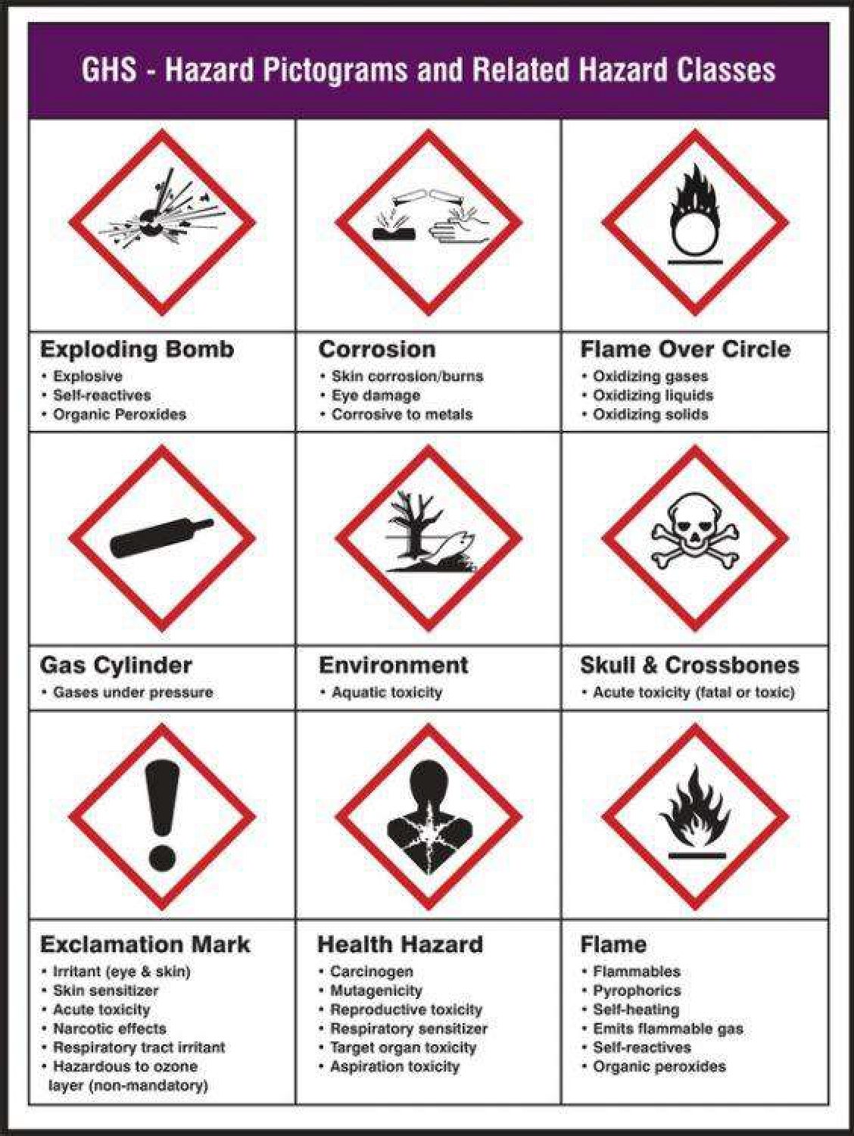
Pictograms
There are nine GHS Pictograms -the chart on the right outlines their meanings
GHS pictograms must be in the shape of a square set at a point and include a black hazard symbol on a white background with a red border

Slide 23
Precautionary Statements
Describe the recommended measures that should be taken to minimize or prevent adverse effects resulting from exposure, or improper storage or handling of a hazardous chemical
GHS categorizes precautionary statements according to whether they relate to
  prevention
  response
  storage
  disposal

Slide 24
Manufacturer Information
GHS labels must include:
  the manufacturer’s name
  contact information, including an address and phone number

Slide 25
Labels, in summary
Who made it
How to contact them if necessary
How it can harm you, and to what degree
Recommended measures to:
  Prevent exposure
  Treat an exposure
  Store the materials safely for use
  Dispose of it if necessary

Slide 26
Safety Data Sheets
Must be in English and include information regarding the specific chemical identity and common names
SDS have a prescribed format, and follow a 16 part format outlined by the GHS
If no SDS has been received for a hazardous chemical, the employer must contact the supplier, manufacturer, or importer to obtain one and maintain a record of the contact
Employers shall have an SDS in the workplace for each hazardous chemical which they use and have onsite at ALL times and they must be readily available

Slide 27
SDS – Key Sections (8 & 10)
Section 8 outlines how to protect employees - prescribed engineering controls and personal protective equipment
Section 10 has the reactivity data workers should be aware of - tells you if a product reacts in dangerous ways with other chemicals

Slide 28
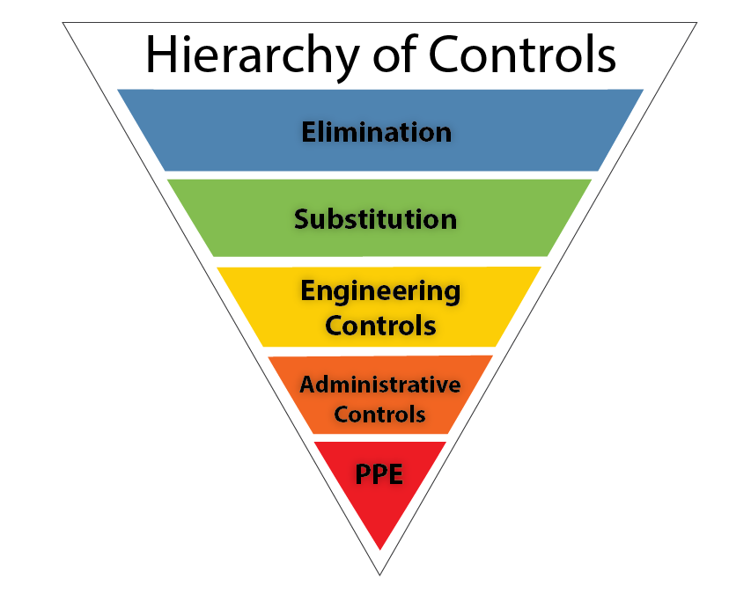
Hierarchy of Controls
The hierarchy of controls is a NIOSH-developed framework ranking hazard safeguards from most to least effective:
Elimination, Substitution, Engineering Controls, Administrative Controls, and PPE
It prioritizes physically removing hazards (e.g., stopping a process) over relying on human behavior (e.g., training) to ensure maximum worker safety

Slide 29
REMEMBER:
A good HazCom program will make employees aware of the routes of entry into the body - such as inhalation, ingestion, absorption and injection
It also makes employees more aware of how the body needs protection from the hazardous substance
It’s always best to select the least harmful chemical first before considering use of something stronger
And it should ensure the employee understands what the labels and pictograms mean

Slide 30
REMEMBER:
Employers shall communicate chemical hazards:
  through their written Haz Com Plan
  at their employees’ initial work assignment
  and anytime a new chemical hazard is introduced to the worksite

Slide 31
How to Train Effectively
Each person, regardless of neurotype, has a preferred learning method
The following is meant to help employers improve training methods for better outcomes

Slide 32
CONSIDERATIONS FOR NEURODIVERSE EMPLOYEES
Employees of different neurotypes may have different needs to consider, talking to employees directly about their preferences is the best way to ensure learning needs are met
Gain trust by asking for consent to ask neurodivergent employees ways on improving trainings

Slide 33
CONSIDERATIONS FOR NEURODIVERSE EMPLOYEES
Create a trusting relationship so that in times of stress, like injury, employees can go to employers without fear. Neurodiverse employees can have anxiety so be patient
  Speak concise and in a neutral tone

Slide 34
CONSIDERATIONS FOR NEURODIVERSE EMPLOYEES
Some employees may need additional support and freedom to ask questions to better understand. It is important to forge this trust early on
  Treat questions with respect so that employees do not fear being ridiculed in the future

Slide 35

Conversation Example
Examples of conversation during a training:
"What cabinet do I get this cleaner from?"
  "There are two utility closets, one on each floor, I will show them both to you."
"Can I add a colored sticker to the bottle? Corrosive is more of a teal color for me so it would be easier to spot."
  "Let's talk about that more after the training, we have to make sure if we can do that. We want to be cautious that it doesn't conflict with the labling process in place."

Slide 36
CONSIDERATIONS FOR NEURODIVERSE EMPLOYEES
Some neurotypes have what is termed as "Black and White" thinking. They cannot see the grey in between.
  This is the way their brain sees situations, usually with only two solutions.
  It also leads to rigidity: Believing there is only "one right way" to do things.
  This is also why it is important to be concise with directions.

Slide 37
UNIVERSAL DESIGN METHODS
Universal design allows educators and learners to set clear goals, anticipate environmental barriers, create meaningful options, and fully embrace human variability
Having multiple methods to learn safety ensures that everyone has the resources they need to learn processes, regardless of neurotype
Consider making step by step documents, signs, videos, and plan on showing processes in person
This way, everyone can have multiple options to learn the same information

Slide 38
SENSORY OVERLOAD
Sensory overload -
Sensory overload is a state where the brain receives too much sensory input to process, leading to symptoms like anxiety, irritability, confusion, and physical discomfort. It can be triggered by common stimuli such as loud noises, bright lights, strong smells, and crowded spaces, but also by emotional stress, physical fatigue, or environmental changes

Slide 39
SENSORY OVERLOAD
Sensory overload -
During sensory overload, information is less likely to be retained, this leads to an unsuccessful training
Recognizing triggers and using strategies like reducing exposure to stimuli, using sensory aids, or finding quiet spaces can help manage it

Slide 40
CONSIDERATIONS FOR NEURODIVERSE EMPLOYEES
Consider ways to ensure neurodiverse people are comfortable when training to ensure information is more easily retained
Sensitivities -
Especially when it comes to employees with Autism, they made be extra sensitive to loud noises or bright lights

Slide 41
CONSIDERATIONS FOR NEURODIVERSE EMPLOYEES
Consider their needs. Converse and ask if any changes to the environment could help their learning experience and prevent sensory overload. (While some of these can help during training, it may not be appropriate while equipment is operating)
  Some items that can be offered:
    white noise machines
    access to white noise music
    tinted glasses
    headphones

Slide 42
CONSIDERATIONS FOR NEURODIVERSE EMPLOYEES
Auditory and visual considerations
  Ensure that your trainings are accessible. Neurodiverse people are prone to co-morbidities
  Visually, you should have large text and describe images or steps for anyone with low vision
  When speaking, ensure that you are using a microphone if any employees have low hearing

Slide 43
CONSIDERATIONS FOR NEURODIVERSE EMPLOYEES
Consider sensitivities to scents -
  For those who are sensitive to scents, some smells may be overwhelming especially from machinery
  There are ways to manage these scents personally and environmentally

Slide 44
CONSIDERATIONS FOR NEURODIVERSE EMPLOYEES
For Employee Personal Management
  Masking: Dab Vicks VapoRub, lavender, peppermint oil, or even toothpaste/ChapStick under employees' nose or inside their mask
  Breathing: Breathe through mouth or take shallow breaths; try humming to block smells
  Scented Items: minty gum, strong mints, or Listerine strips

Slide 45
CONSIDERATIONS FOR NEURODIVERSE EMPLOYEES
For Employee Personal Management
  Hygiene: Wear clean uniforms and socks daily to avoid carrying odors
  Quick Breaks: Step away for fresh air if overwhelmed

Slide 46
CONSIDERATIONS FOR NEURODIVERSE EMPLOYEES
For Environmental Management
  Source Control: Cleanliness is key; clean surfaces
  Enzymatic Cleaners
  Ventilation: Ensure proper air circulation, using fans or opening windows when possible

Slide 47
CONSIDERATIONS FOR NEURODIVERSE EMPLOYEES
Consider Tactile sensitivities -
  May include discomfort from material if wearing gloves
  Hypoallergenic options should always be considered

Slide 48
CONSIDERATIONS FOR NEURODIVERSE EMPLOYEES
Key Types of Hypoallergenic HAZMAT Gloves
Nitrile Gloves (Powder-Free): The most common choice; they are 100% latex-free and provide a strong barrier against chemicals.
Accelerator-Free Nitrile: Specially engineered to avoid Type IV chemical allergies (contact dermatitis) caused by rubber accelerators during manufacturing.

Slide 49
CONSIDERATIONS FOR NEURODIVERSE EMPLOYEES
Vinyl Gloves: A, cost-effective, latex-free, and hypoallergenic alternative, though generally less puncture-resistant than nitrile.
Neoprene Gloves: Offer excellent protection against a wide range of hazardous materials.

Slide 50
CONSIDERATIONS FOR NEURODIVERSE EMPLOYEES
Texture/Grip: find gloves with textured fingertips for better handling of wet or greasy hazardous materials.

Slide 51
CONSIDERATIONS FOR NEURODIVERSE EMPLOYEES
Consider proximity comfort/consent.
  This should be discussed for everyday interactions beyond trainings.
Even something as simple as placing a hand on an employee's shoulder may be extremely uncomfortable to a neurodivergent employee.
Always ask for consent.

Slide 52
CONSIDERATIONS FOR NEURODIVERSE EMPLOYEES
For example, during an interactive in-person training on how to go through hazard procedure, a trainer may want to show an employee a label up close
Trainers should ask if it's alright to be up close before showing each step.
Also, let the employee learn by going through the steps themselves and/or handing them the container with the label.

Slide 53
VERBAL AND NON-VERBAL
Consider some employees may prefer verbal or non-verbal communication
Non-Verbal -
  isn't just about not talking; it's about using diverse communication methods (gestures, visuals,) beyond speech, facing sensory challenges, processing language differently (literal, not nuanced)

Slide 54
VERBAL AND NON-VERBAL
Sometimes certain neurotypes may need to "go nonverbal" (The employee shuts down) due to overwhelm, requiring patience and clear, direct communication, respecting their cues, and understanding their unique sensory/processing needs to bridge gaps
Communication before a shutdown is essential for preparing for these moments

Slide 55
VERBAL AND NON-VERBAL
Though not required, some employees may even prefer having signs on their name badge that show their current availability verbally
  Color coding can be helpful
  This can also be helpful when employees wear headphones

Slide 56
VERBAL AND NON-VERBAL
Make sure when you make trainings that they are also clear
Examples to follow

Slide 57
EXAMPLE UNCLEAR
SAFETY NOTICE – PLEASE REVIEW
Imagine a notice that says the following:
Due to new ordinance 4.0 of the safety committee, these signs must next to hazardous materials
Describe the recommended measures that should be taken to minimize or preventadverse effects resulting from exposure, or improper storage or handling of ahazardous chemical
GHS categorizes precautionary statements according to whether they relate to
  prevention
  response
  storage
  disposal
Due to new ordinance 4.0 of the safety committee, these signs must next to hazardous materials
Describe the recommended measures that should be taken to minimize or prevent adverse effects resulting from exposure, or improper storage or handling of a hazardous chemical
GHS categorizes precautionary statements according to whether they relate to
  prevention
  response
  storage
  disposal

Slide 58

EXAMPLE CLEAR VISUALS AND DESCRIPTIONS
The last slide was too complicated
This shows the most important information all on one page in larger text.
There is also contact information in case employees have questions.

Slide 59
CONSIDERATIONS FOR NEURODIVERSE EMPLOYEES
An emergency buddy –
  May be called something else, but the main goal is to ensure there is a trustworthy coworker for a neurodivergent employee in times of an emergency who can guide them during moments they are overwhelmed.

Slide 60
CONSIDERATIONS FOR NEURODIVERSE EMPLOYEES
Proprioception: awareness of one's body
  You should also consider an employee's proprioception as some neurotypes do not perceive themselves well, especially if they are hyper focused
  They may work themselves too hard physically without even realizing until after a task is done
Be proactive with reminders of self – Todd reminds me a lot!

Slide 61
TIME BUFFERED SCHEDULES
Time-buffered schedules to allow for processing and reflection, for all neurotypes
Consider having breaks during long trainings, or breaks in video trainings
A 15-minute break for every 1-2 hours in-person or live. Be sure to break up with activities and discussions

Slide 62
TIME BUFFERED SCHEDULES
An example for a live day training may look like:
9:30-11:00am Training with 2 breakouts
11:00-11:15am Break
11:15-12:30pm Training with 1 activity
12:30-1:30pm Lunch
1:30-3:00pm Training with 2 breakouts

Slide 63
TIME BUFFERED SCHEDULES
What if you wanted to take that same roughly 6-hour training, and record it? In other words, make it on-demand/ accessible at any time.
That may look like:
15-30 minute videos, with questions in between would be best.
Understandably that is a lot of editing so breaking it up into hour long videos is good if there is a way for learners to pause and return to the content

Slide 64
MEMORY CAPACITY
Even after all you can do to make a training, consider everyone's' memory capacity
On average, it is estimated 50% of what is learned, is immediately forgotten
Spaced Learning helps retain what is taught

Slide 65
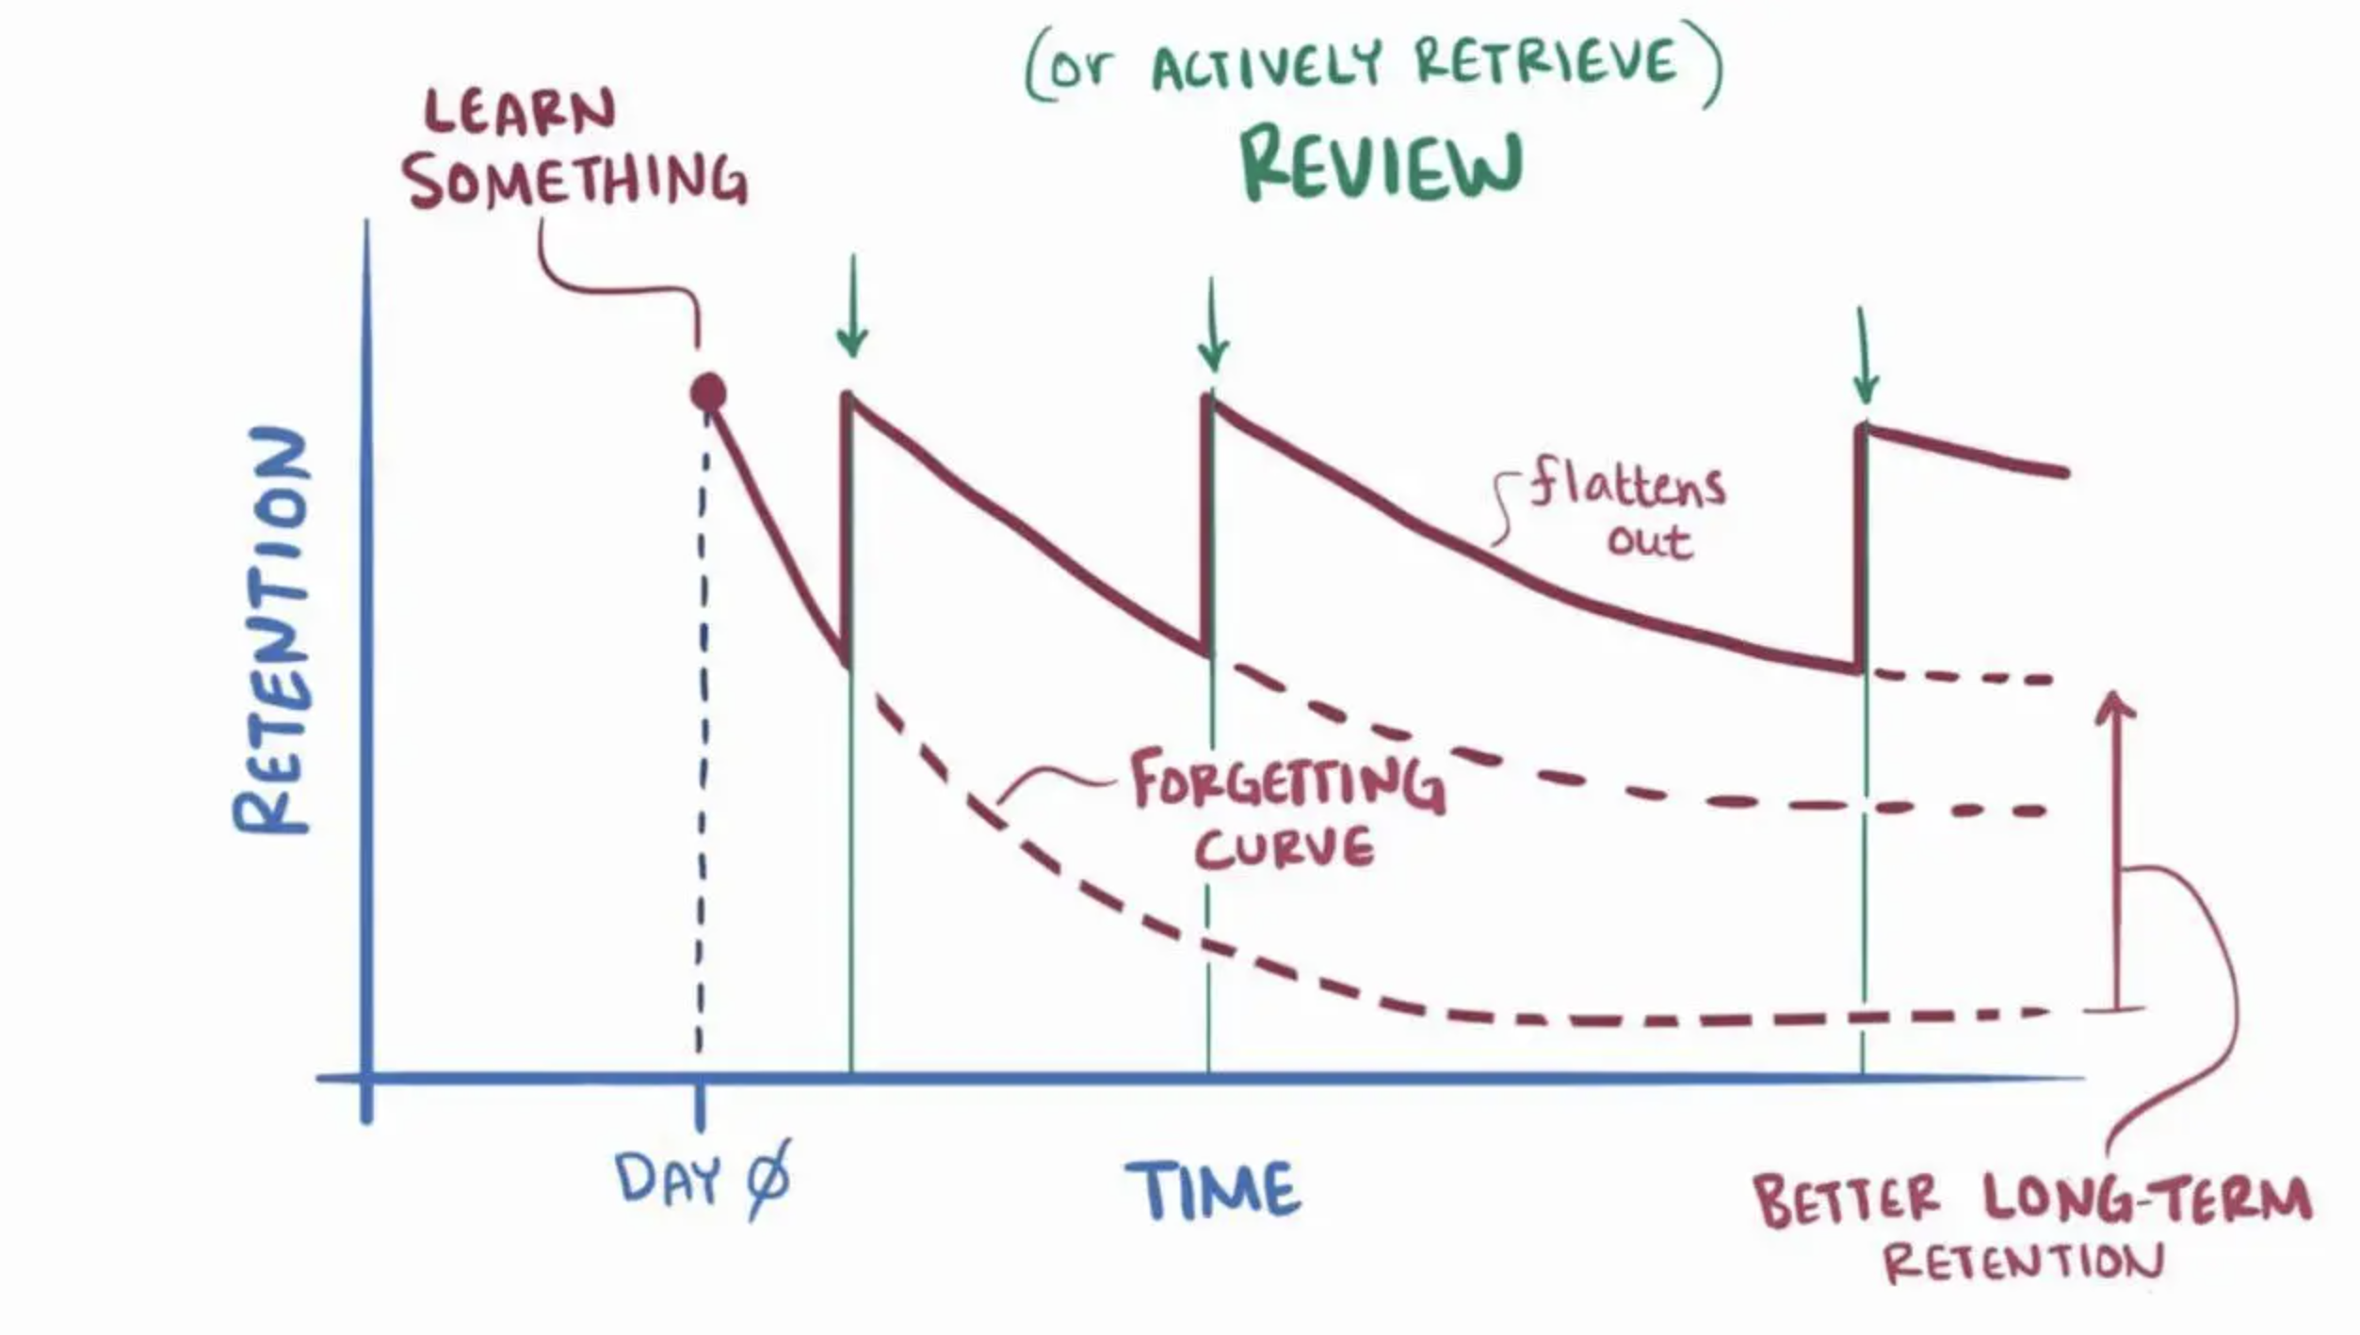
MEMORY CAPACITY

Slide 66
TRAINING LOCATION
There is evidence showing that information retention for all neurotypes is also affected by location
Employees are more likely to remember information in the spot they learned that information
This means that procedures should be taught in the spot they will be used

Slide 67
WHAT CAN YOU APPLY TO YOUR TRAININGS?
How can you improve your safety training?
We created a checklist for you to discuss with your employees and apply to your trainings.

Slide 68
WHAT CAN YOU APPLY TO YOUR TRAININGS?
Is there anything specific from this training that would be beneficial for your safety trainings?

Slide 69
SUMMARY
Where can I get hazard information?
Employees have the “Right to Know”
Workers should demonstrate that they know how to get the information provided by the labels and SDS
They should know about the supplier and workplace labels and other ways used to identify the products and what these labels mean
They must also know how to get the SDS (either by the binder location or by accessing a computer) so that they have a way to obtain information significant to his or her health and safety
SDS must be in a location readily available to employees

Slide 70
SUMMARY
What are the hazards of the controlled product?
The worker should be able to read and understand the label and SDS as well as be aware of any possible harmful effects of the material in question
How am I protected from those hazards?
An understanding of the controls used in the workplace is necessary, whether by means of the engineering, administration, or PPE
Remember the hierarchy of controls

Slide 71
SUMMARY
What do I do in the case of an emergency?
Understanding the procedures to follow in the event of a spill, release, fire or poisoning involving a controlled product is required.
Included in the understanding is the use of personal protective equipment that may be necessary only in the case of emergency
In the event medical treatment is required for an exposure, it is helpful to have a copy of the SDS available to the care provider

Slide 72
SUMMARY
Remember all considerations and accommodations supporting a diverse workforce
When creating trainings, remember to consider the needs of all your employees to improve retention

Slide 73

Thank You – stay safe and healthy!
Incompass Michigan remains committed to being a trusted resource for getting connected and staying informed.

Slide 74
MIOSHA
RESOURCE CITATIONS
Hazard Communication Example Fill In the Blank Plan (MS Word) (CET-5530)
Right To Know Hazard Communication Compliance Guide (SP-22)
Safety Data Sheet (SDS) Location Poster (CET-2105)
New/Revised Safety Data Sheet (SDS) Poster (CET-2106)

Slide 75
OSHA / CDC
RESOURCE CITATIONS
OSHA Brief - Hazard Communication Standard: Labels & Pictograms
OSHA Fact Sheet -Training Requirements for the Revised Hazard Communication Standard (December 1, 2013)
OSHA Publication 3695 - Hazard Communication: Small Entity Compliance Guide for Employers That Use Hazardous Chemicals (March 2014)
OSHA Publication FS-3696 - Steps to an Effective Hazardous Communication Program for Employers That Use Hazardous Chemicals (March 2014)
OSHA Publication 3844 Hazard Communication: Hazard Classification Guide for Manufacturers, Importers, and Employers
Center for Disease Control and Prevention – About Hierarch of Controls - https://www.cdc.gov/niosh/hierarchy-of-controls/about

Slide 76
ADDITIONAL
RESOURCE CITATIONS
Safety and Health Field Guide for Professional Cleaners, 1st ed. – Institute of Inspection Cleaning and Restoration Certification (IICRC), 2022

Slide 77
RESOURCE CITATIONS
Honeybourne, Victoria. (2020). The Neurodiverse Workplace: An Employer’s Guide to Managing and Working with Neurodivergent Employees, Clients and Customers. Jessica Kingsley Publishers: London & Philadelphia, PA.
Praslova, Ludmila N. (2024). The Canary Code: A Guide to Neurodiversity, Dignity, And Intersectional Belonging At Work. Berrett-Koehler Publishers, Inc.: Oakland, CA.
Thompson, E. (2023) A Hidden Force: Unlocking the Potential of Neurodiversity at Work. Fast Company Press: New York.
https://www.cnsnevada.com/what-is-the-memory-capacity-of-a-human-brain/
NEUROINCLUSIVE LEARNING QUICK START PACKET BY TRACEY KING

Slide 78
SAFETY
INCLUDED
Training Project in Partnership with MIOSHA CET Division
This material was prepared under a Consultation Education and Training (CET) Grant, awarded by the Michigan Occupational Safety and Health Administration (MIOSHA).
MIOSHA is a part of the Department of Labor and Economic Opportunity (LEO).
Points of view or opinions stated in this document do not necessarily reflect the view or policies of LEO.

Slide 79
Schedule a free training with us!
Contact us if you wish to have Todd and Katie conduct a free training!
Let us know the following information
  Date, time and length of training
  Desired training content
  How many attendees will be at this training
Katie Kinde – kkinde@incompassmi.org

