Slide 1
SAFETY INCLUDED
Workplace Health and Safety
Webinar Series

Slide 2

Ergonomics
Presenters:
Jamie Green,
MIOSHA
Katie Kinde, Education Coordinator
Incompass Michigan

Slide 3
SAFETY INCLUDED
Training Project in Partnership with MIOSHA CET Division
This material was prepared under a Consultation Education and Training (CET) Grant, awarded by the Michigan Occupational Safety and Health Administration (MIOSHA).
MIOSHA is a part of the Department of Labor and Economic Opportunity (LEO).
Points of view or opinions stated in this document do not necessarily reflect the view or policies of LEO.

Slide 4
ABOUT YOUR PRESENTERS:
Jamie Green
Jamie Green brings more than 26 years of hands-on manufacturing experience and a strong technical foundation in safety to his role at MIOSHA. Throughout his manufacturing career, Jamie held a wide range of positions that provided him with a deep, practical understanding of workplace operations, challenges, and safety needs across the industry.
One of Jamie’s key responsibilities included serving as chairperson for the International Standardization Organization (ISO) processes within his organization. In this role, he led the review of quality documentation and identified critical gaps within the company’s Environmental Health and Safety (EHS) management system. This work strengthened his expertise in regulatory alignment, continuous improvement, and safety system performance.
In 2016, Jamie earned his Certified Safety Professional (CSP) designation, solidifying his credentials in occupational health and safety. Today at MIOSHA, he is committed to partnering with employers, employees, and safety professionals to enhance workplace health and safety programs. His goal is to support organizations in building stronger safety cultures and driving meaningful, sustainable improvements that protect Michigan’s workforce

Slide 5
ABOUT YOUR PRESENTERS:
Katie Kinde
Katie is a 35 year old Autistic self advocate, who loves learning and helping others learn. Katie graduated with a Masters in Education with a focus in Learning Design and Technology in 2021 from Wayne State University.
She currently works for Incompass Michigan as the Education Coordinator, creating trainings, coordinating events, and handling certificate distribution.
Katie has completed multiple Leadership programs in 2023-4, and has presented multiple times about Autism in the workplace.
She became a co-leader in 2024 for the Michigan Advocates to End Seclusion and Restraint, and is now on the EndSAR Board.
In her spare time, she loves walking her rescue yorkie Agro, drawing, and gardening.

Slide 6
ABOUT THE CONTENT
Inclusivity is very important to us
This presentation is made with all needs in mind. We try to avoid using too many colors and pictures, and when we do, we describe them for low vision users
Handouts are available on a shared drive, link will be posted in the chat

Slide 7
Safety Included 2026
OSHA’s recommended practices for safety and health programs present a step-by-step approach to implementing a safety and health program.
These recommended practices recognize that finding and fixing hazards before they cause injury or illness is a far more effective approach.
That’s what this presentation is all about, providing a framework for effective safety programs that promote prevention.

Slide 8
A Safe Workplace is Sound Business - for Everybody, Regardless of Neurotype
Clear, structured visuals and graphics to support comprehension
Minimized sensory distractions in both virtual and in-person settings
Options for verbal and non-verbal participation
Interactive components that promote engagement without overwhelming
Time-buffered schedules to allow for processing and reflection

Slide 9
Ergonomics – Training Objectives
Identify common work-related musculoskeletal disorders (MSDs).
Recognize risk factors associated with work-related MSDs.
Identify ergonomic control methods for eliminating/reducing work-related MSDs.

Slide 10
Training Objectives Continued
Employee Training Considerations for Employers
  Building Trust
  Sensory Overload and Sensitivities
  Verbal vs Non-Verbal
  Clear Signs
  Emergency/Safety Buddy
  Proprioception
  Time Buffered Schedules and Memory Capacity
  Training Locations
Using Safety Included Resources

Slide 11
How to Train Effectively
Each person, regardless of neurotype, has a preferred learning method
The following is meant to help employers improve training methods for better outcomes

Slide 12
CONSIDERATIONS FOR NEURODIVERSE EMPLOYEES
Employees of different neurotypes may have different needs to consider, talking to employees directly about their preferences is the best way to ensure learning needs are met
Gain trust by asking for consent to ask neurodivergent employees ways on improving trainings

Slide 13
CONSIDERATIONS FOR NEURODIVERSE EMPLOYEES
Create a trusting relationship so that in times of stress, like injury, employees can go to employers without fear. Neurodiverse employees can have anxiety so be patient
  Speak concise and in a neutral tone

Slide 14
CONSIDERATIONS FOR NEURODIVERSE EMPLOYEES
Some employees may need additional support and freedom to ask questions to better understand. It is important to forge this trust early on
  Treat questions with respect so that employees do not fear being ridiculed in the future

Slide 15
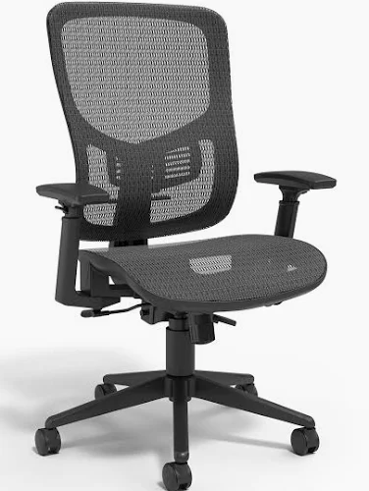
Conversation Example
Examples of conversation during a training:
"Are these the only chairs we can use?"
  "These are the chairs we have, but if you need an accommodation let me know."
"Can I add my own chair cover? Especially something for the arm rests?"
  "Let's talk about that more after the training, we have to make sure if we can do that."

Slide 16
CONSIDERATIONS FOR NEURODIVERSE EMPLOYEES
Some neurotypes have what is termed as "Black and White" thinking. They cannot see the grey in between.
  This is the way their brain sees situations, usually with only two solutions.
  It also leads to rigidity: Believing there is only "one right way" to do things.
  This is also why it is important to be concise with directions.

Slide 17
SENSORY OVERLOAD
Sensory overload -
Sensory overload is a state where the brain receives too much sensory input to process, leading to symptoms like anxiety, irritability, confusion, and physical discomfort. It can be triggered by common stimuli such as loud noises, bright lights, strong smells, and crowded spaces, but also by emotional stress, physical fatigue, or environmental changes

Slide 18
SENSORY OVERLOAD
Sensory overload -
During sensory overload, information is less likely to be retained, this leads to an unsuccessful training
Recognizing triggers and using strategies like reducing exposure to stimuli, using sensory aids, or finding quiet spaces can help manage it

Slide 19
CONSIDERATIONS FOR NEURODIVERSE EMPLOYEES
An emergency buddy –
  May be called something else, but the main goal is to ensure there is a trustworthy coworker for a neurodivergent employee in times of an emergency who can guide them during moments they are overwhelmed.

Slide 20
SENSITIVITIES
Consider ways to ensure neurodiverse people are comfortable when training to ensure information is more easily retained
Sensitivities -
Especially when it comes to employees with Autism, they made be extra sensitive to loud noises or bright lights

Slide 21
SENSITIVITIES
Consider their needs. Converse and ask if any changes to the environment could help their learning experience and prevent sensory overload. (While some of these can help during training, it may not be appropriate while equipment is operating)
  Some items that can be offered:
    white noise machines
    access to white noise music
    tinted glasses
    headphones

Slide 22
SENSITIVITIES
Auditory and visual considerations
  Ensure that your trainings are accessible. Neurodiverse people are prone to co-morbidities
  Visually, you should have large text and describe images or steps for anyone with low vision
  When speaking, ensure that you are using a microphone if any employees have low hearing

Slide 23
SENSITIVITIES
Consider sensitivities to scents -
  For those who are sensitive to scents, some smells may be overwhelming especially from machinery
  There are ways to manage these scents personally and environmentally

Slide 24
SENSITIVITIES
For Employee Personal Management
  Masking: Dab Vicks VapoRub, lavender, peppermint oil, or even toothpaste/ChapStick under employees' nose or inside their mask
  Breathing: Breathe through mouth or take shallow breaths; try humming to block smells
  Scented Items: minty gum, strong mints, or Listerine strips

Slide 25
SENSITIVITIES
For Employee Personal Management
  Hygiene: Wear clean uniforms and socks daily to avoid carrying odors
  Quick Breaks: Step away for fresh air if overwhelmed

Slide 26
SENSITIVITIES
For Environmental Management
  Source Control: Cleanliness is key; clean surfaces
  Enzymatic Cleaners
  Ventilation: Ensure proper air circulation, using fans or opening windows when possible

Slide 27
SENSITIVITIES
Consider Tactile sensitivities -
  May include discomfort from material if wearing certain materials
  Hypoallergenic options should always be considered

Slide 28
PROPRIOCEPTION
Proprioception: awareness of one's body
  You should also consider an employee's proprioception as some neurotypes do not perceive themselves well, especially if they are hyper focused
  They may work themselves too hard physically without even realizing until after a task is done
Be proactive with reminders of self – Todd reminds me a lot!

Slide 29
ACCOMODATIONS
Keeping Proprioception in mind, neurodivergent employees may need more reminders for stretching, or changes to posture like the beginning of this presentation.
Consider buying hypoallergenic solutions for repetititive tasks too, such as shoe insoles for standing employees, or wrist protection for employees at the computer.

Slide 30
ACCOMODATIONS
For psychological ergonomics, consider getting fidget toys that work for your employees.
Always allow employees to use fidget toys to relieve stress when possible.

Slide 31
PROXIMITY
Consider proximity comfort/consent.
  This should be discussed for everyday interactions beyond trainings.
Even something as simple as placing a hand on an employee's shoulder may be extremely uncomfortable to a neurodivergent employee.
Always ask for consent.

Slide 32
PROXIMITY
For example, during an interactive in-person training on how to go through a procedure, a trainer may want to show an employee up close
Trainers should ask if it's alright to be up close before showing each step.
Also, let the employee learn by going through the steps themselves.

Slide 33
VERBAL AND NON-VERBAL
Consider some employees may prefer verbal or non-verbal communication
Non-Verbal -
  isn't just about not talking; it's about using diverse communication methods (gestures, visuals,) beyond speech, facing sensory challenges, processing language differently (literal, not nuanced)

Slide 34
VERBAL AND NON-VERBAL
Sometimes certain neurotypes may need to "go nonverbal" (The employee shuts down) due to overwhelm, requiring patience and clear, direct communication, respecting their cues, and understanding their unique sensory/processing needs to bridge gaps
Communication before a shutdown is essential for preparing for these moments

Slide 35
VERBAL AND NON-VERBAL
Though not required, some employees may even prefer having signs on their name badge that show their current availability verbally
  Color coding can be helpful
  This can also be helpful when employees wear headphones

Slide 36
VERBAL AND NON-VERBAL
Make sure when you make trainings that they are also clear
Examples to follow

Slide 37

EXAMPLE CLEAR VISUALS AND DESCRIPTIONS
This shows the most important information all on one page in large text.
Consider also providing contact information in case employees have questions.

Slide 38
UNIVERSAL DESIGN METHODS
Universal design allows educators and learners to set clear goals, anticipate environmental barriers, create meaningful options, and fully embrace human variability
Having multiple methods to learn safety ensures that everyone has the resources they need to learn processes, regardless of neurotype
Consider making step by step documents, signs, videos, and plan on showing processes in person
This way, everyone can have multiple options to learn the same information

Slide 39
TIME BUFFERED SCHEDULES
Time-buffered schedules to allow for processing and reflection, for all neurotypes
Consider having breaks during long trainings, or breaks in video trainings
A 15-minute break for every 1-2 hours in-person or live. Be sure to break up with activities and discussions

Slide 40
TIME BUFFERED SCHEDULES
An example for a live day training may look like:
9:30-11:00am Training with 2 breakouts
11:00-11:15am Break
11:15-12:30pm Training with 1 activity
12:30-1:30pm Lunch
1:30-3:00pm Training with 2 breakouts

Slide 41
TIME BUFFERED SCHEDULES
What if you wanted to take that same roughly 6-hour training, and record it? In other words, make it on-demand/ accessible at any time.
That may look like:
15-30 minute videos, with questions in between would be best.
Understandably that is a lot of editing so breaking it up into hour long videos is good if there is a way for learners to pause and return to the content

Slide 42
MEMORY CAPACITY
Even after all you can do to make a training, consider everyone's' memory capacity
On average, it is estimated 50% of what is learned, is immediately forgotten
Spaced Learning helps retain what is taught

Slide 43
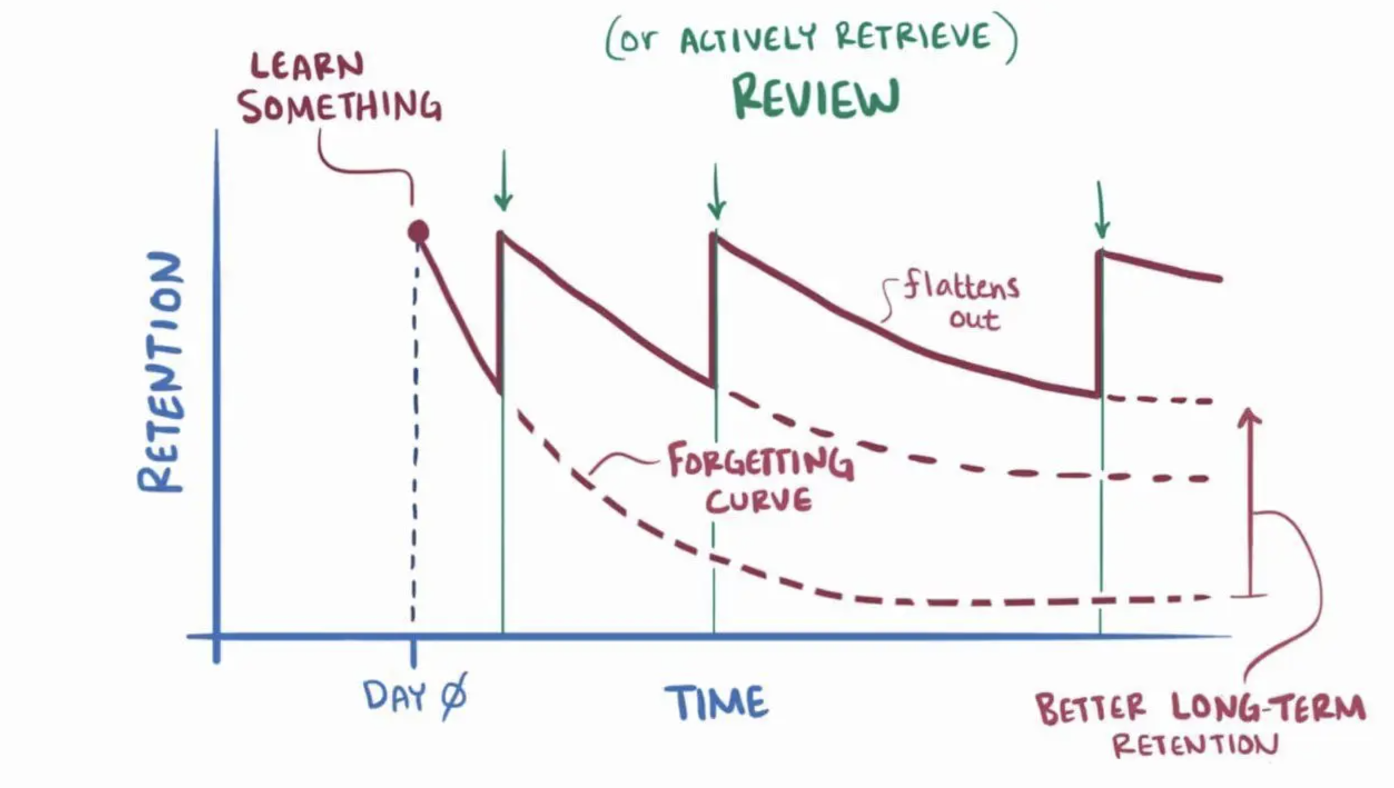
MEMORY CAPACITY

Slide 44
TRAINING LOCATION
There is evidence showing that information retention for all neurotypes is also affected by location
Employees are more likely to remember information in the spot they learned that information
This means that procedures should be taught in the spot they will be used

Slide 45
A RESOURCE TO APPLY TO YOUR TRAININGS
We created a checklist for you to discuss with your employees and apply to your trainings.

Slide 46
SUMMARY
Ergonomics can help you on your job
WMSDs can happen in jobs with risk factors
Risk factors can be reduced and WMSDs prevented
Reporting signs and symptoms early is important
You can help your company put ergonomics changes into place

Slide 47
SUMMARY
Remember all considerations and accommodations supporting a diverse workforce
When creating trainings, remember to consider the needs of all your employees to improve retention

Slide 48

Thank You – stay safe and healthy!
Incompass Michigan remains committed to being a trusted resource for getting connected and staying informed.

Slide 49
RESOURCE CITATIONS
MIOSHA, Fact Sheet #001 – Ergonomics: Rev. 3/15/23
OSHA, Ergonomics: https://www.osha.gov/ergonomics

Slide 50
RESOURCE CITATIONS
Honeybourne, Victoria. (2020). The Neurodiverse Workplace: An Employer’s Guide to Managing and Working with Neurodivergent Employees, Clients and Customers. Jessica Kingsley Publishers: London & Philadelphia, PA.
Praslova, Ludmila N. (2024). The Canary Code: A Guide to Neurodiversity, Dignity, And Intersectional Belonging At Work. Berrett-Koehler Publishers, Inc.: Oakland, CA.
Thompson, E. (2023) A Hidden Force: Unlocking the Potential of Neurodiversity at Work. Fast Company Press: New York.
https://www.cnsnevada.com/what-is-the-memory-capacity-of-a-human-brain/
NEUROINCLUSIVE LEARNING QUICK START PACKET BY TRACEY KING

Slide 51
Schedule a free training with us!
Contact us if you wish to have Todd and Katie conduct a free training!
Let us know the following information
  Date, time and length of training
  Desired training content
  How many attendees will be at this training
Katie Kinde – kkinde@incompassmi.org

Slide 52
INTOUCH SAFETY
Training Project in Partnership with MIOSHA CET Division
This material was prepared under a Consultation Education and Training (CET) Grant, awarded by the Michigan Occupational Safety and Health Administration (MIOSHA).
MIOSHA is a part of the Department of Labor and Economic Opportunity (LEO).
Points of view or opinions stated in this document do not necessarily reflect the view or policies of LEO.

Slide 53
Thanks for Joining
Stick around to ask questions

