Slide 1
SAFETY INCLUDED
Workplace Health and Safety
Series

Slide 2

Safety Included
Bloodborne Pathogens
Presenters: Todd Culver, President and CEO and Katie Kinde Education Coordinator,
Incompass Michigan

Slide 3
SAFETY INCLUDED
Training Project in Partnership with MIOSHA CET Division
This material was prepared under a Consultation Education and Training (CET) Grant, awarded by the Michigan Occupational Safety and Health Administration (MIOSHA).
MIOSHA is a part of the Department of Labor and Economic Opportunity (LEO).
Points of view or opinions stated in this document do not necessarily reflect the view or policies of LEO.

Slide 4
ABOUT YOUR PRESENTERS:
Todd Culver
Todd provides leadership in developing programs, strategic initiatives, and financial plans, in accordance with the purpose, vision and values of the association.
He has been with the Association since 1995, also serving as Project Director and Assistant Director.
As Project Director, lead a technical assistance and training project, focusing on Occupational Health and Safety for member organizations.
Prior to coming to Incompass, Todd worked in manufacturing for an automotive supplier, with plant management responsibilities that included environmental health and safety compliance

Slide 5
ABOUT YOUR PRESENTERS:
Katie Kinde
Katie is a 35 year old Autistic self advocate, who loves learning and helping others learn. Katie graduated with a Masters in Education with a focus in Learning Design and Technology in 2021 from Wayne State University.
She currently works for Incompass Michigan as the Education Coordinator, creating trainings, coordinating events, and handling certificate distribution.
Katie has completed multiple Leadership programs in 2023-4, and has presented multiple times about Autism in the workplace.
She became a co-leader in 2024 for the Michigan Advocates to End Seclusion and Restraint, and is now on the EndSAR Board.
In her spare time, she loves gardening and gives free plants away to neighbors. She also loves playing videogames with her husband Andrew, walking her rescue yorkie Agro, making jewelry, drawing, and creating miniature houses.

Slide 6
ABOUT THE CONTENT
Inclusivity is very important to us
This presentation is made with all needs in mind. We try to avoid using too many colors and pictures, and when we do, we describe them for low vision users
Handouts are available on a shared drive, link will be posted in the chat

Slide 7
Safety Included 2026
OSHA’s recommended practices for safety and health programs present a step-by-step approach to implementing a safety and health program, built around seven core elements that make up a successful program.
The main goal of safety and health programs is to prevent workplace injuries, illnesses, and deaths, as well as the suffering and financial hardship these events can cause for workers, their families, and employers.

Slide 8
Safety Included 2026
The recommended practices use a proactive approach to managing workplace safety and health.
Traditional approaches are often reactive – problems are addressed only after a worker is injured or becomes sick, a new standard or regulation is published, or an outside inspection finds a problem that must be fixed.
These recommended practices recognize that finding and fixing hazards before they cause injury or illness is a far more effective approach.

Slide 9
Safety Included 2026
The most rigorous preventive safety program takes the view that there is ALWAYS something about an incident leading to injury that could have been different.
Accidents don’t “just happen.”
It is incumbent upon us to continuously assess the landscape to identify the potential for a problem, and fix it before one occurs.
That’s what this presentation is all about, providing a framework for effective safety programs that promote prevention.

Slide 10
Safety Included 2026
Clear, structured visuals and graphics to support comprehension
Minimized sensory distractions in both virtual and in-person settings
Options for verbal and non-verbal participation
Interactive components that promote engagement without overwhelming
Time-buffered schedules to allow for processing and reflection

Slide 11
A SAFE WORKPLACE IS SOUND BUSINESS –
FOR EVERYBODY REGARDLESS OF NEUROTYPE

Slide 12
Safety Included 2026
Bloodborne Pathogens – Training Objectives
The MIOSHA Standard
  Employer responsibilities and requirements
Definitions
The diseases these pathogens can cause
Risky situations
  Job tasks and categories
How to protect yourself

Slide 13
Safety Included 2026
Bloodborne Pathogens – Training Objectives
Employee Training Considerations for Employers
  Building Trust
  Emergencies
  Sensory Overload and Sensitivities
  Verbal vs Non-Verbal
  Clear Signs
  Proprioception
  Time Buffered Schedules and Memory Capacity
  Training Locations
Using SafetyIncluded Resources

Slide 14
Part 554. Bloodborne Infectious Diseases
Exposure Determination:
An employer shall evaluate routine and reasonably anticipated tasks and procedures to determine whether there is actual or reasonably anticipated employee exposure to blood or other potentially infectious material.
Maintain a list of those job categories where there may be exposure

Slide 15
Part 554. Bloodborne Infectious Diseases
Training:
Required for all who face exposure as part of their job duties
At no cost, and during working hours
At the time of initial assignment, with annual refresher
At appropriate levels to promote employee understanding and safety

Slide 16
Definitions
BLOODBORNE PATHOGENS: pathogenic microorganisms present in human blood
  Including Hepatitis B, HIV, and Hepatitis C
CONTAMINATED: presence (or reasonably anticipated presence) of blood or other potentially infectious materials
Notes:
Germ, virus, bacteria – something that can make you sick; carried or transmitted in human blood; but transmission can only occur if contact occurs in certain ways

Slide 17
Other Potentially Infectious Materials (OPIM)
Materials Included
*NOT included
Semen
Vaginal secretions
Amniotic fluid
Synovial fluid
Saliva in dental procedures
Vomit
Urine
Feces
Sweat
Tears
Spit
* Unless visibly contaminated with blood or OPIM

Slide 18
Potential Exposures – Risky Situations
Contact with non-intact skin
  Rendering first aid without protective equipment, provider has cut, sore, or scratch
Through mucous membranes – eyes, nose, mouth
  Blood splash, or accidental secondary contact with contaminated gloved hands and face
Wound from contaminated sharp object
  Dirty needle, broken glass

Slide 19
Potential Exposures – Risky Situations
Appendix to MIOSHA Standard
Health Care Personnel (Doctors & Nurses, Dentists & Dental Care Workers)
Housekeepers, Janitors, Maintenance Workers

Slide 20
Signs and Symptoms
Hepatitis B - symptoms of HBV are mild and flu-like.
  Fatigue, stomach pain, loss of appetite, and nausea.
  Further progression can lead to jaundice (yellowing of the eyes and skin), and a darkened urine can occur. However, individuals infected with HBV will often show no symptoms for some time.

Slide 21
Signs and Symptoms
Hepatitis C - HCV can be symptomatic or result in mild illness.
  If symptoms do occur, one out of five may experience jaundice, dark urine, or flu-like symptoms.
  After acute infection, up to 1/4 of persons appear to resolve their infection without treatment.

Slide 22
Signs and Symptoms
Hepatitis C -
Regardless of how the HCV infection is resolved, it does not provide immunity to reinfection. Chronic HCV infection develops in the remaining 75%-85% of persons infected, with chronic liver disease developing in 70% of cases.
  Extreme fatigue is a very common symptom in persons with chronic hepatitis C.

Slide 23
Signs and Symptoms
Human Immunodeficiency Virus – Can be asymptomatic or mild illness.
  People may not have any symptoms when first infected.
  Within a month or two after exposure to the virus, flu-like symptoms may include: fever, headache, fatigue, enlarged lymph nodes.

Slide 24
Signs and Symptoms
Human Immunodeficiency Virus – Other symptoms often experienced months to years before the onset of AIDS include:
    Lack of energy
    Weight loss
    Frequent fevers and sweats
    Persistent skin rashes or flaky skin

Slide 25
Hepatitis B Vaccine
The number of new infections has declined dramatically in recent years, primarily due to routine vaccination
3 shots, administered over 6 months
  2 shot option for different brand, about one month apart
Centers for Disease Control and Prevention (CDC) recommends vaccination for everyone under 18 years old, and any adult who is at risk
A federal advisory panel recently voted to change longstanding universal Hep B vaccination guidelines, but the official CDC guidelines have not changed

Slide 26
Hepatitis B Vaccine
MIOSHA Requirement
Within 10 working days of the time of initial assignment… an employer shall make the hepatitis B vaccination available to each employee at risk of exposure

Slide 27
Hepatitis B Vaccine
If an employee initially declines, but later decides to accept, the employer shall provide the vaccine at that time

Slide 28
Hepatitis B Vaccine
First Aid Responder option
  May postpone offering if primary job assignment is not rendering first aid – only collateral duty
  Must be offered within 24 hours of event where responder renders assistance in any situation involving the presence of blood or OPIM

Slide 29
Universal Precautions
BE CAREFUL ALL THE TIME
Assume all human blood and body fluids are infectious
Whether treating an injury, or conducting a cleanup, use Universal Precautions before you get involved
Take the necessary steps to make sure potential infectious material doesn’t get in you, and doesn’t get on you

Slide 30
Personal Protective Equipment
Single use gloves – latex, nitrile, or vinyl
CPR masks
Eye protection, surgical masks, gowns / protective clothing

Slide 31
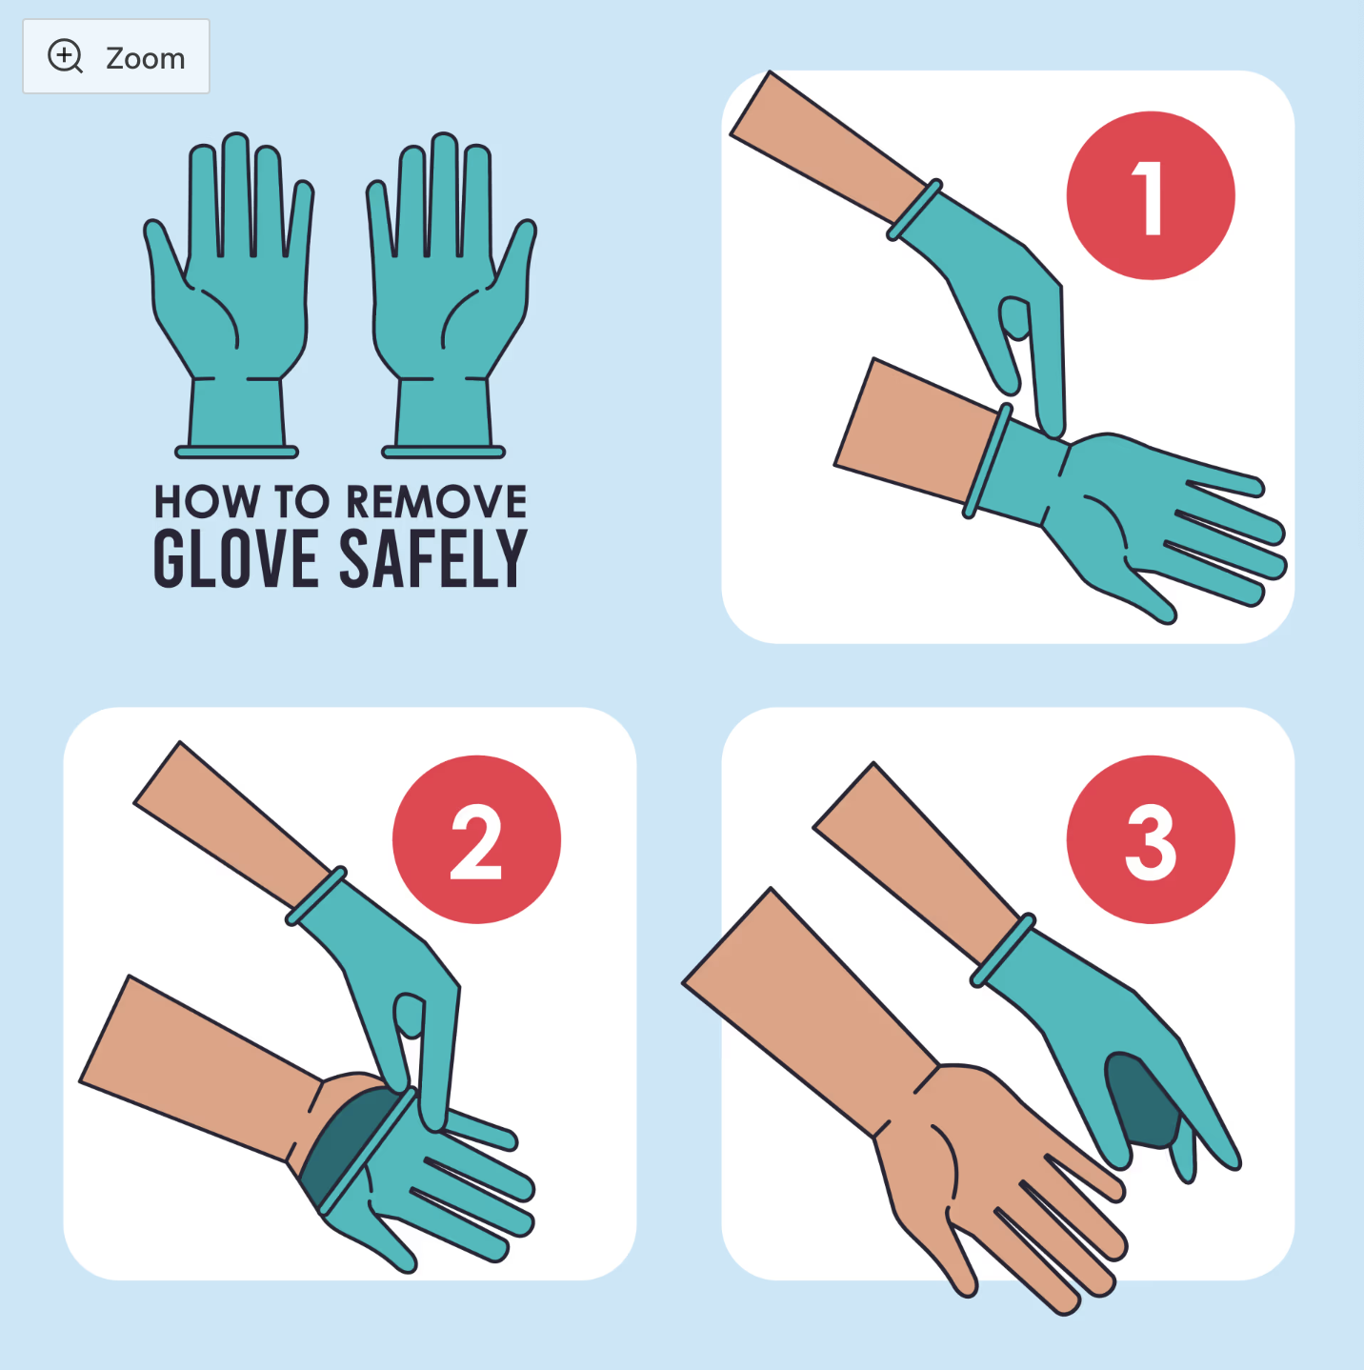
Glove Removal
Grasp the outside glove with the opposite gloved hand

Slide 32
Glove Removal
Pull off the glove, away from your body, turn it inside out

Slide 33
Glove Removal
Hold the removed glove in the gloved hand
Slide your fingers underneath the gloved hand and peel the second glove over the first glove

Slide 34
Remove PPE and Wash Hands
Properly dispose of single-use gloves
Turn items inside out, place in designated containers
Wash any contaminated clothing
Wash hands and any other exposed skin with soap and water
  Waterless disinfectants and alcohol wipes can be effective as well

Slide 35
Cleanup Procedures
Wear Personal Protective Equipment
Bleach/water solution (1:10 ratio) or EPA-registered disinfectant
Use tongs, or brush and dust pan to pick up broken glass – not hands

Slide 36


Regulated Waste Disposal
Includes liquid or semiliquid blood or OPIM, along with other contaminated items
Dispose by placing in closeable biohazard or red-colored container

Slide 37
Exposure Control Plan
Exposure Determination (who’s at risk)
Hepatitis Vaccine Policy (options for employees and employers)
Control methods (universal precautions, PPE, hand washing, needle and waste disposal)
Post-exposure Evaluation (reporting requirements, immediate treatment, and ongoing follow-up)
Training (initial and annual refresher)
Recordkeeping (medical, training, Sharps Log)

Slide 38
How to Train Effectively
Each person, regardless of neurotype, has a preferred learning method
The following is meant to help employers improve training methods for better outcomes

Slide 39
CONSIDERATIONS FOR NEURODIVERSE EMPLOYEES
Employees of different neurotypes may have different needs to consider, talking to employees directly about their preferences is the best way to ensure learning needs are met
Gain trust by asking for consent to ask neurodivergent employees ways on improving trainings

Slide 40
CONSIDERATIONS FOR NEURODIVERSE EMPLOYEES
Create a trusting relationship so that in times of stress, like injury or spillage of bodily fluid, employees can go to employers without fear. Neurodiverse employees can have anxiety so be patient
  Speak concise and in a neutral tone

Slide 41
CONSIDERATIONS FOR NEURODIVERSE EMPLOYEES
Some employees may need additional support and freedom to ask questions to better understand. It is important to forge this trust early on
  Treat questions with respect so that employees do not fear being ridiculed in the future

Slide 42
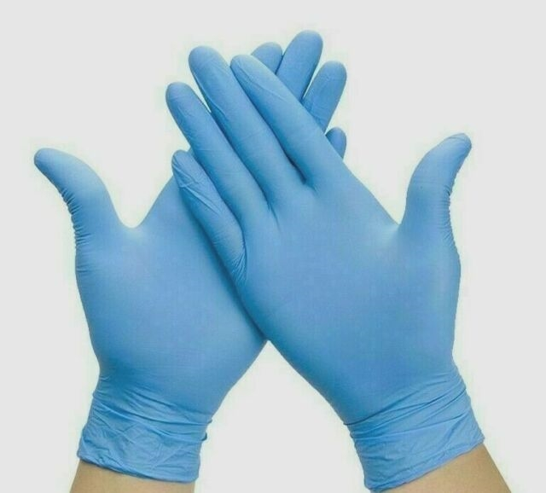
CONSIDERATIONS FOR NEURODIVERSE EMPLOYEES
Examples of conversation during a training:
"What type of gloves are these?"
  "They are medical grade gloves, and they can be used for first aid and cleanup."
"Well... I mean, are they latex free?"
  Manager reads the box: "Basic SynGuard Nitrile Examination Gloves are powder-free, medical-grade, and latex-free"

Slide 43
CONSIDERATIONS FOR NEURODIVERSE EMPLOYEES
"Why do we get blue gloves?"
  "I am not sure, it's just the ones that we order."
"What sizes do we have?"
  "We have small, medium, and large."
"Can we get other colors?"
  "I am not sure. I may have to get back with you on that."
"Can I bring in my own gloves?"
  "It's company policy to use the gloves provided, which will help keep you safe. They are designed to to be appropriate for the job we must do."

Slide 44
CONSIDERATIONS FOR NEURODIVERSE EMPLOYEES
"What if the glove box is empty?"
  "You can talk to Stacey, she has the key to the supply closet, and can get more gloves."
"What if Stacey is not here that day, or busy?"
  "Let me know, I can also unlock that closet too, but it's Staceys job to do it."
"In my last job, someone stole all my gloves. What if someone takes the box of gloves?"
  "That is highly unlikely here, but if you suspect this is happening please let me know right away."

Slide 45
UNIVERSAL DESIGN METHODS
Universal design allows educators and learners to set clear goals, anticipate environmental barriers, create meaningful options, and fully embrace human variability
Having multiple methods to learn safety ensures that everyone has the resources they need to learn processes, regardless of neurotype
Consider making step by step documents, signs, videos, and plan on showing processes in person
This way, everyone can have multiple options to learn the same information

Slide 46
CONSIDERATIONS FOR NEURODIVERSE EMPLOYEES
For neurodivergent employees, handling workplace emergencies involves a combination of pre-established strategies and on-the-spot adaptations, such as developing clear, written emergency plans, minimizing sensory overload, and creating a support system with clear communication channels
Consider creating a personal emergency checklist between the employee and manager

Slide 47
CONSIDERATIONS FOR NEURODIVERSE EMPLOYEES
Another tip, there should be easy to access information for employees to contact supervisors during an emergency.
That means multiple forms of the same information, accessible to everyone.

Slide 48
CONSIDERATIONS FOR NEURODIVERSE EMPLOYEES
Consider:
  Giving a direct phone number for the employee to put in their cellphone
  A business card sized reminder for their wallet that says "in case of emergencies call ***"
  A card that can fit in the employees name badge or lanyard with contact information
  A sign or "what to do" binder in the workspace where hazards are, that has information on how to contact someone in an emergency
  If the employee has a close coworker, consider having them be a emergency buddy in case your neurodivergent employee may go non-verbal

Slide 49
CONSIDERATIONS FOR NEURODIVERSE EMPLOYEES
An emergency buddy –
  May be called something else, but the main goal is to ensure there is a trustworthy coworker for a neurodivergent employee in times of an emergency who can guide them during moments they are overwhelmed.

Slide 50
SENSORY OVERLOAD
Sensory overload -
Sensory overload is a state where the brain receives too much sensory input to process, leading to symptoms like anxiety, irritability, confusion, and physical discomfort. It can be triggered by common stimuli such as loud noises, bright lights, strong smells, and crowded spaces, but also by emotional stress, physical fatigue, or environmental changes

Slide 51
SENSORY OVERLOAD
Sensory overload -
During sensory overload, information is less likely to be retained, this leads to an unsuccessful training
Recognizing triggers and using strategies like reducing exposure to stimuli, using sensory aids, or finding quiet spaces can help manage it

Slide 52
CONSIDERATIONS FOR NEURODIVERSE EMPLOYEES
Consider ways to ensure neurodiverse people are comfortable when training to ensure information is more easily retained
Sensitivities -
Especially when it comes to employees with Autism, they made be extra sensitive to loud noises or bright lights

Slide 53
CONSIDERATIONS FOR NEURODIVERSE EMPLOYEES
Consider their needs. Converse and ask if any changes to the environment could help their learning experience and prevent sensory overload
  Some items that can be offered:
    white noise machines,
    access to white noise music,
    tinted glasses,
    headphones

Slide 54
CONSIDERATIONS FOR NEURODIVERSE EMPLOYEES
Auditory and visual considerations
  Ensure that your trainings are accessible. Neurodiverse people are prone to co-morbidities
  Visually, you should have large text and describe images or steps for anyone with low vision
  When speaking, ensure that you are using a microphone if anyone with low hearing

Slide 55
CONSIDERATIONS FOR NEURODIVERSE EMPLOYEES
Consider sensitivities to scents -
  For those who are sensitive to scents, cleaning materials may be overwhelming
  There are ways to manage these scents personally and environmentally

Slide 56
CONSIDERATIONS FOR NEURODIVERSE EMPLOYEES
For Employee Personal Management
  Masking: Dab Vicks VapoRub, lavender, peppermint oil, or even toothpaste/chapstick under employees nose or inside their mask.
  Breathing: Breathe through mouth or take shallow breaths; try humming to block smells.
  Scented Items: Keep minty gum, strong mints, or Listerine strips handy.
  Essential Oils: Use a badge reel with a felt pad soaked in lemon or peppermint oil for personal scent relief.
  Hygiene: Wear clean uniforms and socks daily to avoid carrying odors.
  Quick Breaks: Step away for fresh air if overwhelmed.

Slide 57
CONSIDERATIONS FOR NEURODIVERSE EMPLOYEES
For Environmental Management
  Source Control: Cleanliness is key; remove soiled linens and clean surfaces.
  Odor Absorbers: Place coffee grounds, charcoal, or baking soda in bowls around the room.
  Enzymatic Cleaners: Use products like Nature's Miracle to neutralize odors at their source (bacteria).
  Air Fresheners/Diffusers: Use hospital-approved, hypoallergenic room sprays or diffusers, or even patient-controlled ones.
  Ventilation: Ensure proper air circulation, using fans or opening windows when possible.

Slide 58
CONSIDERATIONS FOR NEURODIVERSE EMPLOYEES
Consider Tactile sensitivities -
  For those who are sensitive to the feel of latex, soft thin silk or cotton gloves can be used underneath normal gloves
  For those who do not like the feeling of normal masks:
    Material Matters: Choose soft, breathable fabrics like cotton or silk liners.
    Reduce Pressure: Use "ear savers" or hats to place straps over, not on, the ears.
    Adjustable & Secure: Look for toggles or velcro to customize the fit and reduce tightness.

Slide 59
CONSIDERATIONS FOR NEURODIVERSE EMPLOYEES
PPE – employees of all neurotypes may have these issues, however, neurodiverse ones are more prone.
Consider:
  Skin allergies to latex – Have accessible hypoallergenic gloves

Slide 60
CONSIDERATIONS FOR NEURODIVERSE EMPLOYEES
Consider proximity comfort/consent. This should be discussed for every day interactions beyond trainings.
Even something as simple as placing a hand on an employees shoulder may be extremely uncomfortable to a neurodivergent employee.
Always ask for consent.

Slide 61
CONSIDERATIONS FOR NEURODIVERSE EMPLOYEES
For example, during an interactive in-person training on glove disposal, a trainer may need to hold their hands up close to a neurodivergent employee to show each step of glove removal.
Trainers should ask if it's alright to be up close before showing each step.
Also, let the employee learn by removing their own pair of gloves.

Slide 62
VERBAL AND NON-VERBAL
Consider some employees may prefer verbal or non-verbal communication
Non-Verbal -
  isn't just about not talking; it's about using diverse communication methods (gestures, visuals,) beyond speech, facing sensory challenges, processing language differently (literal, not nuanced)

Slide 63
VERBAL AND NON-VERBAL
Sometimes certain neurotypes may need to "go nonverbal" (shut down) due to overwhelm, requiring patience and clear, direct communication, respecting their cues, and understanding their unique sensory/processing needs to bridge gaps
Communication before a shutdown is essential for preparing for these moments

Slide 64

VERBAL AND NON-VERBAL
Though not required, some employees may even prefer having signs on their door or on their name badge that show their current availability verbally
  Color coding can be helpful

Slide 65
VERBAL AND NON-VERBAL
Make sure when you make trainings that they are also clear
Examples to follow

Slide 66
EXAMPLE UNCLEAR
Imagine a notice that says the following:
Due to new ordinance 3.7 of the safety committee, we must all be cautious of sharp materials and follow emergency procedures.
Immediate First Aid (Do First!)
Wash the Wound: Use soap and water to thoroughly wash any cuts or needle sticks for 10-15 minutes.
Encourage Bleeding: Gently squeeze the puncture site to help it bleed, but don't scrub aggressively.
Flush Mucous Membranes: If splashed in the eyes, nose, or mouth, flush thoroughly with clean water or saline for several minutes.
Next Steps (Seek Care Immediately)
Seek Medical Attention: Go to the nearest emergency room or your workplace's occupational health department without delay.
Report the Incident: Tell your supervisor and complete an incident report, detailing the circumstances and the source of the sharp (if known).
Get Medical Evaluation: A healthcare provider will assess your risk, possibly test you and the source, and provide guidance on treatments like PEP (Post-Exposure Prophylaxis) for HIV or Hepatitis B vaccination/immunoglobulin.
SAFETY NOTICE – PLEASE REVIEW
Due to new ordinance 3.7 of the safety committee, all objects contaminated by biohazard materials must go into these bins located in every room.
Immediate First Aid (Do First!)
Wash the Wound: Use soap and water to thoroughly wash any cuts or needle sticks for 10-15 minutes.
Encourage Bleeding: Gently squeeze the puncture site to help it bleed, but don't scrub aggressively.
Flush Mucous Membranes: If splashed in the eyes, nose, or mouth, flush thoroughly with clean water or saline for several minutes.
Next Steps (Seek Care Immediately)
Seek Medical Attention: Go to the nearest emergency room or your workplace's occupational health department without delay.
Report the Incident: Tell your supervisor and complete an incident report, detailing the circumstances and the source of the sharp (if known).
Get Medical Evaluation: A healthcare provider will assess your risk, possibly test you and the source, and provide guidance on treatments like PEP (Post-Exposure Prophylaxis) for HIV or Hepatitis B vaccination/immunoglobulin.

Slide 67

EXAMPLE CLEAR VISUALS AND DESCRIPTIONS
The last slide was too wordy especially for an emergency
Injury management should be first and foremost. A first aid kit should be nearby, have a sign showing where it is
Next to the biohazard box should be an informational packet with pictures and steps on what goes in the box, how to fill the box with waste, and even a QR code to a video
There should also be refresher trainings in-person to ensure everyone knows what to do

Slide 68
CONSIDERATIONS FOR NEURODIVERSE EMPLOYEES
Propioception: awareness of ones body
  You should also consider an employees propioception as some neurotypes do not perceive themselves well, especially if they are hyperfocused
  They may work themselves too hard physically without even realizing until after a task is done
  Ensure if an employee has poor propioception that they take extra precautions when working with sharp objects
Be proactive with reminders of self – Todd reminds me a lot!

Slide 69
CONSIDERATIONS FOR NEURODIVERSE EMPLOYEES
Propioception: awareness of ones body
Another consideration, if your employee is prone to touching their eyes, you may want to have them use safety glasses.

Slide 70
TIME BUFFERED SCHEDULES
Time-buffered schedules to allow for processing and reflection, for all neurotypes
Consider having breaks during long trainings, or breaks in video trainings

Slide 71
MEMORY CAPACITY
Even after all you can do to make a training, consider everyones' memory capacity
On average, it is estimated 50% of what is learned, is immediately forgotten
Spaced Learning helps retain what is taught

Slide 72
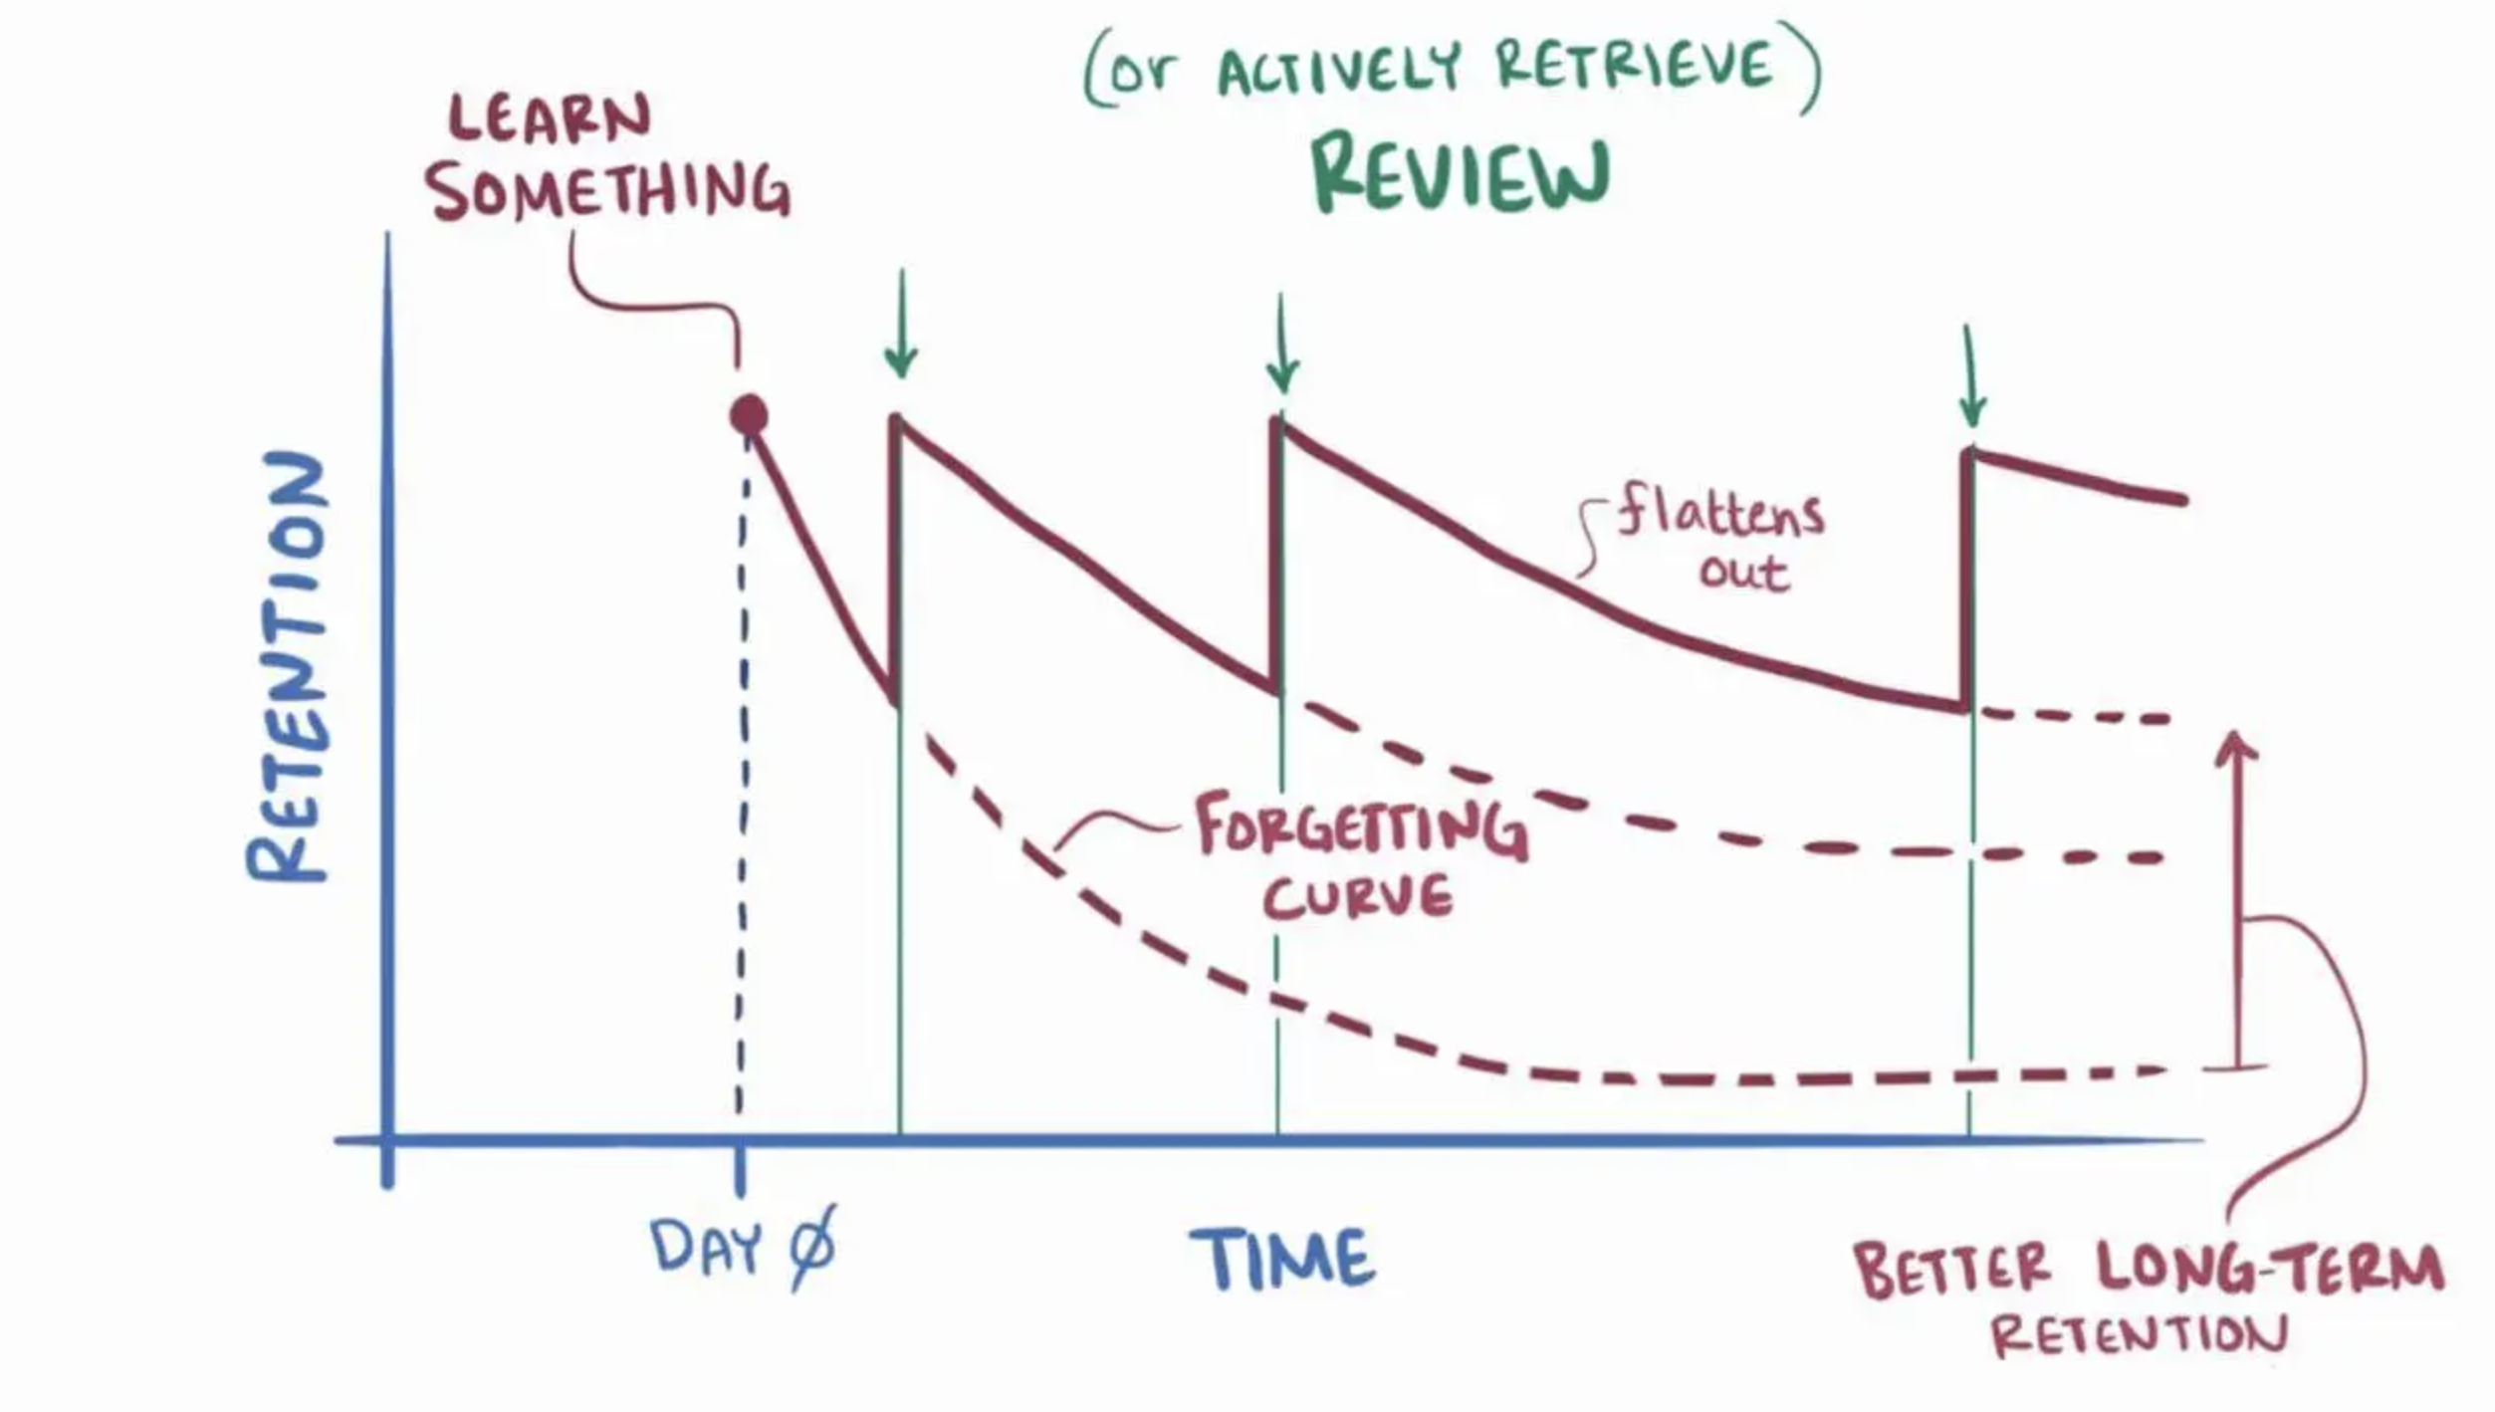
MEMORY CAPACITY

Slide 73
TRAINING LOCATION
There is evidence showing that information retention for all neurotypes is also affected by location
Employees are more likely to remember information in the spot they learned that information
This means that procedures should be taught in the spot they will be used
If you are going over emergency procedures, teach them in the place an emergency might happen

Slide 74
WHAT CAN YOU APPLY TO YOUR TRAININGS?
How can you improve your safety training?
We created a checklist for you to discuss with your employees, and apply to your trainings.

Slide 75
WHAT CAN YOU APPLY TO YOUR TRAININGS?
After seeing all this information, do you have any specific from this training you wish to apply to your own trainings?

Slide 76

Thank You – stay safe and healthy!
Incompass Michigan remains committed to being a trusted resource for getting connected and staying informed.

Slide 77
Questions?

Slide 78
RESOURCE CITATIONS
MIOSHA General Industry Standard, “Part 554, Bloodborne Infectious Diseases”
MIOSHA Fact Sheet, “G-004, Bloodborne Infectious Diseases”
MIOSHA CET-5230, “Sample Bloodborne Infectious Diseases Exposure Control Plan for Employers with Limited Employee Exposure”
Centers for Disease Control and Prevention, “DHHS (NIOSH) Publication Number 2007-157, Bloodborne Pathogen Exposure”
  https://www.cdc.gov/niosh/docs/2007-157/default.html

Slide 79
RESOURCE CITATIONS
Honeybourne, Victoria. (2020). The Neurodiverse Workplace: An Employer’s Guide to Managing and Working with Neurodivergent Employees, Clients and Customers. Jessica Kingsley Publishers: London & Philadelphia, PA.
Praslova, Ludmila N. (2024). The Canary Code: A Guide to Neurodiversity, Dignity, And Intersectional Belonging At Work. Berrett-Koehler Publishers, Inc.: Oakland, CA.
Thompson, E. (2023) A Hidden Force: Unlocking the Potential of Neurodiversity at Work. Fast Company Press: New York.
https://www.cnsnevada.com/what-is-the-memory-capacity-of-a-human-brain/
https://www.cdc.gov/infection-control/media/pdfs/Sharps-Safety-Workbook-2008-P.pdf
https://i.etsystatic.com/33167966/r/il/298c4a/4994626697/il_1588xN.4994626697_loxe.jpg
NEUROINCLUSIVE LEARNING QUICK START PACKET BY TRACEY KING

Slide 80
INTOUCH SAFETY
Training Project in Partnership with MIOSHA CET Division
This material was prepared under a Consultation Education and Training (CET) Grant, awarded by the Michigan Occupational Safety and Health Administration (MIOSHA).
MIOSHA is a part of the Department of Labor and Economic Opportunity (LEO).
Points of view or opinions stated in this document do not necessarily reflect the view or policies of LEO.

Slide 81
Schedule a free training with us!
Contact us if you wish to have Todd and Katie conduct a free training!
Let us know the following information
  Date, time and length of training
  Desired training content
  How many attendees will be at this training
Katie Kinde – kkinde@incompassmi.org

