Slide 1
SAFETY INCLUDED
Workplace Health and Safety
Series

Slide 2

Safety Included
Hearing Conservation
Presenters:
Todd Culver, President and CEO, Incompass Michigan
& Katie Kinde, Education Coordinator, Incompass Michigan

Slide 3
SAFETY INCLUDED
Training Project in Partnership with MIOSHA CET Division
This material was prepared under a Consultation Education and Training (CET) Grant, awarded by the Michigan Occupational Safety and Health Administration (MIOSHA).
MIOSHA is a part of the Department of Labor and Economic Opportunity (LEO).
Points of view or opinions stated in this document do not necessarily reflect the view or policies of LEO.

Slide 4
ABOUT YOUR PRESENTERS:
Todd Culver
Todd provides leadership in developing programs, strategic initiatives, and financial plans, in accordance with the purpose, vision and values of the association.
He has been with the Association since 1995, also serving as Project Director and Assistant Director.
As Project Director, lead a technical assistance and training project, focusing on Occupational Health and Safety for member organizations.
Prior to coming to Incompass, Todd worked in manufacturing for an automotive supplier, with plant management responsibilities that included environmental health and safety compliance

Slide 5
ABOUT YOUR PRESENTERS:
Katie Kinde
Katie is a 35 year old Autistic self advocate, who loves learning and helping others learn. Katie graduated with a Masters in Education with a focus in Learning Design and Technology in 2021 from Wayne State University.
She currently works for Incompass Michigan as the Education Coordinator, creating trainings, coordinating events, and handling certificate distribution.
Katie has completed multiple Leadership programs in 2023-4, and has presented multiple times about Autism in the workplace.
She became a co-leader in 2024 for the Michigan Advocates to End Seclusion and Restraint, and is now on the EndSAR Board.
In her spare time, she loves gardening and gives free plants away to neighbors. She also loves playing videogames with her husband Andrew, walking her rescue yorkie Agro, making jewelry, drawing, and creating miniature houses.

Slide 6
ABOUT THE CONTENT
Inclusivity is very important to us
This presentation is made with all needs in mind. We try to avoid using too many colors and pictures, and when we do, we describe them for low vision users
Handouts are available on a shared drive, link will be posted in the chat

Slide 7
Safety Included 2026
OSHA’s recommended practices for safety and health programs present a step-by-step approach to implementing a safety and health program, built around seven core elements that make up a successful program.
The main goal of safety and health programs is to prevent workplace injuries, illnesses, and deaths, as well as the suffering and financial hardship these events can cause for workers, their families, and employers.

Slide 8
Safety Included 2026
The recommended practices use a proactive approach to managing workplace safety and health.
Traditional approaches are often reactive – problems are addressed only after a worker is injured or becomes sick, a new standard or regulation is published, or an outside inspection finds a problem that must be fixed.
These recommended practices recognize that finding and fixing hazards before they cause injury or illness is a far more effective approach.

Slide 9
Safety Included 2026
The most rigorous preventive safety program takes the view that there is ALWAYS something about an incident leading to injury that could have been different.
Accidents don’t “just happen.”
It is incumbent upon us to continuously assess the landscape to identify the potential for a problem, and fix it before one occurs.
That’s what this presentation is all about, providing a framework for effective safety programs that promote prevention.

Slide 10
Safety Included 2026
Clear, structured visuals and graphics to support comprehension
Minimized sensory distractions in both virtual and in-person settings
Options for verbal and non-verbal participation
Interactive components that promote engagement without overwhelming
Time-buffered schedules to allow for processing and reflection

Slide 11
A SAFE WORKPLACE IS SOUND BUSINESS –
FOR EVERYBODY REGARDLESS OF NEUROTYPE

Slide 12
Hearing Conservation – Training Objectives
Noise Exposure
Noise Levels
Hearing Loss
MIOSHA Standard
Noise Monitoring
Audiometric Testing
Hearing Protection
General Accommodations

Slide 13
Hearing Conservation – Training Objectives
Employee Training Considerations for Employers
  Building Trust
  Sensory Overload and Sensitivities
  Verbal vs Non-Verbal
  Clear Signs
  Proprioception
  Time Buffered Schedules and Memory Capacity
  Training Locations
Using Safety Included Resources

Slide 14
Noise Exposure Levels
Your employer is responsible for determining the level of noise in the workplace, and identifying employees who are exposed to noise levels at or above 85 decibels averaged over a typical workday.
  This is called an 8-hour time-weighted average (TWA)
Noise is defined as “unwanted, excessive, or dangerous sound.”

Slide 15
Hearing Loss
If an employee is exposed to an excessive amount of noise, over a sustained period of time, there is a risk of hearing loss
Hearing loss occurs in the inner ear

Slide 16
Hearing Loss
Short exposure to excessive noise may cause temporary hearing loss, but if the exposure stops, hearing can return to normal
  This is called “bounce back”
However, if you are continually exposed to excessive noise, parts of the inner ear can be damaged permanently, resulting in permanent hearing loss

Slide 17
Warning Signs of Hearing Loss
Difficulty in hearing consonants such as “S” or ”T” in normal conversation
Difficulty in separating speech from background noise
Complaints from others that you are talking too loudly
Having to turn up the volume on TV or music
Difficulty hearing ringing phones or whistles
Difficulty hearing soft sounds, such as a child’s voice or rippling water
Constant ringing (tinnitus)

Slide 18
Noise in the Workplace – Two Types
Continuous
  Grinders, lathes, power equipment
Impulse
  Pneumatic/impact tools, explosives
Both types of noise can be harmful, depending on how loud it is, and how long you are exposed

Slide 19
Noise Exposure
There are three factors to keep in mind about noise exposure:
  Loudness
  Duration, or length of exposure
  Distance from the source of the noise

Slide 20
Noise Exposure
When you are exposed to high noise levels, serious and permanent damage can result
Although you may believe you are getting used to high noise levels, this usually means you are enduring hearing loss
If the noise level is loud enough that you have to “get used to it,” hearing protection is probably necessary

Slide 21
Rule of Thumb for Noise
If you must raise your voice to be heard in the workplace, noise levels should be evaluated to ensure excessive exposures are controlled

Slide 22
Noise Levels
Loudness is measure in decibels (dBA)
Some typical noise levels:
Whisper | 20 Decibels (dBA)
Normal conversation | 65
Kitchen blender | 85
Lawn mower | 95
Concert | 105
Aircraft takeoff | 145

Slide 23
MIOSHA Standard – Part 380. Occupational Noise Exposure
“Action level” means an 8-hour, time-weighted average noise exposure of 85 decibels
  Hearing Conservation Program
  Noise Monitoring
  Audiometric Testing
  Personal Protective Equipment
  Employee Training
  Recordkeeping

Slide 24
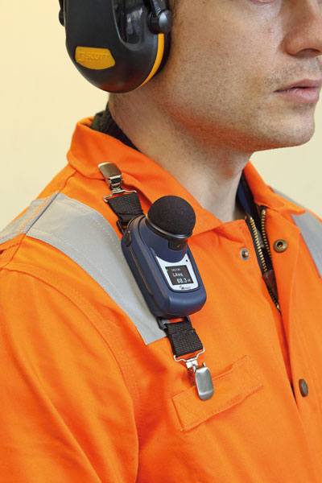
Noise Monitoring
Exposure is best determined using a noise dosimeter
Employee wears this device, which has a microphone that is usually worn on the shoulder
Dosimeter records the data and computes average noise exposure in dBA and the percent dose
Results are representative of the employee’s noise exposure

Slide 25
Noise Monitoring
MIOSHA Standard requires implementation of a hearing conservation program when an employee’s exposure meets or exceeds action level

Slide 26
Audiometric Testing
Monitors sharpness of your hearing
Baseline / Annual
Tests ability to hear various decibel levels
Given yearly to employees who are exposed to 85 dBA or higher over 8-hour TWA

Slide 27
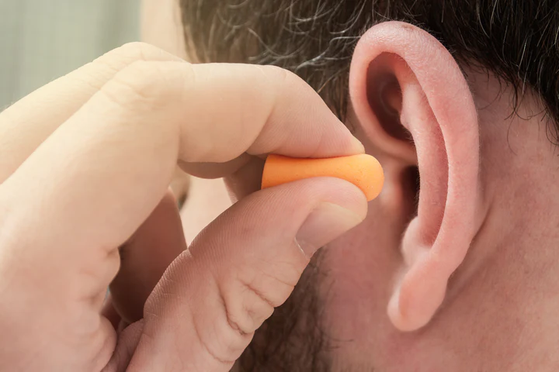
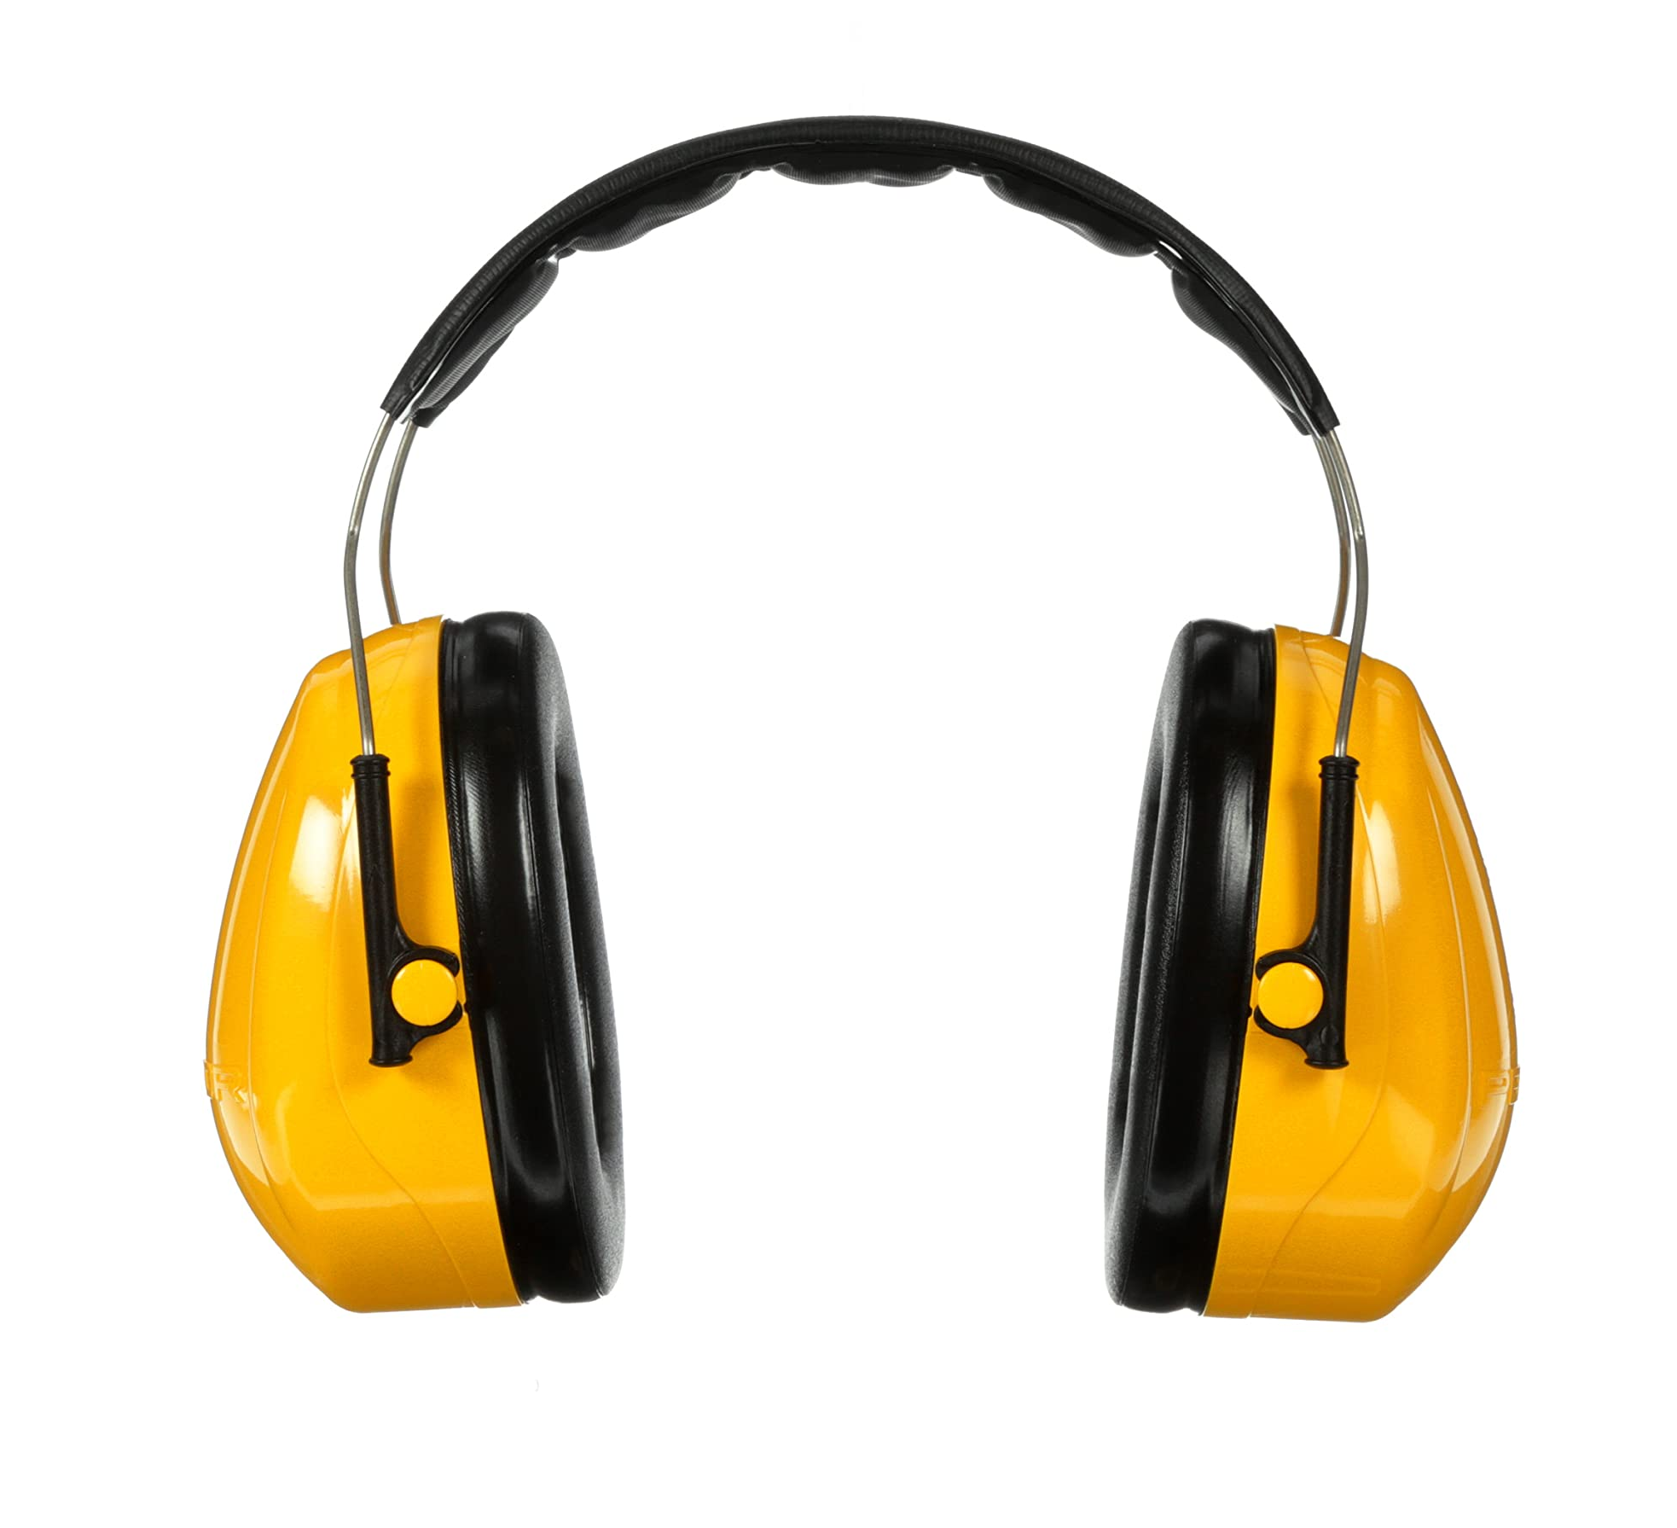
Hearing Protection
Two major types of hearing protection devices to reduce noise exposure:
  Earplugs
  Earmuffs

Slide 28
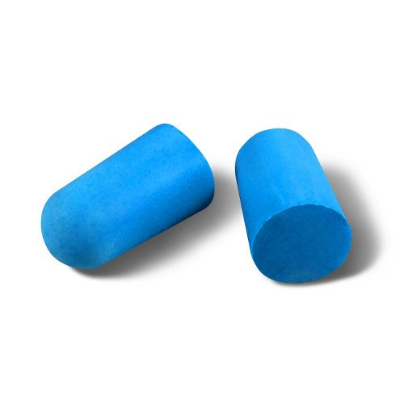
Hearing Protection
Earplugs fit into your ear canal, blocking excessive noise from reaching the inner ear and causing damage

Slide 29
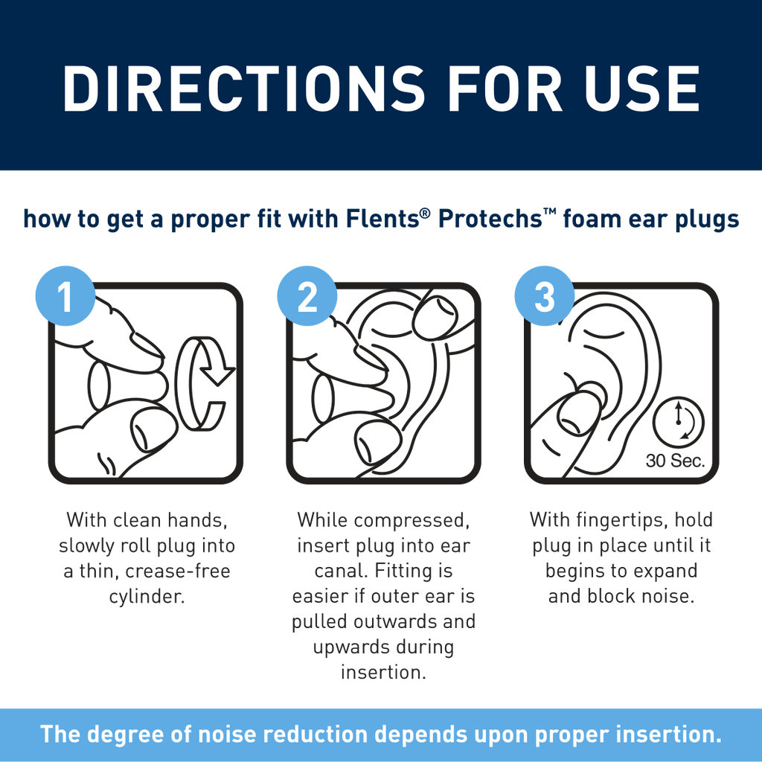
How to Use Foam Insert Earplugs
1. With clean hands, roll plug into small, crease-free cylinder between thumb and forefinger

Slide 30
How to Use Foam Insert Earplugs
2. With other hand, pull ear outward and upward to allow ear canal to open

Slide 31
How to Use Foam Insert Earplugs
3. Insert plug well into ear with fingertip, and hold in place to allow plug time to fully expand

Slide 32
Things to remember - earplugs
  Hands should be clean before inserting
  Must fit tightly in the ear canal
  Should be checked and adjusted throughout the workday
  Reusable earplugs should be cleaned with soap and water, then stored in their case
  Replace earplugs that show signs of wear

Slide 33
Hearing Protection
Earmuffs are worn over the ear, preventing excessive noise from entering ear canal

Slide 34
How to Use Earmuffs
Inspect inner linings for cracks, tear, or other signs of wear
Center earmuffs so that equal pressure is distributed around ears for tight seal

Slide 35
How to Use Earmuffs
Push aside hair and earrings to keep from interfering with seal
Make sure glasses/eye protection do not interfere with seal

Slide 36
Things to remember - earmuffs
  Seal should be checked and adjusted throughout the workday
  When finished, clean cushions with wet cloth
  Replace earmuffs that show signs of wear

Slide 37
Part 380. Occupational Noise Exposure
When employees are subjected to sound exceeding those listed in Table G-16. feasible administrative or engineering controls shall be utilized.
  If such controls fail to reduce sound levels within the levels of Table G-16, personal protective equipment shall be provided and used to reduce sound levels within the levels of the table.

Slide 38
Part 380. Occupational Noise Exposure
As it relates to noise exposure:
  Eliminate the hazard (identify substitute equipment that runs quieter)
  Contain the hazard (walls, curtains, baffles, preventing noise from reaching employees
  Last line of defense: PPE, earplugs or earmuffs

Slide 39
Accommodations
The following is meant to teach employers about accommodations for better outcomes for all employees of all neurotypes

Slide 40
Accommodations
Neurodivergent employees may have sensitive hearing, which if not accommodated, can lead to sensory overload
Loud or numerous noises can be distracting, sometimes even painful to those with sensitive hearing

Slide 41
Accommodations
For example, an office space of 20 employees may not seem loud
Those with hearing sensitivities may be able to pick up the conversations at every cubicle, hear the cars driving by outside, and coworkers typing on their keyboards all at once
This can be overwhelming when trying to focus on a task

Slide 42

Accommodations
A quiet safe space can help reduce sensory overload, but as an employer, your main goal should be prevention of sensory overload

Slide 43
Accommodations
Ear plugs or normal earmuffs may not be enough to help reduce sensory overload on their own
Employees who have sensitive hearing, may ask for noise cancelling headphones, which suppress ambient sounds using active noise control (ANC)
If requested, these will:
  Eliminate background noise
  Reduce sensory overload
  Improve productivity and focus

Slide 44
Accommodations
Headphones and earmuffs don't accommodate all employees
Bone conduction headphones send sound as vibrations through your cheekbones and jaw to your inner ear, bypassing the eardrum, which keeps your ears open to ambient sounds for increased situational awareness.
These headphones are comfortable for long periods, don't block the ear canal, and are a good option for those with certain hearing impairments, though bass quality can be lighter and sound leakage may occur at high volumes.

Slide 45
Accomodations
Communication with Headphones
The key is open dialogue to find what works for specific tasks and team dynamics, ask "What's the best way to get your attention when you're wearing headphones?"
  Set clear communication rules, using visual cues (like one headphone out) for availability
    Get their attention visually first (wave, knock) before speaking.
  establishing a headphone policy (when/where okay)
  using digital tools
  ensuring safety/volume limits

Slide 46
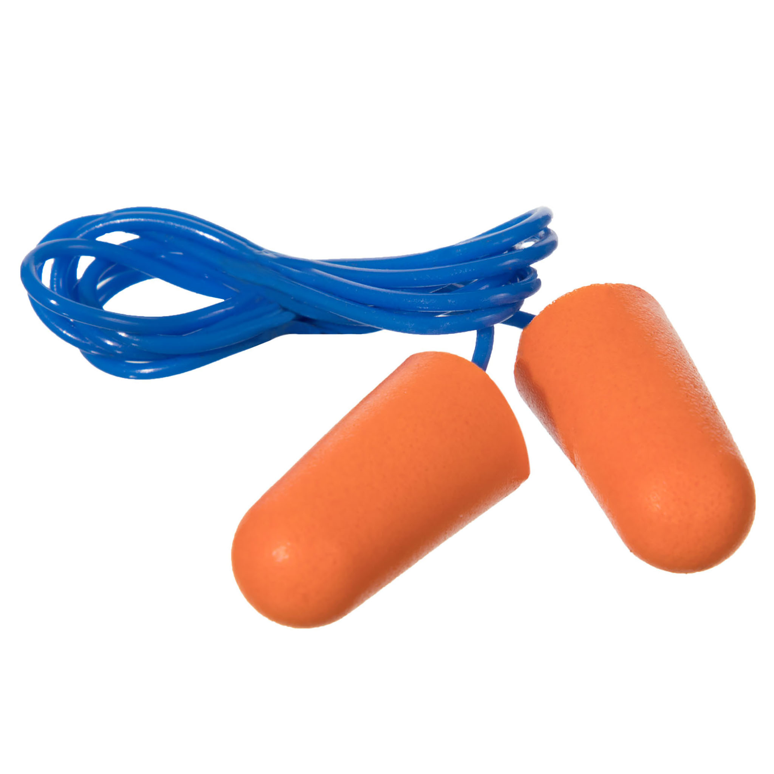
Accommodations
Consider earplugs with additional hardware
  Different shaped earplugs, such as surfers earplugs, etc.
  Earplugs with a cord
  A carrying case that can attach to employee for their earplugs

Slide 47
Accommodations
Hypoallergenic earplugs may be needed if an employee has skin conditions
Consider ones made from medical-grade silicone, soft synthetic rubber, or memory foam, that are suitable for sensitive skin
  Loop (silicone),
  Shush (synthetic rubber),
  Comply (foam) offering such options to prevent allergic reactions like contact dermatitis.

Slide 48
Accommodations
For a comprehensive database on potential accommodation alternatives, visit https://askjan.org/

Slide 49
How to Train Effectively
Each person, regardless of neurotype, has a preferred learning method
The following is meant to help employers improve training methods for better outcomes

Slide 50
CONSIDERATIONS FOR NEURODIVERSE EMPLOYEES
Employees of different neurotypes may have different needs to consider, talking to employees directly about their preferences is the best way to ensure learning needs are met
Gain trust by asking for consent to ask neurodivergent employees ways on improving trainings

Slide 51
CONSIDERATIONS FOR NEURODIVERSE EMPLOYEES
Create a trusting relationship so that in times of stress, like injury, employees can go to employers without fear. Neurodiverse employees can have anxiety so be patient
  Speak concise and in a neutral tone

Slide 52
CONSIDERATIONS FOR NEURODIVERSE EMPLOYEES
Some employees may need additional support and freedom to ask questions to better understand. It is important to forge this trust early on
  Treat questions with respect so that employees do not fear being ridiculed in the future

Slide 53
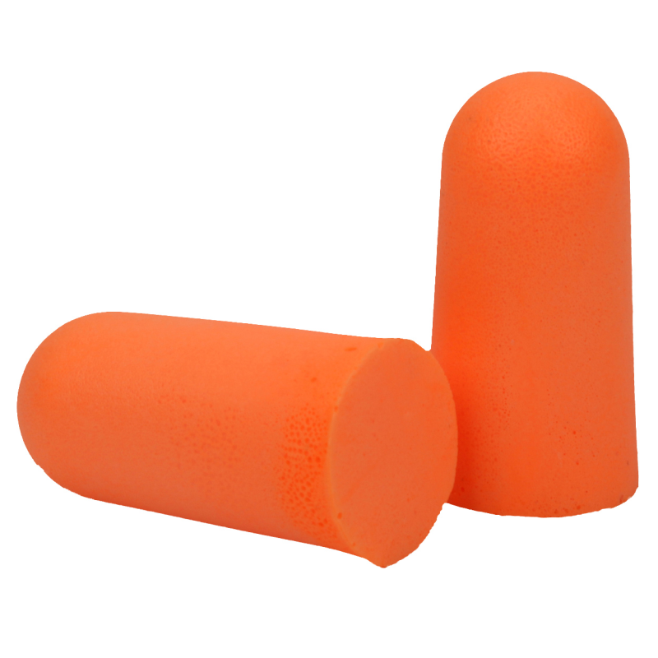
Conversation Example
Examples of conversation during a training:
"Why do we get orange earplugs?"
  "I am not sure; it's just the ones that we order."
"Can we get other colors?"
  "I am not sure. I may have to get back with you on that."
"Can I bring in my own?"
  "It's company policy to use the ones provided, which will help keep you safe. They are designed to be appropriate for the job we must do. If you need different ones, let's do some research."

Slide 54
Conversation Example
"What if the ear plug container is empty?"
  "You can talk to Stacey; she has the key to the supply closet and can get more."
"What if Stacey is not here that day, or busy?"
  "Let me know, I can also unlock that closet too, but it's Stacey's job to do it."
"In my last job, someone stole all the ear plugs. What if someone takes the box of ear plugs?"
  "That is highly unlikely here, but if you suspect this is happening, please let me know right away."

Slide 55
UNIVERSAL DESIGN METHODS
Universal design allows educators and learners to set clear goals, anticipate environmental barriers, create meaningful options, and fully embrace human variability
Having multiple methods to learn safety ensures that everyone has the resources they need to learn processes, regardless of neurotype
Consider making step by step documents, signs, videos, and plan on showing processes in person
This way, everyone can have multiple options to learn the same information

Slide 56
SENSORY OVERLOAD
Sensory overload -
Sensory overload is a state where the brain receives too much sensory input to process, leading to symptoms like anxiety, irritability, confusion, and physical discomfort. It can be triggered by common stimuli such as loud noises, bright lights, strong smells, and crowded spaces, but also by emotional stress, physical fatigue, or environmental changes

Slide 57
SENSORY OVERLOAD
Sensory overload -
During sensory overload, information is less likely to be retained, this leads to an unsuccessful training
Recognizing triggers and using strategies like reducing exposure to stimuli, using sensory aids, or finding quiet spaces can help manage it

Slide 58
CONSIDERATIONS FOR NEURODIVERSE EMPLOYEES
Consider ways to ensure neurodiverse people are comfortable when training to ensure information is more easily retained
Sensitivities -
Especially when it comes to employees with Autism, they made be extra sensitive to loud noises or bright lights

Slide 59
CONSIDERATIONS FOR NEURODIVERSE EMPLOYEES
Consider their needs. Converse and ask if any changes to the environment could help their learning experience and prevent sensory overload
  Some items that can be offered:
    white noise machines
    access to white noise music
    tinted glasses
    Headphones as stated earlier

Slide 60
CONSIDERATIONS FOR NEURODIVERSE EMPLOYEES
Auditory and visual considerations
  Ensure that your trainings are accessible. Neurodiverse people are prone to co-morbidities
  Visually, you should have large text and describe images or steps for anyone with low vision
  When speaking, ensure that you are using a microphone if any employees have low hearing

Slide 61
CONSIDERATIONS FOR NEURODIVERSE EMPLOYEES
Consider sensitivities to scents -
  For those who are sensitive to scents, some smells may be overwhelming especially from machinery
  There are ways to manage these scents personally and environmentally

Slide 62
CONSIDERATIONS FOR NEURODIVERSE EMPLOYEES
For Employee Personal Management
  Masking: Dab Vicks VapoRub, lavender, peppermint oil, or even toothpaste/ChapStick under employees' nose or inside their mask
  Breathing: Breathe through mouth or take shallow breaths; try humming to block smells
  Scented Items: minty gum, strong mints, or Listerine strips

Slide 63
CONSIDERATIONS FOR NEURODIVERSE EMPLOYEES
For Employee Personal Management
  Essential Oils: Use a badge reel with a felt pad soaked in lemon or peppermint oil for personal scent relief
  Hygiene: Wear clean uniforms and socks daily to avoid carrying odors
  Quick Breaks: Step away for fresh air if overwhelmed

Slide 64
CONSIDERATIONS FOR NEURODIVERSE EMPLOYEES
For Environmental Management
  Source Control: Cleanliness is key; clean surfaces
  Odor Absorbers: Place coffee grounds, charcoal, or baking soda in bowls around the room
  Enzymatic Cleaners

Slide 65
CONSIDERATIONS FOR NEURODIVERSE EMPLOYEES
For Environmental Management
  Air Fresheners/Diffusers: Use hospital-approved, hypoallergenic room sprays or diffusers, or even patient-controlled ones
  Ventilation: Ensure proper air circulation, using fans or opening windows when possible

Slide 66
CONSIDERATIONS FOR NEURODIVERSE EMPLOYEES
Consider Tactile sensitivities -
  In the accommodations section, we went over some of the options of different materials
  May include discomfort from pressure, material, or weight. Soft over-ear designs with plush padding and gentle clamping force are preferred over tight earbuds or heavy models to avoid irritation, pain, and sensory overload
  Hypoallergenic options should always be considered, as discussed previously

Slide 67
CONSIDERATIONS FOR NEURODIVERSE EMPLOYEES
Consider proximity comfort/consent.
  This should be discussed for everyday interactions beyond trainings.
Even something as simple as placing a hand on an employee's shoulder may be extremely uncomfortable to a neurodivergent employee.
Always ask for consent.

Slide 68
CONSIDERATIONS FOR NEURODIVERSE EMPLOYEES
For example, during an interactive in-person training on how to use ear plugs, a trainer may want to show an employee up close
Trainers should ask if it's alright to be up close before showing each step.
Also, let the employee learn by inserting and removing their own pair of ear plugs.

Slide 69
VERBAL AND NON-VERBAL
Consider some employees may prefer verbal or non-verbal communication
Non-Verbal -
  isn't just about not talking; it's about using diverse communication methods (gestures, visuals,) beyond speech, facing sensory challenges, processing language differently (literal, not nuanced)

Slide 70
VERBAL AND NON-VERBAL
Sometimes certain neurotypes may need to "go nonverbal" (shut down) due to overwhelm, requiring patience and clear, direct communication, respecting their cues, and understanding their unique sensory/processing needs to bridge gaps
Communication before a shutdown is essential for preparing for these moments

Slide 71
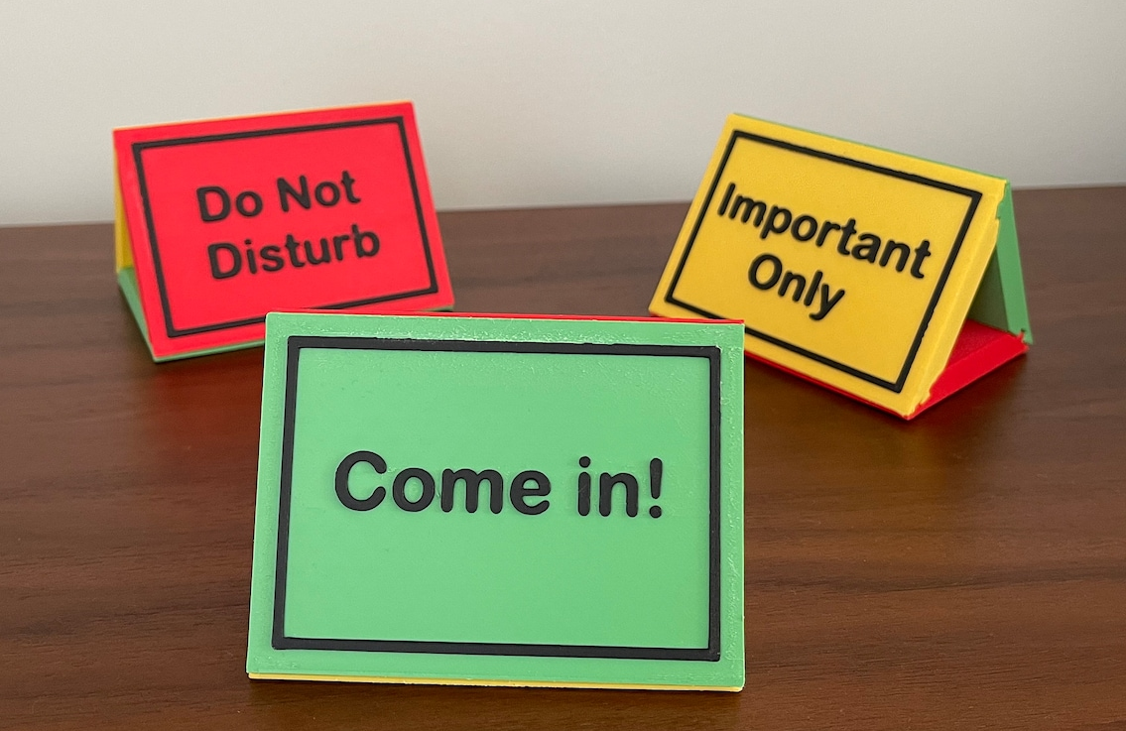
VERBAL AND NON-VERBAL
Though not required, some employees may even prefer having signs on their door or on their name badge that show their current availability verbally
  Color coding can be helpful
  This can also be helpful when employees wear headphones

Slide 72
VERBAL AND NON-VERBAL
Make sure when you make trainings that they are also clear
Examples to follow

Slide 73
EXAMPLE UNCLEAR
Imagine a notice that says the following:
Due to new ordinance 3.8 of the safety committee, we must all be cautious of hearing loss
When you are exposed to high noise levels, serious and permanent damage can result
Although you may believe you are getting used to high noise levels, this usually means you are enduring hearing loss
If the noise level is loud enough that you have to “get used to it,” hearing protection is probably necessary
If you must raise your voice to be heard in the workplace, noise levels should be evaluated to ensure excessive exposures are controlled
Contact your manager asap if you believe changes need to be made or if you are suffering from hearing loss
SAFETY NOTICE – PLEASE REVIEW
Due to new ordinance 3.8 of the safety committee, we must all be cautious of hearing loss
When you are exposed to high noise levels, serious and permanent damage can result
Although you may believe you are getting used to high noise levels, this usually means you are enduring hearing loss
If the noise level is loud enough that you have to “get used to it,” hearing protection is probably necessary
If you must raise your voice to be heard in the workplace, noise levels should be evaluated to ensure excessive exposures are controlled
Contact your manager asap if you believe changes need to be made or if you are suffering from hearing loss

Slide 74
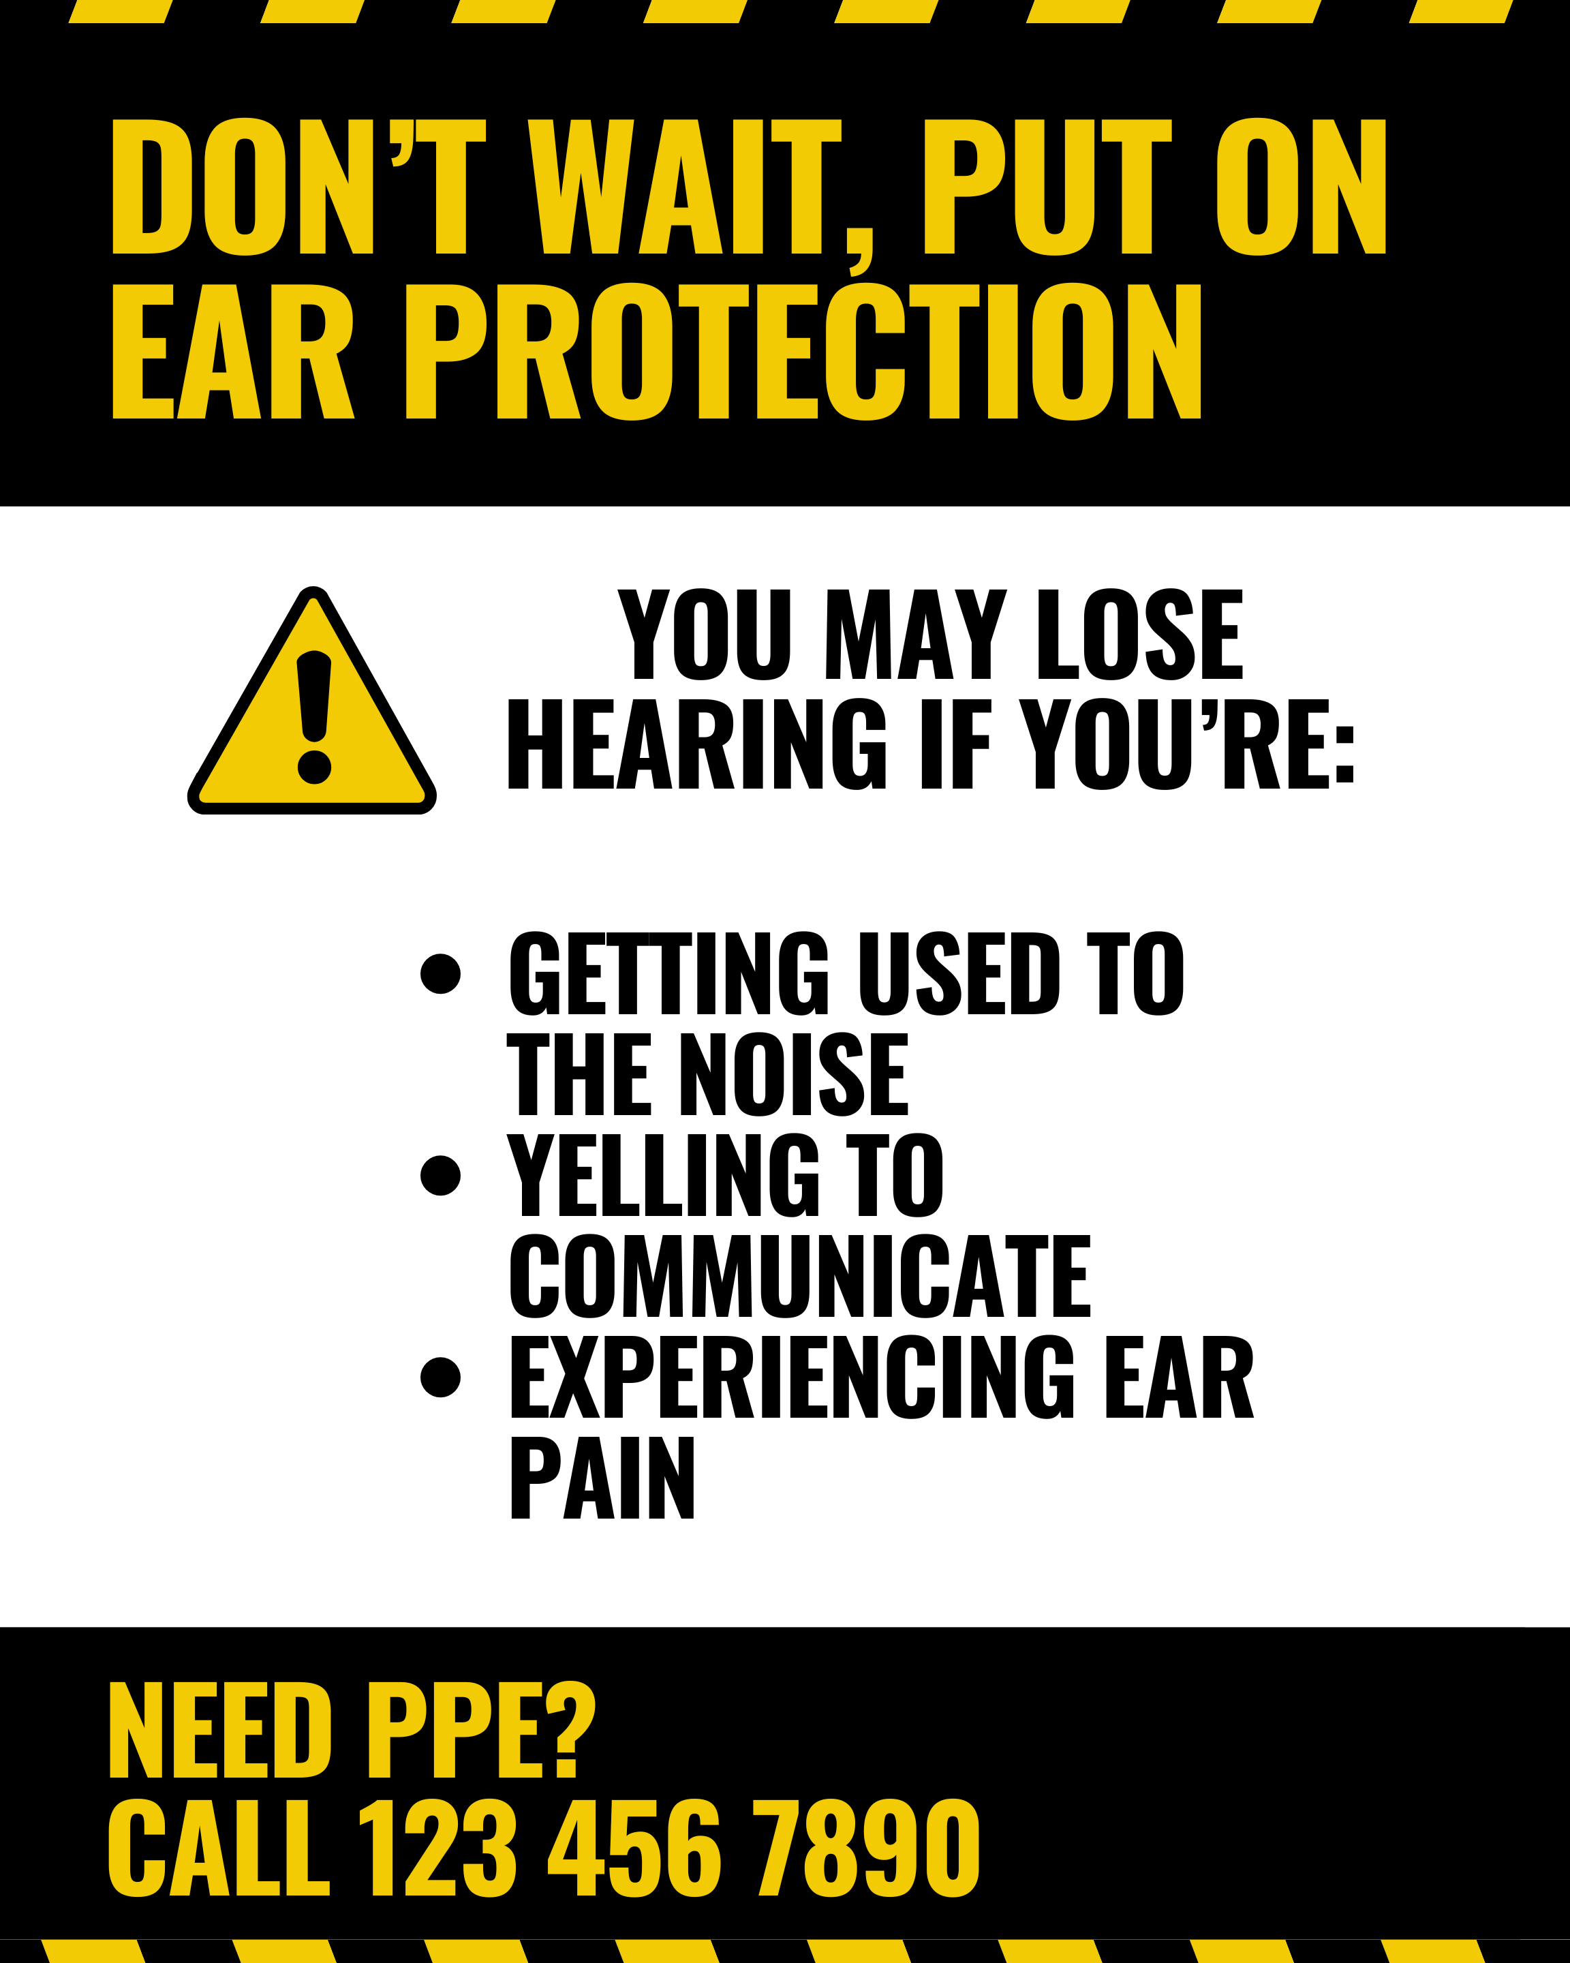
EXAMPLE CLEAR VISUALS AND DESCRIPTIONS
The last slide was too wordy
Hearing protection should be first and foremost
Contact Information should be readily available
In areas of high noise levels, there should be an informational packet with pictures and steps on how to protect hearing, and even a QR code to a video

Slide 75
CONSIDERATIONS FOR NEURODIVERSE EMPLOYEES
Proprioception: awareness of one's body
  You should also consider an employee's proprioception as some neurotypes do not perceive themselves well, especially if they are hyper focused
  They may work themselves too hard physically without even realizing until after a task is done
  They may not realize ear plugs could be damaging their skin until it causes a wound
Be proactive with reminders of self – Todd reminds me a lot!

Slide 76
TIME BUFFERED SCHEDULES
Time-buffered schedules to allow for processing and reflection, for all neurotypes
Consider having breaks during long trainings, or breaks in video trainings

Slide 77
MEMORY CAPACITY
Even after all you can do to make a training, consider everyone's' memory capacity
On average, it is estimated 50% of what is learned, is immediately forgotten
Spaced Learning helps retain what is taught

Slide 78
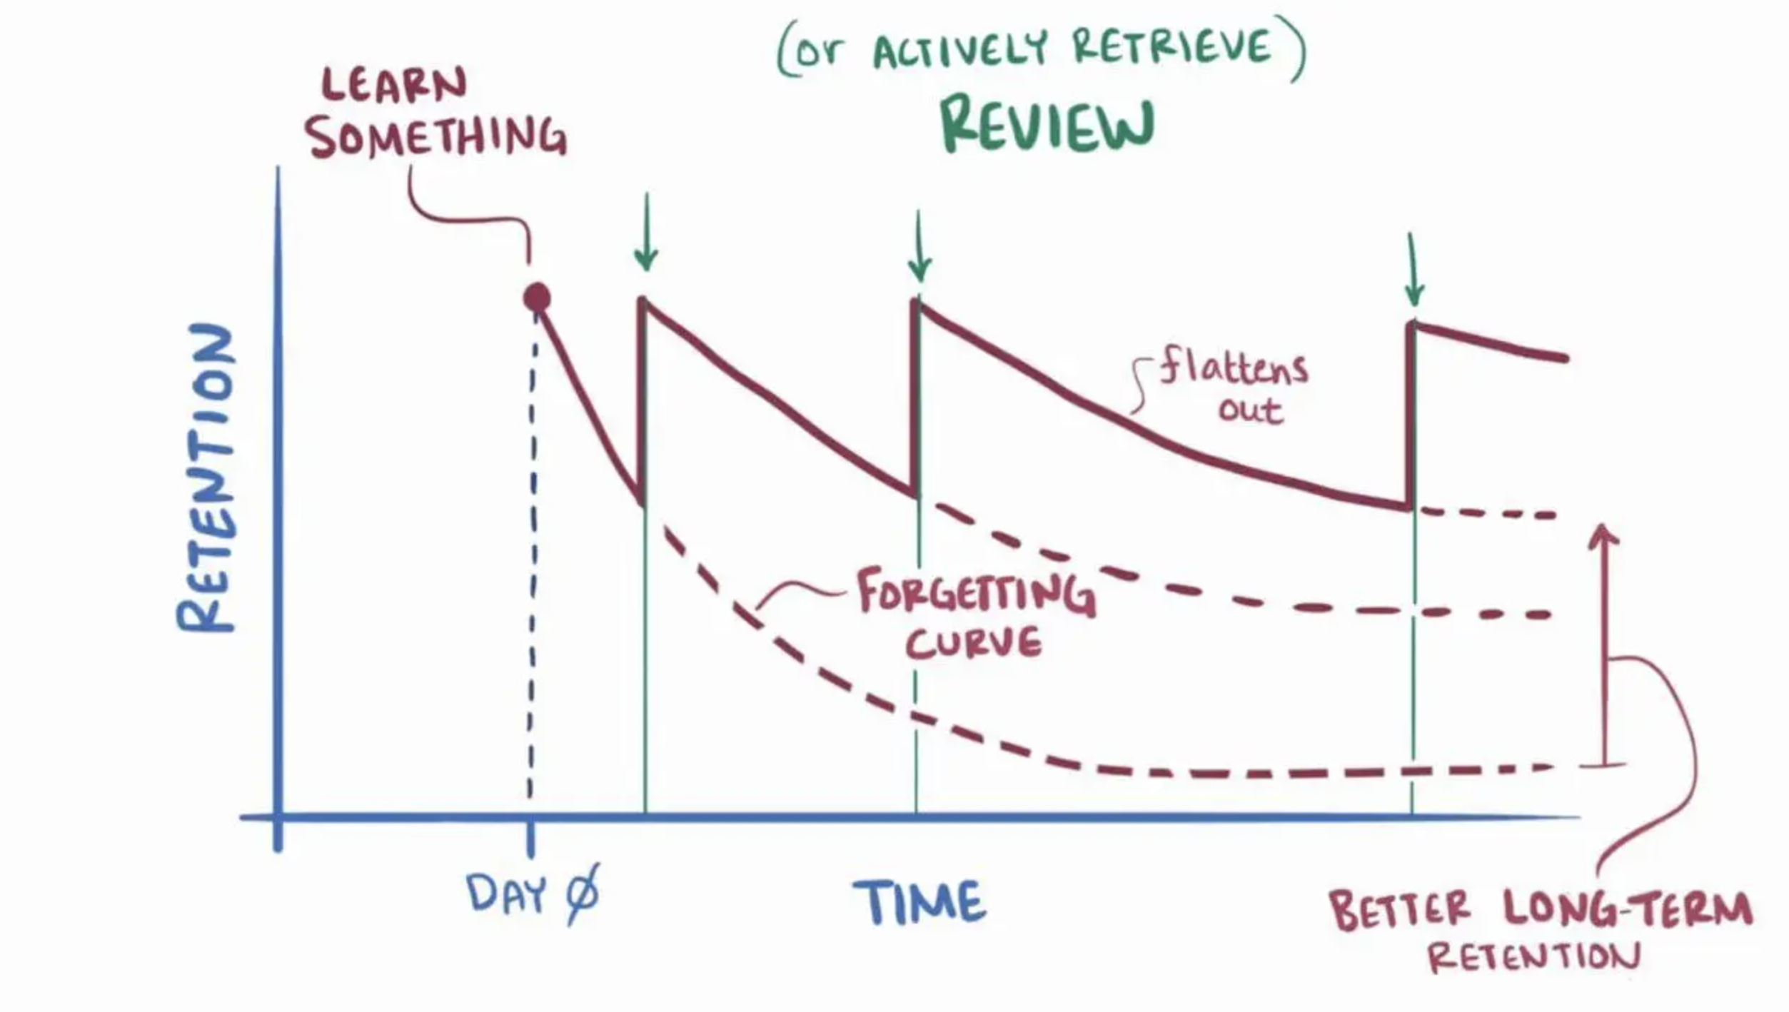
MEMORY CAPACITY

Slide 79
TRAINING LOCATION
There is evidence showing that information retention for all neurotypes is also affected by location
Employees are more likely to remember information in the spot they learned that information
This means that procedures should be taught in the spot they will be used

Slide 80
WHAT CAN YOU APPLY TO YOUR TRAININGS?
How can you improve your safety training?
We created a checklist for you to discuss with your employees and apply to your trainings.

Slide 81
WHAT CAN YOU APPLY TO YOUR TRAININGS?
Is there anything specific from this training that would be beneficial for your safety trainings?

Slide 82
SUMMARY
If an employee is exposed to an excessive amount of noise, over a sustained period of time, there is a risk of hearing loss
Employers must maintain a workplace “free from any recognized hazards” – including excessive noise
Per MIOSHA Standard, employers must respond with administrative or engineering controls, or PPE
Hearing Protection and Conservation are an important element of workplace safety

Slide 83
SUMMARY
Remember the principles of noise reduction in the context of Occupational Noise Exposure, and accommodations supporting a diverse workforce
When creating trainings, remember to consider the needs of all of your employees to improve retention

Slide 84

Thank You – stay safe and healthy!
Incompass Michigan remains committed to being a trusted resource for getting connected and staying informed.

Slide 85
RESOURCE CITATIONS
MIOSHA General Industry Standard
  “Part 380, Occupational Noise Exposure”
MIOSHA Fact Sheet
  #11 “Noise and Hearing Conservation”

Slide 86
RESOURCE CITATIONS
Honeybourne, Victoria. (2020). The Neurodiverse Workplace: An Employer’s Guide to Managing and Working with Neurodivergent Employees, Clients and Customers. Jessica Kingsley Publishers: London & Philadelphia, PA.
Praslova, Ludmila N. (2024). The Canary Code: A Guide to Neurodiversity, Dignity, And Intersectional Belonging At Work. Berrett-Koehler Publishers, Inc.: Oakland, CA.
Thompson, E. (2023) A Hidden Force: Unlocking the Potential of Neurodiversity at Work. Fast Company Press: New York.
https://www.cnsnevada.com/what-is-the-memory-capacity-of-a-human-brain/
NEUROINCLUSIVE LEARNING QUICK START PACKET BY TRACEY KING

Slide 87
Schedule a free training with us!
Contact us if you wish to have Todd and Katie conduct a free training!
Let us know the following information
  Date, time and length of training
  Desired training content
  How many attendees will be at this training
Katie Kinde – kkinde@incompassmi.org

Slide 88
SAFETY INCLUDED
Training Project in Partnership with MIOSHA CET Division
This material was prepared under a Consultation Education and Training (CET) Grant, awarded by the Michigan Occupational Safety and Health Administration (MIOSHA).
MIOSHA is a part of the Department of Labor and Economic Opportunity (LEO).
Points of view or opinions stated in this document do not necessarily reflect the view or policies of LEO.

