Slide 1
Returning Post COVID-19
Employer’s Guide
Workplace Safety and Health
Notes:
Drafted by Audrey Carlstrom and Kristin Osterkamp. Last revised: 4/22/20

Slide 2
Objectives
COVID-19 Overview
Emergency Rules COVID-19
Hazard Assessment
Exposure Control
Establish Workplace Procedures
Applicable MIOSHA Rules (PPE, Sanitation, General Duty Obligations)
Disinfection Methods
What to do if employees have symptoms
Provide Employee Training
Temporary Workforce Concerns
Resources
Notes:
During today’s presentation, we will cover the following objectives.
COVID-19 Overview - First we will provide a COVID-19 overview to ensure we all have a basic understanding of the virus, signs and symptoms of exposure and how the illness spreads.
Hazard Assessment – Next, we will cover what is involved with conducting a hazard assessment.
Controlling Exposure – During this section we will discuss using the hierarchy of controls to control employee exposure to the coronavirus
Establish Workplace Procedures – In this section we will discuss establishing workplace procedures.
Applicable MIOSHA Rules (PPE, Sanitation, General Duty Obligations) – including MIOSHA related applicable rules
Disinfection Methods
What to do if employees have symptoms
Provide Employee Training – In this section we will discuss key elements that employees should be trained on when returning to work.
Resources – Lastly, we will cover useful resources such as, sample written program templates, OSHA and CDC coronavirus related resources.

Slide 3
Overview - Coronavirus
Coronaviruses are a family of viruses that can cause illness in people. Coronaviruses circulate among animals, including camels, cattle, and cats.
SARS-CoV-2, the seventh known human coronavirus and the virus that causes COVID-19, is thought to have jumped species from animals to begin infecting humans.
Other coronaviruses have cause other outbreaks – Severe Acute Respiratory Syndrome (SARS) & Middle East Respiratory Syndrome (MERS)
Illustration: CDC / Alissa Eckert & Dan Higgins
Notes:
Overall coronavirus is a family of viruses, SARS-CoV-2 is the specific strain of the coronavirus that causes the COVID-19 illness. In the past other coronavirus strains have cause notable outbreaks such as SARS and MERS.
SARS and MERS had more regional epidemic outbreaks, but still cause respiratory distress.
The last time we’ve have a virus has widespread and impactful as the current SARS-CoV-2 was during the pandemic flu of 1918

Slide 4
Overview – Signs & Symptoms
COVID-19 causes mild to severe respiratory illness – can cause a severe pneumonia-like illness
Typical symptoms
Fever (>100.4°F)
Cough
Shortness of Breath
New loss of taste or smell
Symptoms begin 2-14 days after exposure
Notes:
Symptoms of COVID-19 typically display as pneumonia like symptoms. People often have a fever, a dry cough, or shortness of breath. Some of the milder cases that haven’t displayed those symptoms have reported instances of a new loss of taste or smell. Typically symptoms appear 2 to 14 days after being exposed to the virus.

Slide 5
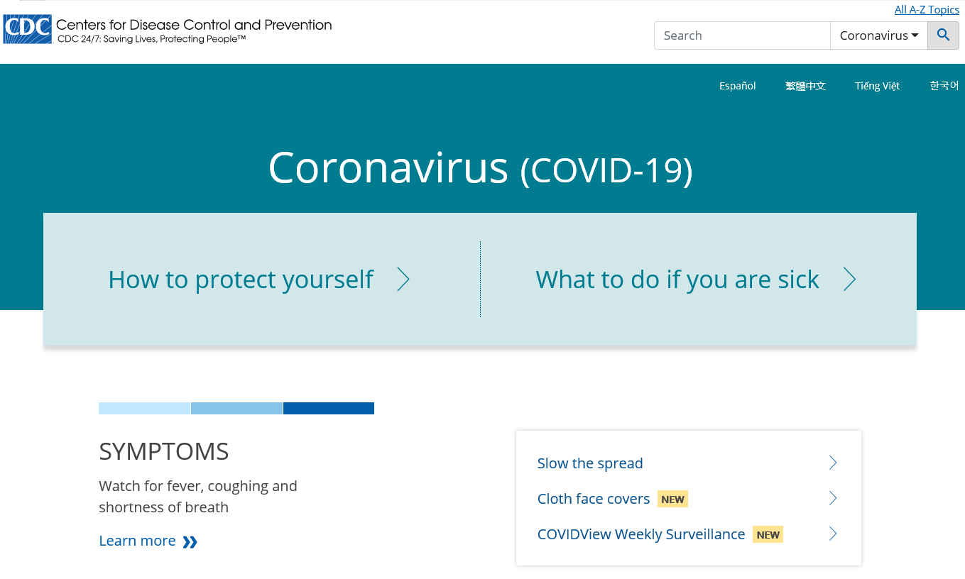
How COVID-19 is Spread?
Person-to-person spread.
Close contact from person-to-person in respiratory droplets from someone who is infected.
People without symptoms are able to spread virus.
Contact with contaminated surfaces and then touch eyes, nose or mouth.
Latest situation summary:
www.cdc.gov/coronavirus/2019-ncov/
Notes:
COVID-19 is spread most directly between people through close contact with individuals that are infected. Most infected individuals have symptoms, but people without symptoms may still be infected. These asymptomatic individuals are still able to transmit the virus to spread the infection.
Since the primary spread of this virus is through respiratory droplets, the CDC has recommended face coverings for the public to reduce the likelihood of the spread of the respiratory droplets between individuals. This decreases the likelihood of transmitting the virus to others.
COVID-19 can also be transmitted through contact with a contaminated surface. If a contaminated surface is touched and then the individual subsequently touches their eyes, nose, or mouth, that individual may then become infected with the virus.

Slide 6
Applicable Rules & Regulations
Notes:
In this next section, we will discuss applicable rules and regulations.

Slide 7
Existing MIOSHA Standards
Follow existing MIOSHA standards to help protect workers from exposure to SARS-CoV-2 and infection with COVID-19.
Employers should remember that MIOSHA can use the General Duty Clause, MIOSHA Act 154 408.1011 Sec 11 (a) Duties of Employer, to ensure that workers are protection from recognized safety and health hazards that may cause serious harm
MIOSHA Enforcement Guidance - COVID19 Interim Enforcement Plan
Relevant MIOSHA Standards
MIOSHA Emergency Rules for COVID-19
Personal Protective Equipment Part 33 (OSHA 1910 Subpart I)
Hazard Communication Part 430 (OSHA 1910.1200)
Respiratory Protection Part 451 (OSHA 1910.134)
Recordkeeping Part 11 (29 CFR 1904)
Sanitation Part 474 (OSHA 1910.141)
General Duty MIOSHA Act 154 Section 11(a) (OSHAct Sec 5(a)(1))
Notes:
MIOSHA has existing standards that are still enforced during the COVID19 pandemic. Here’s a list of applicable MIOSHA/OSHA standards. MIOSHA has published an enforcement instruction to guide how these standards are being enforced during the pandemic response.

Slide 8
Hazard Assessment
Notes:
In this next section, we will cover the topic of Hazard Assessment.

Slide 9
Hazard Assessment – Exposure Risk
Very High Risk
High potential for exposure to known sources of COVID-19
Healthcare, laboratory, morgue employees with contact to known COVID-19 patients
High Risk
High potential for exposure to known or suspected COVID-19 cases
Healthcare delivery, support staff, medical transport workers
Medium Risk
Jobs that require frequent and/or close contact (within 6 ft) with people who may be infected, but are not known or suspected COVID-19 patients
Contact with the general public, schools, high population density work environments
Low Risk
Jobs that do not require contact with people known or suspected of being infected with coronavirus
No frequent close contact (within 6ft) with the general public
Minimal contact with co-workers
Notes:
Generally, the first step in conducting a workplace hazards assessment is to determine which exposure risk category your workplace operations fall into.
OSHA created the exposure risk categories noted on this slide, to assist employer’s in identifying their facility’s exposure risk.
The Very High Risk category includes:
High potential for exposure to known sources of COVID-19
Examples include: Healthcare, laboratory, morgue employees with contact to known COVID-19 patients
The High Risk category includes:
High potential for exposure to known or suspected COVID-19 cases
Examples of this category include: Healthcare delivery, support staff, medical transport workers
The Medium Risk category includes:
Jobs that require frequent and/or close contact (within 6 ft) with people who may be infected, but are not known or suspected COVID-19 patients
Examples include: Workplaces with contact with the general public, schools and high population density work environments
The Low Risk category includes:
Jobs that do not require contact with people known or suspected of being infected with coronavirus
No frequent close contact (within 6ft) with the general public
Minimal contact with co-workers
Focus of this presentation is primarily for medium and low risk categories.

Slide 10
Hazard Assessment
Where/How/What sources of Exposure
General public
Customers/Visitors
Co-workers
Assess methods of social distancing
Staggered work shifts, lunch & breaks
Downsizing operations
Teleworking from home
Cross train on-site workers to perform critical tasks
Assess job tasks with shared equipment & workstations
Assess need for Basic Infection Prevention
Access to handwashing facilities & hand sanitizer (≥60% alcohol)
Cleaning & disinfection procedures & materials for workstations
Notes:
Initially when conducting a hazard assessment for your facility, you need to assess the potential sources of coronavirus exposure.
Where/How/What sources of Exposure
Potential exposures could include exposure to the general public, customers or visitors, and co-workers.
Once you have identified potential sources of exposure, the employer needs to assess methods of social distancing for workplace operations.
Some methods to incorporate social distancing include: staggered work shifts, staggered lunch and break times, downsizing operations, conducting work remotely from home and cross train workers to perform critical tasks, in order to optimize staffing during downsized onsite operations.
As part of your hazard assessment you will want to assess job tasks involving shared equipment and workstations. If you have shared equipment and workstations, this will require the employer to develop related basic infection prevention procedures.
With regards to basic infection prevention, employers must ensure access to handwashing facilities and that hand sanitizer is provided when handwashing facilities are not immediately available. Disinfection procedures will be determined based on your facility’s frequently accessed workstations, high touch areas, communal areas and shared equipment.
Cleaning and disinfecting materials must be provided to employees. Employees will need to be trained on the proper use of these materials to include any related chemical hazards.

Slide 11
Exposure Control
Notes:
Once the employer has identified potential hazards, the next step is to determine how best to control those hazards.

Slide 12
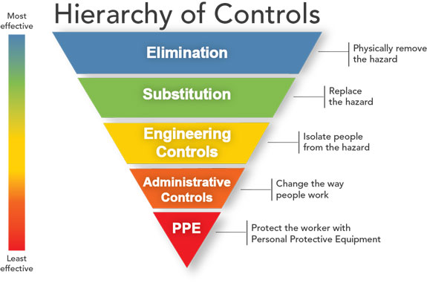
Workplace Controls
Engineering Controls
High-efficiency Air Filters
Increased Ventilation Rates
Physical Barriers – Clear plastic barriers, sneeze guard, plexiglass
Installing a drive-thru window
Administrative Controls
Offer pick up options for customers to minimize contact between employees, clients, customers
Establish self-assessment for employees prior to entering workplace
Implement telework/work from home when feasible
Alternate or stagger work shifts to reduce number of employees in facility at a time
Train on good hand and respiratory hygiene and post signs to encourage behaviors
Notes:
As with any other workplace hazard, we always want to use the hierarchy of controls. This graphic illustrates the hierarchy of controls from most effective to least effective. In regard to controlling exposure to the coronavirus, we should not jump straight to PPE and must first implement engineering and administrative controls.
Examples of potential Engineering Controls include:
High-efficiency Air Filters
Increased Ventilation Rates – This relates to increasing the amount of outside air within the workplace.
Physical Barriers – Installing clear plastic barriers, sneeze guard, plexiglass
Installing a drive-thru window for customer service.
Administrative Controls
Offer pick up options for customers to minimize contact between employees, clients, customers
Establish self-assessment for employees prior to entering workplace
Implement telework/work from home when feasible
Alternate or stagger work shifts to reduce number of employees in facility at a time
Train on good hand and respiratory hygiene and post signs to encourage behaviors

Slide 13
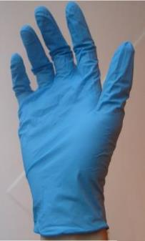
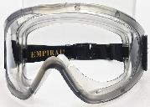
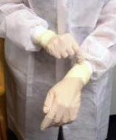
Personal Protective Equipment (PPE)
Very High Risk Exposure
High Risk Exposure
Medium Risk Exposure
Low Risk Exposure
No need for additional PPE beyond what is typically used for job tasks
CDC recommends face coverings for the public
Clockwise from L: public domain; WikimediaCommons; CDC/Kimberly Smith & Christine Ford
Notes:
PPE decided on level of risk of exposure. Higher risk = higher levels of PPE
Face covering for everyone in the public. Employers should encourage face coverings especially when employees are using public transit to get to and from the workplace.
OSHA and CDC recommend respiratory protection for certain workers who have close contact with potentially infectious people, including healthcare, border protection, and screening workers tending to persons under investigation (PUI) for COVID-19 and those providing care for suspected or confirmed patients. Standard biosafety practices in BSL-2 and BSL-3 microbiological laboratories—including clinical labs—also call for respiratory protection for certain activities, including any tasks that may generate aerosols.
Whenever needed, use respiratory protection, including NIOSH-certified disposal N95 filtering facepiece or better (e.g., elastomeric APRs with N95 particulate cartridges, PAPRs with N100/HEPA filters) respirators, as part of a comprehensive, written respiratory protection program that meets the requirements of OSHA’s Respiratory Protection standard (29 CFR 1910.134) and includes medical exams, fit testing, and training.
OSHA has released enforcement memoranda detailing enforcement discretion around the Respiratory Protection standard, including cases in which employers may consider re-use or extended use of N95 filtering facepiece respirators (FFRs), other NIOSH-certified FFRS, elastomeric APRs, PAPRs, respiratory protection equipment that was previously NIOSH-certified by that has exceeded its manufacturer’s recommended shelf-life, and respiratory protection equipment certified in accordance with the standards from other countries or jurisdictions. See www.osha.gov/enforcementmemos for complete details.

Slide 14
Workplace Controls
Personal Protective Equipment – MIOSHA Part 33 PPE
Examples: Gloves, face shield, goggles,
Respiratory Protection – MIOSHA Part 451
OSHA Enforcement Memos
Required vs Voluntary
Sample Written Program
NIOSH Certified vs “Face Masks”
Follow CDC guidance for face coverings (respirators vs surgical mask vs cloth/paper coverings) – Maryland DOL Fact Sheet on Respirators
Notes:
Note to discuss N, R, P

Slide 15
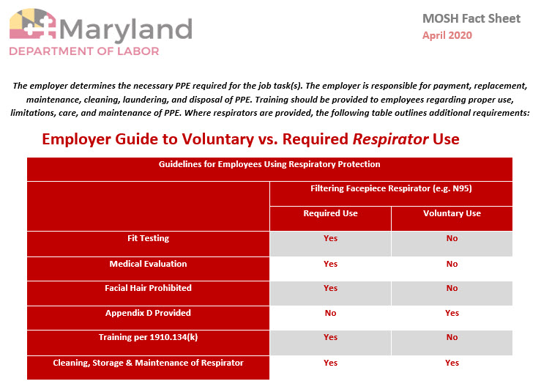
PPE – Respirators vs Face Coverings
Notes:
CDC Guidance recommends face coverings for everyone in the public. There’s a significant distinction between face coverings/home made masks and NIOSH certified respirators. All PPE should be assessed based on exposure risk and optimizing PPE supply for high risk workers.
https://www.dllr.state.md.us/labor/mosh/moshfacemask.pdf

Slide 16
Establish Workplace Procedures

Slide 17
Existing MIOSHA Standards
Follow existing MIOSHA standards to help protect workers from exposure to SARS-CoV-2 and infection with COVID-19.
Employers should remember that MIOSHA can use the General Duty Clause, MIOSHA Act 154 408.1011 Sec 11 (a) Duties of Employer, to ensure that workers are protection from recognized safety and health hazards that may cause serious harm
MIOSHA Enforcement Guidance - COVID19 Interim Enforcement Plan
Relevant MIOSHA Standards
MIOSHA Emergency Rules for COVID-19
Personal Protective Equipment Part 33 (OSHA 1910 Subpart I)
Hazard Communication Part 430 (OSHA 1910.1200)
Respiratory Protection Part 451 (OSHA 1910.134)
Recordkeeping Part 11 (29 CFR 1904)
Sanitation Part 474 (OSHA 1910.141)
General Duty MIOSHA Act 154 Section 11(a) (OSHAct Sec 5(a)(1))
Notes:
MIOSHA has existing standards that are still enforced during the COVID19 pandemic. Here’s a list of applicable MIOSHA/OSHA standards. MIOSHA has published an enforcement instruction to guide how these standards are being enforced during the pandemic response.

Slide 18
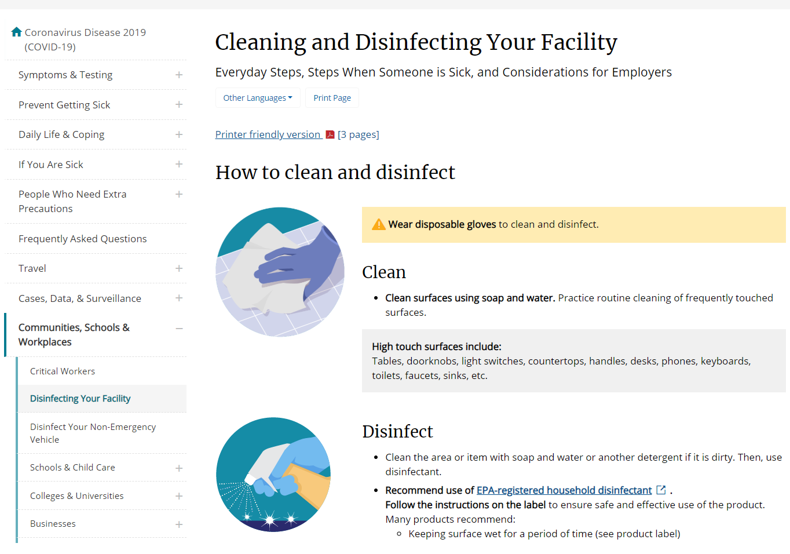
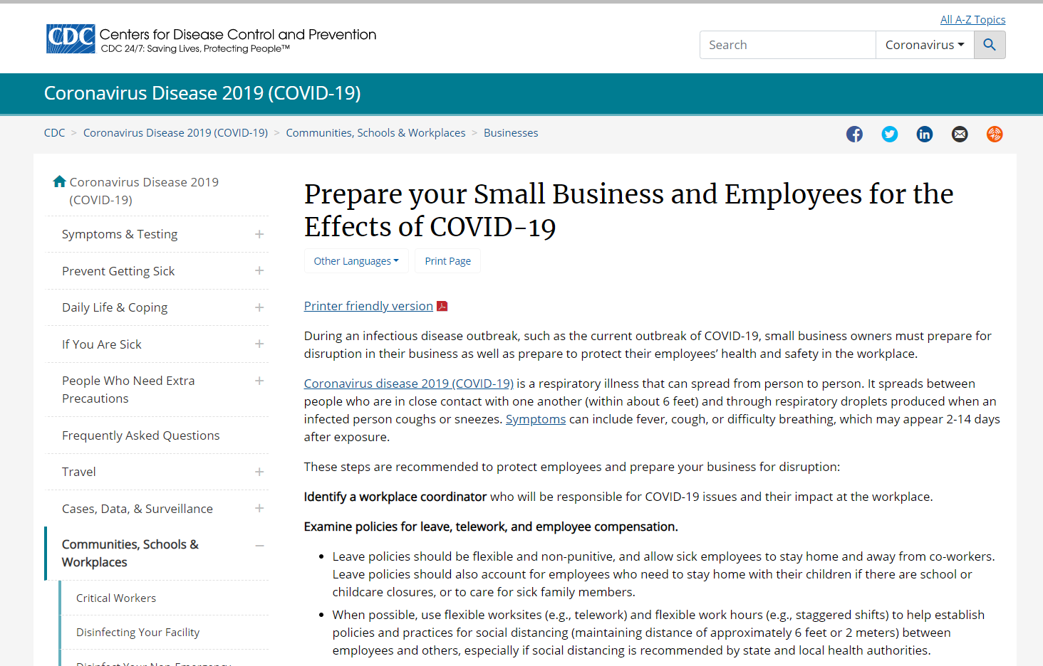
Establish Workplace Procedures
CDC Resource – Prepare your business for the effects of COVID-19
Notes:
Photos are hyperlinked to the displayed webpages
CDC Info to disinfections
https://www.epa.gov/pesticide-registration/list-n-disinfectants-use-against-sars-cov-2
http://npic.orst.edu/ingred/ptype/amicrob/covid19.html
https://www.cdc.gov/coronavirus/2019-ncov/community/organizations/cleaning-disinfection.html

Slide 19
List of EPA Disinfectants for Coronavirus
Notes:
Photo is hyperlinked to full publication
Cleaning refers to the removal of germs, dirt, and impurities from surfaces. It does not kill germs, but by removing them, it lowers their numbers and the risk of spreading infection.
Disinfecting refers to using chemicals, for example, EPA-registered disinfectants, to kill germs on surfaces. This process does not necessarily clean dirty surfaces or remove germs, but by killing germs on a surface after cleaning, it can further lower the risk of spreading infection.
CDC Info to disinfections
https://www.epa.gov/pesticide-registration/list-n-disinfectants-use-against-sars-cov-2
http://npic.orst.edu/ingred/ptype/amicrob/covid19.html
https://www.cdc.gov/coronavirus/2019-ncov/community/organizations/cleaning-disinfection.html

Slide 20
Workplace Procedures – Key Elements
Development an Infectious Disease Preparedness and Response Plan
Develop an Exposure Control Plan
Identify Workplace COVID-19 Coordinator
Examine & Update Policies
Telework
Leave
Employee Compensation
Identify Essential Employees & Business Functions
Establish Chain of Communication
Train Employees of new procedures and policies
Notes:
MIOSHA Emergency COIVD-19 Rules specifies and requires program elements for Critical Infrastructure Workers that are different from guidelines given for other categories of workers.

Slide 21
Workplace Procedures – Key Elements
Facility Preparation
HVAC function
Cooling Towers
Emergency Exits
General Housekeeping
Clean & Disinfect Frequently Used Surfaces
Door handles, countertop, handrails, workstations
AIHA Guidance for Facility Managers (HVAC & Cooling Towers)
Recovering from COVID-19 Building Closures
Notes:
HVAC & Cooling towers should be running before employees return to workplace. Risk of legionella increases in systems that are unused and symptoms of legionnaires are similar to COVID-19 “pneumonia like”
AIHA guidance document primarily focus on building ventilation & cooling towers

Slide 22
Workplace Procedures – Key Elements
Self-screening of employees prior to work
Temperature, self monitoring symptoms (Cough, fever, shortness of breath)
Require employees to report symptoms and self-isolate
Notify supervisors and stay home
Don’t allow employees to return until home isolation criteria is met (Follow CDC Guidance)
Inform other employees of possible workplace exposure (ADA & HIPAA compliant – keep confidentiality)
Encourage sick employees to stay home
Update sick leave policies to public health guidance
Training employees on policies for having symptoms and sick leave policies
Social Distancing – min 6ft
Provide lines of demarcation
Install physical barriers between customers and/or employees
Notes:
Information from Appendix C of MIOSHA COVID-19 Interim Enforcement Plan
Protecting Employees’ Health
Encourage sick employees to stay home
Develop flexible policies for scheduling/telework/leave
Promote handwashing and etiquette for coughing & sneezing
Perform routine cleaning
Provide education and training materials to employees
Talk to employees about their concerns
Develop plans to minimize face to face contact
Minimize travel for work
Develop procedures for if an employee becomes sick while at work

Slide 23
Workplace Procedures – Key Elements
Cleaning Procedures
The employer should routinely clean and disinfect all areas such as offices, bathrooms, common areas, and shared electronic equipment
If a sick employee is suspected or confirmed to have COVID-19, perform enhanced cleaning and disinfection of all frequently touched surfaces in the workplace
Follow the manufacturer’s instructions for all cleaning and disinfection products (e.g., required PPE, concentration, application method and contact time).
Evaluate procedures to ensure no new hazards are created (e.g. dermatitis from new disinfectant)
This Photo by Unknown Author is licensed under CC BY-SA
Notes:
Appendix C Of MIOSHA Enforcement Guidance
Important to follow manufacturer’s instructions for using disinfection – use proper PPE – do not want to create a new hazard while eliminating the current hazard

Slide 24
Workplace Procedures – Cleaning & Disinfecting
Cleaning
Refers to the removal of germs, dirt, and impurities from surfaces. It does not kill germs, but by removing them
Use soap and water
Disinfecting
Refers to using chemicals to kill germs on surfaces. This process does not necessarily clean dirty surfaces or remove germs, but by killing germs on a surface after cleaning
Common Disinfectants
Bleach Solution - ⅓ cup bleach per gallon water or 4 teaspoons bleach per quart water
70% alcohol solutions may also be used – wipes or liquid
Common Products - not inclusive
Windex Disinfectant Cleaner, Comet Disinfecting Bathroom Cleaner, Scrubbing Bubbles Restroom Cleaner II, Lysol Bathroom Cleaner
Notes:
Wipe down surfaces such as door push bars, shopping carts, points of sale, chairs in waiting areas, and other areas that customers, visitors, or workers frequently touch

Slide 25
Workplace Procedures – Sick Employees
Employer reporting procedures
Require employees to report when they are sick or experiencing symptoms of COVID-19
Contact local or state health department immediately when a worker may have COVID-19
Recording COVID-19 Illnesses on MIOSHA 300 Log
Healthcare industries, emergency response organizations, and correctional institutions must continue to determine work-relatedness based on the standard
Other employers are to make work-related determinations based on reasonably available objective evidence that the illness is work-related
OSHA Enforcement Memo for Recoding COVID-19 Cases
Notes:
The employer’s workplace reporting procedures for sick employees must require employees to report when they are sick or experiencing symptoms of COVID-19 and report to local or state health departments as applicable.
As far as when an employer is required to record a workplace related COVID-19 related illness. Employers that workers in healthcare, emergency response, and correction institutions are still required to meet the work-relatedness determinations base on the recordkeeping standard.
Other employers are to record COVID-19 illnesses when there is objective evidence that the illness is work related AND that evidence was reasonably available to the employer.
Here we’ve linked to the OSHA Enforcement Memo for Guidance on Recording COVID-19 cases

Slide 26
Workplace Procedures – Sick Employees
Returning to Work After COVID-19 Guidelines (Non-healthcare settings)
At least 3 days without fever (without use of fever-reducing medications)
AND
Improvement in Respiratory Symptoms (cough/shortness of breath)
AND
At least 7 days have passed since symptoms first appeared
Current CDC Guidelines for Discontinuation of Isolation
This Photo by Unknown Author is licensed under CC BY-ND
This Photo by Unknown Author is licensed under CC BY-SA-NC

Slide 27
Provide Employee Training

Slide 28
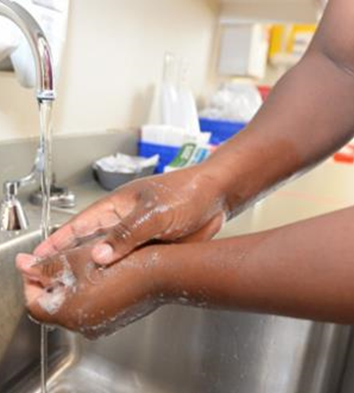
Employee Training – Hygiene Etiquette
Handwashing
Use soap and water
Wash for 20 seconds
Scrub all surface of hand – between fingers, backs of hand, fingernails
Hand Sanitizer
Use when soap and water are unavailable
Sanitizer should be ≥60% alcohol
Coughing & Sneezing
Cover your mouth and nose with tissue
If you don’t have a tissue use your upper sleeve NOT YOUR HANDS
Remember to wash your hands after
Avoid touching eyes, nose, or mouth with unwashed hands
Photo: U.S. Department of Defense

Slide 29
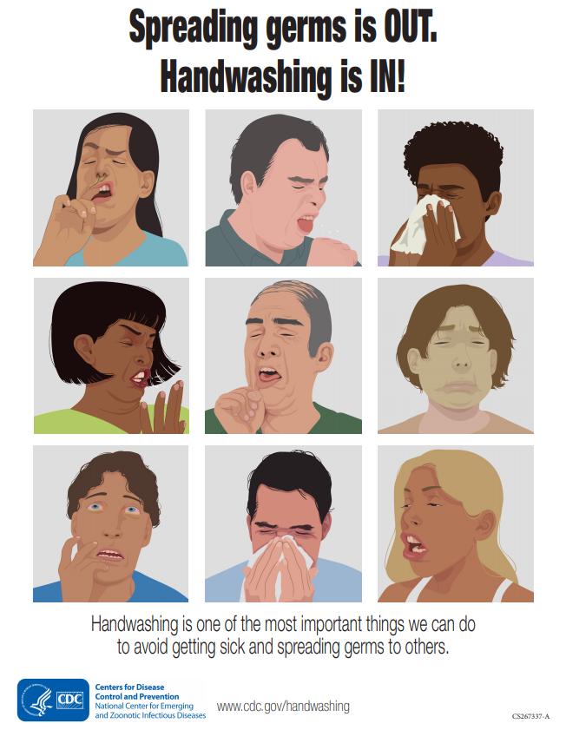
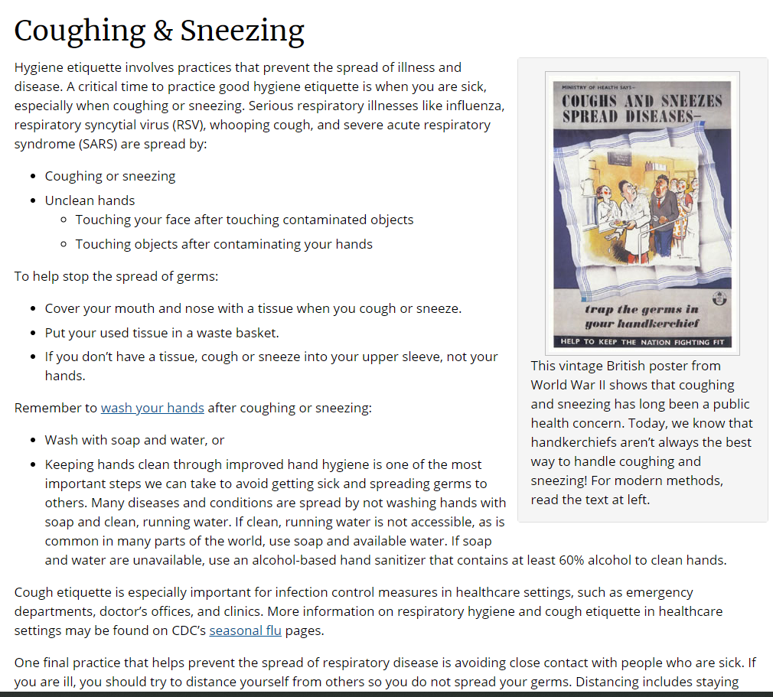
Employee Training – Hygiene Posters
CDC Handwashing posters
CDC Information on Coughing & Sneezing

Slide 30
Employee Training
Train new policies and procedures
Self Screening Procedure
Telework Duties
Employee Sick Policy
Employee Leave Policy
New Controls
Barriers, Drive-Thru/Pick-up Policies,
Cleaning of workspace
PPE Requirements
Training on new disinfectant chemicals
Changes in shift schedules
Training

Slide 31
JOINT EMPLOYMENT STRUCTURE
A SharED responsibility

Slide 32
Joint Employment Structure
Both the host employer and the staffing agency are employers of the temporary worker.
Share responsibility and control over the employee
Host Employer
Staffing Agency
Shared
Responsibility
Temporary Worker
Notes:
ALL workers must receive equal protection
Expectation: Host and the staffing companies will contractually assign responsibilities
Consider which employer can best prevent hazards and fulfill compliance with OSHA
Due diligence must be exercised to inquire and verify that full compliance has been achieved

Slide 33
Shared Responsibility
Temporary Staffing Agency
Emergency Action Plans
Staffing agency trains on generic program elements (ex. means of reporting emergencies and alarm system requirements)
Recording and Reporting of Occupational I & I
Staffing Agency: may provide procedures for obtaining treatment for on- the job injuries and illnesses: What, when to report
Host Employer
Emergency Action Plans
Host provides site specific routes of exit, muster locations, local emergency contact numbers and alarm notifications.
Recording and Reporting of Occupational I & I
Host Company records injuries/illnesses for directly supervised temporary workers.

Slide 34
Protecting temporary employees
Conduct
Conduct Safety & Health Training and New Project Orientation
Develop
Develop an Injury and Illness Tracking
Implement
Implement Injury and Illness Prevention Program
Conduct
Conduct Incidents, Injury and Illness Investigation
Maintain
Maintain Contact with Workers
Notes:
Note: Unless otherwise legally required, these recommendations are for the purposes of guidance and in some cases represent best practice.
Staffing agencies may be best positioned for general safety training, long-term medical surveillance
Host employers normally responsible for workplace-specific training and compliance with standards
Both employers may be held responsible for violative conditions

Slide 35
PROTECTING TEMPORARY WORKERS
Whether temporary or permanent, all workers always have the right to a safe and healthy work workplace. The staffing agency and the host employer are joint employers of temporary workers and therefore, both are responsible for providing and maintaining a safe work environment for those workers. The staffing agency and the host employer must work together to ensure that the Michigan Occupational Safety and Health (MIOSHA Act 154) requirements are fully met.

Slide 36
MIOSHA Resources
CET
MTI
Sample Programs (Link on this page)
RCA Form

Slide 37
Resources
MIOSHA Enforcement Guidance - COVID19 Interim Enforcement Plan
State of Michigan – Coronavirus & Frequently Asked Questions
OSHA – COVID-19 Information
OSHA Publication - Guidance on Preparing Workplaces for COVID-19
CDC – Coronavirus Disease (COVID-19)
CDC – Interim Guidance for Businesses to Plan and Respond to COVID-19
CDC – Interim Guidance for Conserving and Extending Respirator Supply (non-healthcare)
Maryland Dept of Labor – Factsheet on Respirators and Face Coverings

Slide 38
MIOSHA Contact Information
Michigan Occupational Safety and Health Administration
Consultation Education and Training Division
525 W. Allegan, P.O. Box 30643
Lansing, Michigan 48909-8143
For further information or to request consultation, education
and training services, call 517-284-7720
or
visit our website at
www.michigan.gov/miosha
Notes:
If you need any additional information. Please contact MIOSHA Consultation and Education Division

